Slide 1
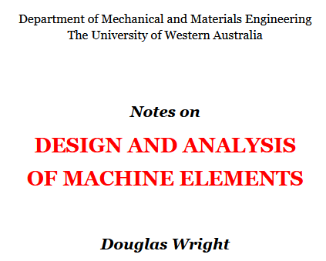
Quick Guide to Gears
INTRODUCTION
NOMENCLATURE
DESIGN
STRESS, STRENGTH AND SAFETY
MISCELLANEOUS STRENGTH TOPICS
SPRINGS
THREADED FASTENERS
WELDED JOINTS
CYLINDERS
PRESSURE VESSELS
SQUIRREL CAGE MOTORS
V-BELT DRIVES
BRAKES
SPUR GEARS
BUCKLING
FRACTURE MECHANICS
FINITE ELEMENTS
UNITS, DIMENSIONS & CONVERSIONS
PROGRAM DIRECTORY
https://danotes.mech.uwa.edu.au/

Slide 2
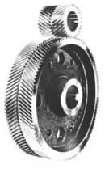
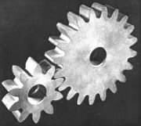
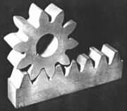
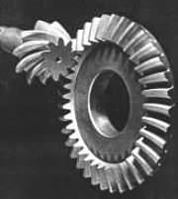
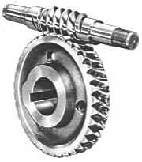
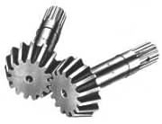
A pair of spur gears for mounting on parallel shafts. The 10 teeth of the smaller pinion and the 20 teeth of the wheel lie parallel to the shaft axes | A rack and pinion. The straight rack translates rectilinearly and may be regarded as part of a wheel of infinite diameter | Like spur gears helical gears connect parallel shafts, however the teeth are not parallel to the shaft axes but lie along helices about the axes
Straight bevel gears for shafts whose axes intersect | Hypoid gears - one of a number of gear types for offset shafts | A worm and wormwheel gives a large speed ratio but with significant sliding

Slide 3
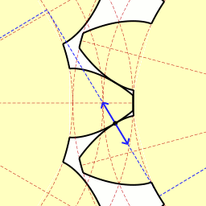
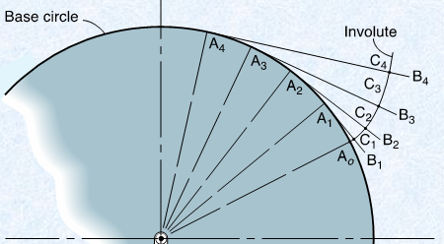
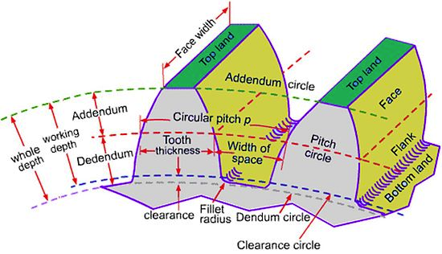
Gear tooth contact occurs along a line at a constant angle, the pressure angle.
The Involute tooth shape is the path of unwinding a string from a circle.
Pitch circle
Pitch circle
Gears behave like two friction wheels with diameters equal to their Pitch Diameters.

Slide 4
The pitch of two gears in mesh must be the same!

Slide 5
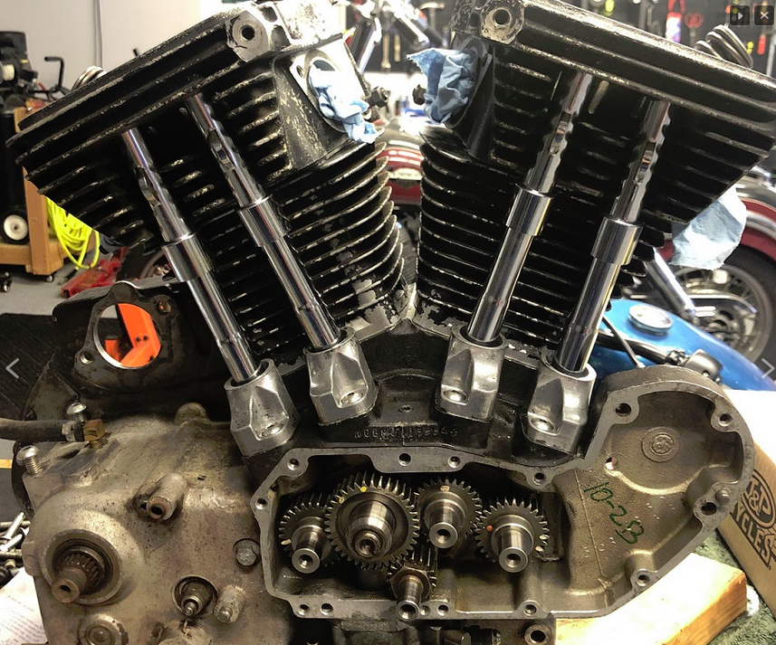
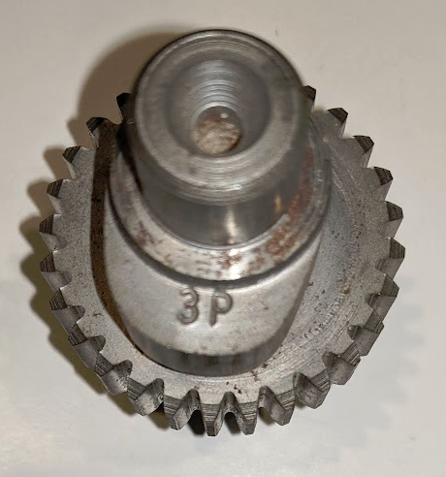
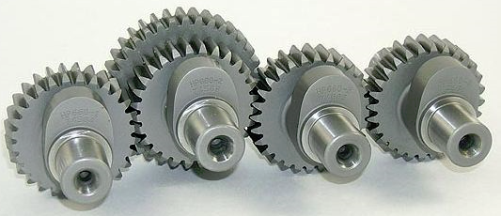
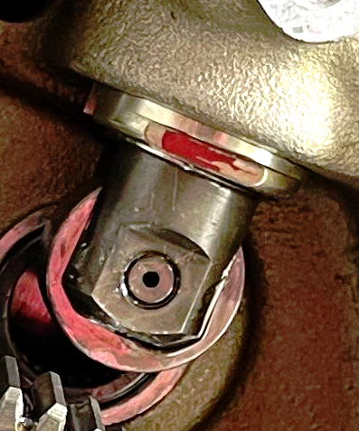
Harley-Davidson Sportster camshaft gears
Intake
Exhaust
Exhaust
Pushrod
The 3P gear has 28 teeth.
Crankshaft
Its Pitch Diameter, Dp = 1.75 Inches. Its Diametral Pitch = 28/1.75 = 16
Cam Follower

Slide 6
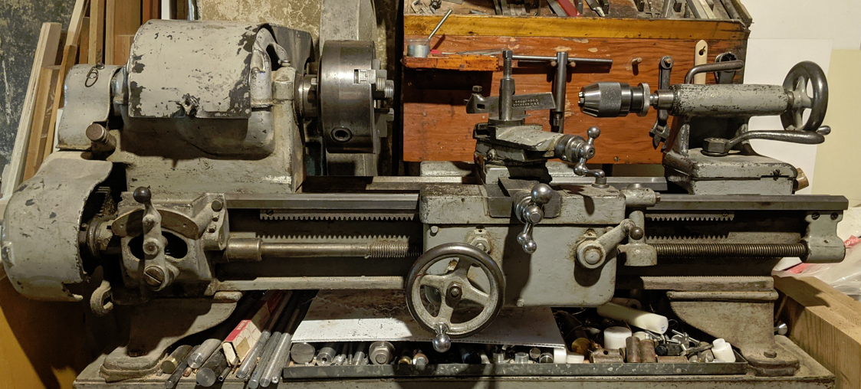
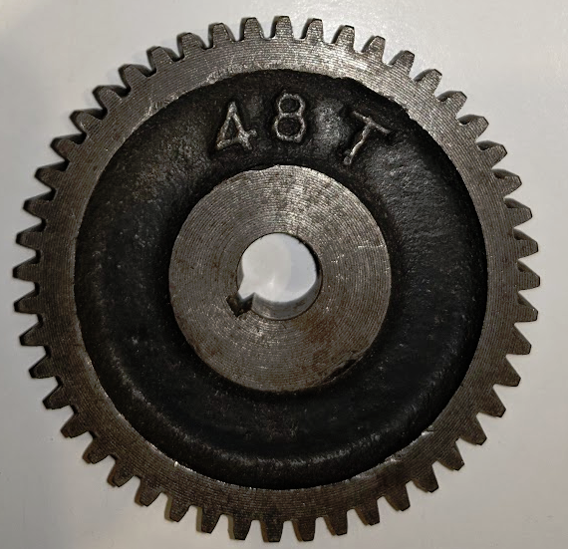
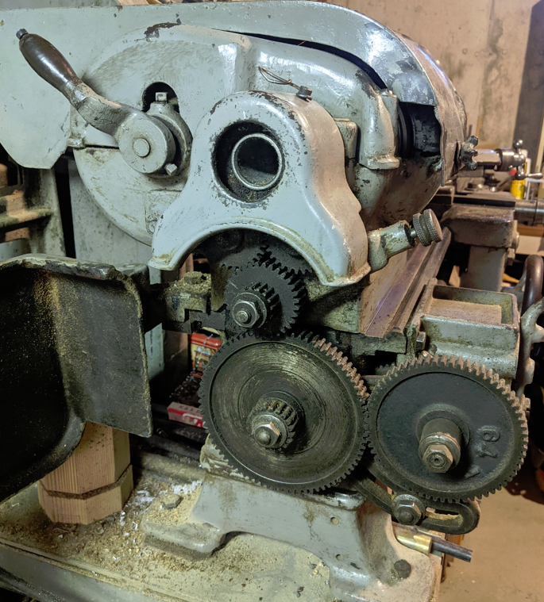
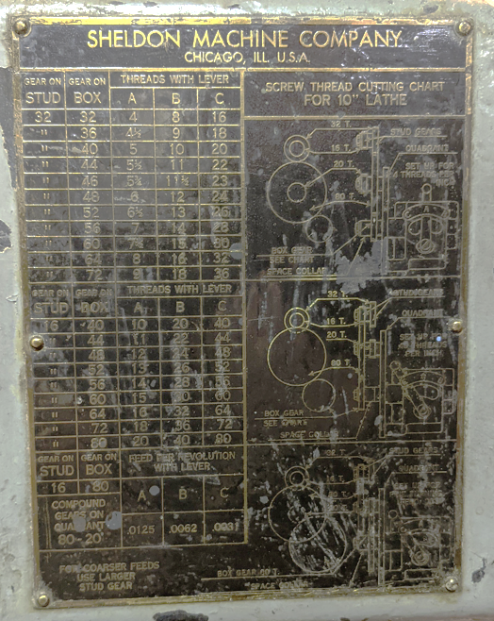
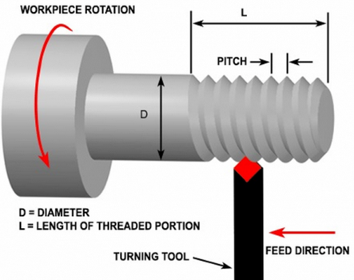
My 1943 Sheldon metal lathe has a whole set of spur gears for cutting threads.
It can cut threads from 4 to 80 threads/inch by selecting the proper gears.
This gear has 48 teeth.
ABC Lever
Leadscrew
Carriage
Spindle
Its Pitch Diameter, Dp = 3.0 Inches. Its Diametral Pitch = 48/3.0 = 16

Slide 7
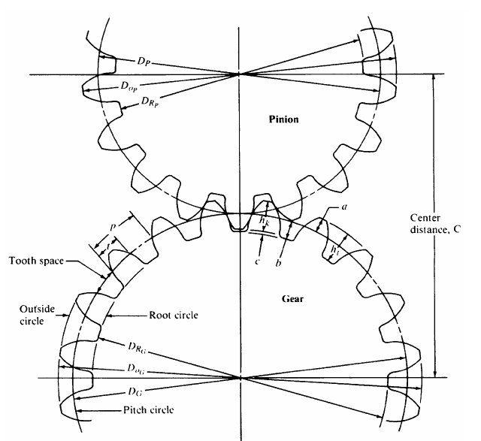
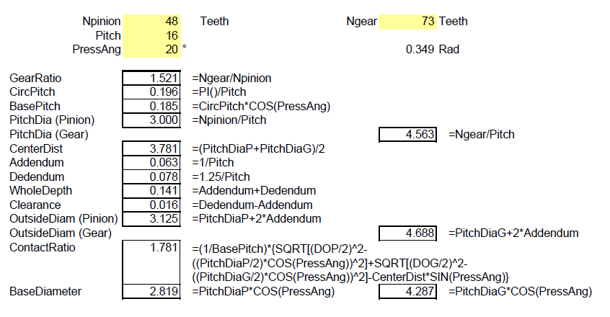
For standard gears, four inputs are all that are necessary to determine all the gear features.
Pinion = Driving gear
Gear = Driven gear
Pinion
Gear

Slide 8
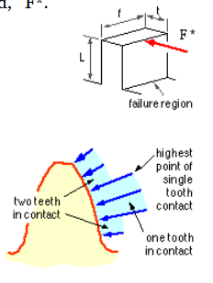
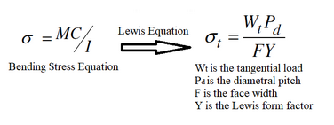
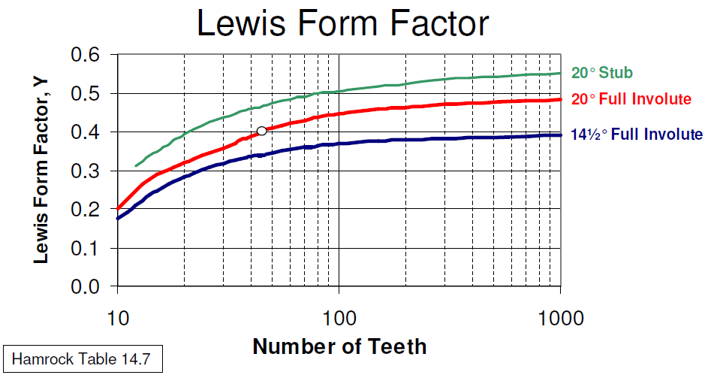
Apart from one-off overloads, there are three common modes of tooth failure
bending fatigue leading to root cracking,
surface contact fatigue leading to flank pitting, and
lubrication breakdown leading to scuffing.
For analysis, the gear tooth is represented as a simple cantilever beam with a tip load.
In 1894, Wilfred Lewis came up with the Lewis equation for tooth loads:
In 1894 though, no one knew about stress concentration yet, so it wasn’t included in the equation.

Slide 9
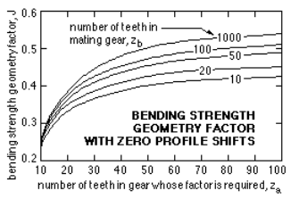
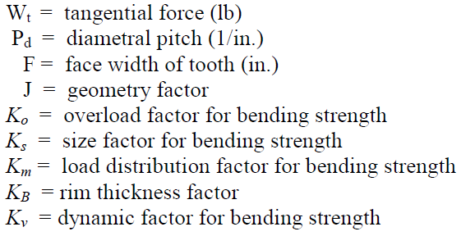
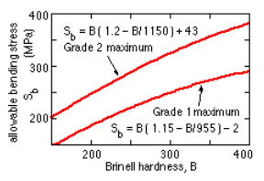
Current gear analysis approaches are “governed” by the AGMA – the American Gear Manufacturers Association.
Here is a good discussion of AGMA design -https://theengineeringblog.com/gear-design-by-agma-theory/
Gleason Corporation, Rochester, NY provides a free “Gear Calculator App” that runs on PCs/notebooks as well on mobile devices with Android and iOS.
Also see Hamrock Chapter 14 & 15

