Slide 1
Fairfield Senior Center Economic Development in a Changing World
October 2016

Slide 2
Mark S. LeClair Fairfield University
Professor of Economics
Director of MPA Program

Slide 3
If you want Copies of the Slides
Go to my Webpage:
www.faculty.Fairfield.edu/mleclair
Click on Link
Must have Powerpoint on computer

Slide 4
Outline of 5 Sessions
Week 1: What is Developmental Economics as a discipline? What is the difference between Regional and Global Development? What does the world look like right now?
Week 2: Regional Problems and Regional Development Policy
Week 3: Global Development and Global Development Goals

Slide 5
Week 4: Political Economy….How does development policy interact/conflict with politics?
Week 5: Political Systems and Economic Development

Slide 6
Economic Development as a Discipline
Two Distinct parts of discipline
Regional and Global
In U.S., how to we save troubled inner cities? Globally, how do we address poverty and its consequences?
Example: Bridgeport’s issues with poverty, housing, employment, urban decay versus hunger on a global basis

Slide 7
What does the Discipline seek to do?
Identify problems facing urban or rural areas
Design policies to address those policies
Evaluate the effectiveness of those policies
The “stadium gambit” as an example
HarborYard
Bass Pro and the “mall gambit” (e.g. Waterbury)

Slide 8
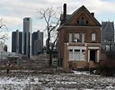
What does World Look Like Right Now?

Slide 9
Some of America’s Poorest Cities
McAllen-Edinburg-Mission, Texas
> Median household income: $33,761
Brownsville-Harlingen, Texas
> Median household income: $30,953
Dalton, Ga.
> Median household income: $32,858

Slide 10
Compare to…………….
San Jose-Sunnyvale-Santa Clara, Calif.
> Median household income: $90,737
Bridgeport-Stamford-Norwalk, Conn.
> Median household income: $79,841
(kind of surprising, but that’s what happens when mixing the very rich and the less so…)
City-data.com gives data specific to individuals cities

Slide 11
What about U.S. States (by per capita income)? Ranked by 2014 Median HH Income
Rank State 2014 2010 2009 2007 2000
1 Maryland $70,004 $69,272 $70,545 $87,080 $72,372
2 New Jersey $69,825 $68,342 $70,378 $84,035 $70,169
3 California $67,458 $67,034 $71,595 $90,967 $81,972
4 Connecticut $65,753 $66,953 $68,460 $81,333 $67,639
DC $65,124 $63,098 $57,214 $52,746 $50,681
5 Massachusetts $64,859 $62,081 $61,401 $59,365 $56,236
6 New Hampshire $64,712 $63,557 $62,731 $61,369 $60,489
7 Virginia $62,881 $61,330 $58,233 $59,562 $55,108

Slide 12
Poorest States (Ranked by 2014 Income)*
44 | Louisiana | $41,734 | $41,725 | $43,614 | $42,367 | $40,676
45 | Tennessee | $41,693 | $41,664 | $42,822 | $41,567 | $40,001
46 | Alabama | $41,415 | $40,489 | $42,666 | $40,554 | $38,473
47 | Kentucky | $41,141 | $40,072 | $41,538 | $40,267 | $38,466
 | Guam | $38,973 | - | - | - | -
48 | Arkansas | $38,758 | $37,823 | $38,815 | $38,134 | $37,420
49 | West Virginia | $38,482 | $37,435 | $37,989 | $37,060 | $37,227
50 | Mississippi | $36,919 | $36,646 | $37,790 | $36,338 | $35,261

Slide 13
Connecticut Cities – Where did all the Money Go?
Median Household Income:
Bridgeport: $42,700 (Median HH Income)
Waterbury: $36,736
Hartford: $27,417
New London: $40,900
Stamford: $72,706
Willimantic: $33,403
New Canaan: $178,371

Slide 14
Median Household Income is representative of all the other issues, such as:
Housing, jobs, etc.
Income disparity in Connecticut may be greater than anywhere, with possible exception of California

Slide 15
The Bigger Picture (CERC)
Population, housing stock, demographics, schools, parks, etc.
www.cerc.com
These are considered development as opposed to income measures
Connecticut is somewhat unique in that all major cities are troubled
All have housing stock issues, educational issues or other problems

Slide 16
Examples
City Population Unemployment Poverty Rate Math Mastery
(2010-14)
New Haven 130,553 9.0% 26.4% 41.2%
Stamford 125,401 5.5% 9.9% 59.6%
Bridgeport 146,680 10.2% 23.6% 33.7%
Waterbury 109,887 10.7% 24.2% 27.1%
Hartford 125,211 12.2% 34.4% 32.5%
------------------------------------------------------------------------------------------------------
State 3,592,053 6.6% 10.5% 65.2%

Slide 17
Summmary
Outside of Stamford, cities in Connecticut are deeply troubled
Yet, urban areas are small in comparison to those in other states
Don’t have a Detroit to try to fix
Amount of money and effort to solve cities’ problems not overwhelming
Persistence of problems represents a policy failure

Slide 18
Global Development
Have to avoid always equating income with development
Although it usually is a strong indicator

Slide 19
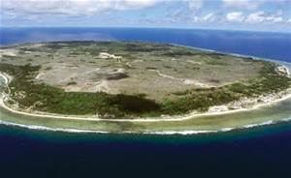
Island Nation of Nauru

Slide 20
GDP per Capita: $15,211
Very high by developing nation standards
Quality of life not so high
Island is made of bird droppings
Mined as phosphate fertilizer
In the process, made island almost uninhabitable
At one point, islanders tried to buy a new island (no one was selling)

Slide 21
Global Differences in Income – GDP/Capita, PPP Basis
1 | Qatar | 132,099
2 | Luxembourg | 98,987
3 | Singapore | 85,253
4 | Brunei | 79,587
5 | Kuwait | 70,166
6 | Norway | 68,430
7 | United Arab Emirates | 67,617
8 | San Marino | 63,104
9 | Switzerland | 58,551
— | Hong Kong | 56,701
10 | United States | 55,805

Slide 22
Other End of the Spectrum
178 | Niger | 938 | 2014
179 | Liberia | 842 | 2014
180 | Malawi | 822 | 2014
181 | Burundi | 770 | 2014
182 | Congo, Dem. Rep. | 746 | 2014
183 | Central African Republic | 594 | 2014

Slide 23
Regional versus Global Development
Global Development seeks to raise living standards AND address development indicators
As in the Millennium Development Goals of the UN
Infant mortality, longevity, educational attainment, health, etc.
Regional development addresses more localized problems, perhaps inside a very rich country/state
Bridgeport or Waterbury
Approaches are very different

Slide 24
Questions?

Slide 25
Week #2 – Regional Problems and Regional Development Policy
What Causes Regional Development Issues?
Departure of an industry or industries
Demographics
Transportation issues (A serious problem in Connecticut)
Failed infrastructure
Natural disaster
Misuse of Resources (Tragedy of the Commons, 1968, Garrett Hardin)

Slide 26
Examples
Departure of industry (too many to name)
Automobile industry leaving Detroit
Steel industry departing Pennsylvania
Textile industry departing New England
Economic issues of the “valley”
Brass industry in Waterbury
Argument is that towns and areas can either sit back and allow decline or try to respond in some way

Slide 27
Demographics and Transportation
Changing demographics may make an area unsuitable for manufacturing
Aging labor force may mean labor is scarcer and more expensive
Transportation is one of Connecticut’s biggest issue at present
Cannot attract new firms if roads don’t work
Unfortunately, State has few options to fix this
Rail system is at capacity. No place to put new roads

Slide 28
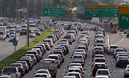
Our joyful morning commute

Slide 29
Failed Infrastructure (Beyond Roads)
Metro North beyond capacity since gas prices rose in 2007
Deep-water ports in State are inadequate (only New Haven is fully operating)
Unlike rest of country, airport is OK (compare Bradley to Laguardia)
State is very careless with infrastructure funds – used dedicated highway money to balance the State budget

Slide 30
Natural Disasters
Famous example of coal industry in Wilkes-Barre
1959 Knox Coal Mine disaster left many mines flooded
No way to reopen
City (and area) went into decline
Coast of Mississippi has never recovered from Katrina

Slide 31
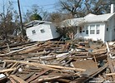

Slide 32
Misuse of Resources
“Tragedy of the Commons”
Shared resources are unpriced (free)
Fishing, mining, timbering
Best strategy of individual is to exploit as rapidly as possible
But, result is destruction of resource
Georges Bank was one of world’s best fishing areas. Now largely off limits to fishing

Slide 33
Timbering
At one point, nearly all large trees in the northeast had been cut down
Reason why the largest trees in Connecticut (in the Pequonnock Valley in Trumbull) are only 155 feet high
Once timber all cut down, industry moved on
Reforestation is now largely complete, but industry never came back
Only in Northwest is there a well-maintained lumbering industry that replants as it cuts

Slide 34
Once Regional Industry Gone, what Comes Next?
Generally, population decline, a drop in household income, deteriorating property prices, and economic decay
In a purely free-market world, you simply move on to the next economically vibrant area
Problem (even from an objective view) is that billions of dollars in assets are destroyed in the process (e.g. housing stock)

Slide 35
Bridgeport as a Case Study
Used to be a vibrant, economically important city
Tourist destination for New Yorkers
Decline of defense industry in the 1950s set off decay
City now has a deteriorating housing stock, a very troubled downtown area (which is getting worse, not better)
Problems with crime, poverty, etc.
Defense industry is not coming back; what does city do?

Slide 36
Regional Development Tactics – the Good, the Bad and the Silly
Common tactics include:
The “stadium gambit”
Enterprise Zones – low tax areas that promote retailing
Intellectual corridors (more regional in nature)
Declare an area a high-tech corridor and use tax breaks to spur investment (Route 128 in Boston)
Growth poles – a regionally-based, industry specific development initiative (e.g. auto industry and suppliers)

Slide 37
What did Bridgeport Try?
The bluefish stadium and HarborYard Arena
Generally acknowledged as ineffective
Isolated on wrong side of 95, no businesses developed around arena
Example of the over-used and rather ridiculous stadium approach
Moving HCC to the old Sears Building
Problem: NO integration with community (could be on the moon)

Slide 38
Moving police barracks downtown
Nice idea; reduces crime and stimulates some retail trade
Not very impactful
SteelPointe Harbor
First dramatic development project carried out by city
Unfortunately, undertaken in 2008 – put on hold
Now moving forward

Slide 39
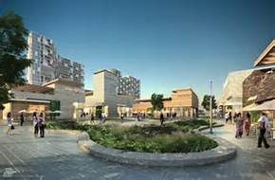

Slide 40
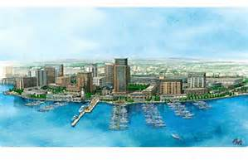

Slide 41
Opening of Bass Pro a major accomplishment
Foresee housing, retail, commercial space once completed
First real attempt at redevelopment
To actually fix city’s problems would need a new industrial base (e.g. financial)
Not sure that is going to happen

Slide 42
Other Local Examples of Transformations
Sleepy Hollow (N. Tarrytown, New York)
GM plant closes – North Tarrytown renamed Sleepy Hollow in order to become a tourist destination
Waterbury, CT
Brass industry departs – open Brassworks Mall as a regional attraction

Slide 43
Major Fail…………………………New London
Gave enormous tax breaks to Pfizer to redevelop New London
Used eminent domain to clear area for Pfizer (see Little Pink House)
Pfizer changed its mind
Left behind a wasteland

Slide 44
Questions?

Slide 45
Week 3 – Global Development Goals and International Development Policies
To eradicate extreme poverty and hunger
To achieve universal primary education
To promote gender equality and empower women
To reduce child mortality
To improve maternal health
To combat HIV/AIDS, malaria, and other diseases
To ensure environmental sustainability
To develop a global partnership for development

Slide 46
Many of these would be achieved if Incomes were raised – Incomes per Capita in Poor Nations
177 | Rwanda | 1,800 | 2015 est.
178 | Burkina Faso | 1,800 | 2015 est.
179 | Mali | 1,800 | 2015 est.
180 | North Korea | 1,800 | 2014 est.
181 | Haiti | 1,800 | 2015 est.
182 | The Gambia | 1,700 | 2015 est.
183 | Ethiopia | 1,700 | 2015 est.
184 | Comoros | 1,600 | 2015 est.
185 | Sierra Leone | 1,600 | 2015 est.
186 | Togo | 1,500 | 2015 est.
187 | Guinea-Bissau | 1,500 | 2015 est.
188 | Madagascar | 1,500 | 2015 est.

Slide 47
Infant Mortality per 1000 Live Births (2015) – U.S. = 5.80
1 | Afghanistan | 112.80 | 2016 est.
2 | Mali | 100.00 | 2016 est.
3 | Somalia | 96.60 | 2016 est.
4 | Central African Republic | 88.40 | 2016 est.
5 | Guinea-Bissau | 87.50 | 2016 est.
6 | Chad | 87.00 | 2016 est.
7 | Niger | 82.80 | 2016 est.
8 | Angola | 76.50 | 2016 est.
9 | Burkina Faso | 73.80 | 2016 est.
10 | Nigeria | 71.20 | 2016 est.

Slide 48
Life Expectancy – Versus U.S. 79.3 years
Country and Rank Afghanistan | 161 | 60.5
Benin | 162 | 60.0
Burkina Faso | 163 | 59.9
Togo | 163 | 59.9
Democratic Republic of the Congo | 165 | 59.8
Burundi | 166 | 59.6
Guinea | 167 | 59.0

Slide 49
Generalities…….
Much of the remaining global development work needs to take place in Africa, although there are exceptions (Afghanistan)
Infant mortality rates and other measures of development are closely linked to civil unrest and war
Nations that have problems with either (or both) infant mortality and/or life expectancy are commodity dependent in trade

Slide 50
Development Policies – The Regional becomes National
Many of the development goals are best achieved through the UN, World Bank and NGOs
e.g. global vaccination programs, green revolution initiatives, infrastructure improvements
Economic development policy focuses on economic growth as a driver of improvement

Slide 51
Most Important Policy Prescription may be the use of Growth Poles
May be natural or induced
Natural poles are typically a resource (e.g. minable mineral)
Induced – large industrial (or other investment) that has strong linkages to surrounding economy
Sikorsky (although probably too small) provides an illustration
Not only produces helicopters (and jobs), but draws from numerous other sub-contractors who create jobs

Slide 52
Traveling Route I-80 to Midwest
Pass by several modern automobile plants that are the size of cities
Impact on surrounding areas is dramatic

Slide 53
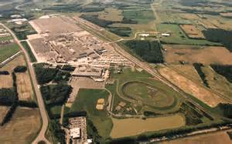

Slide 54
Development Policy may Focus on these Induced Growth Poles
Identify region in distress
Identify regional assets (cheap labor, transportation links)
Propose industrial development that has:
Linkages
Spillovers

Slide 55
Spillovers – positive economic impacts that are a result of presence of growth pole
Increased spending on housing due to increased wages and employment
Linkages – direct economic impacts that come from firm buying inputs to carry out production
Sub-contractors

Slide 56
Case Study……………………………….
Boeing production facility in South Carolina
Produces the 787 Dreamliner
Assembly line is 1000 feet long (3 football fields)
Employs 8,100 workers at very high wages
Much smaller than Seattle plant, but economic impacts still high

Slide 57
Is it a growth pole or just a manufacturing facility…..
Assessment usually based on employment and linkages to other sectors
South Carolina is a borderline case
72,000 employed in Seattle at Boeing – clearly that is driving development

Slide 58
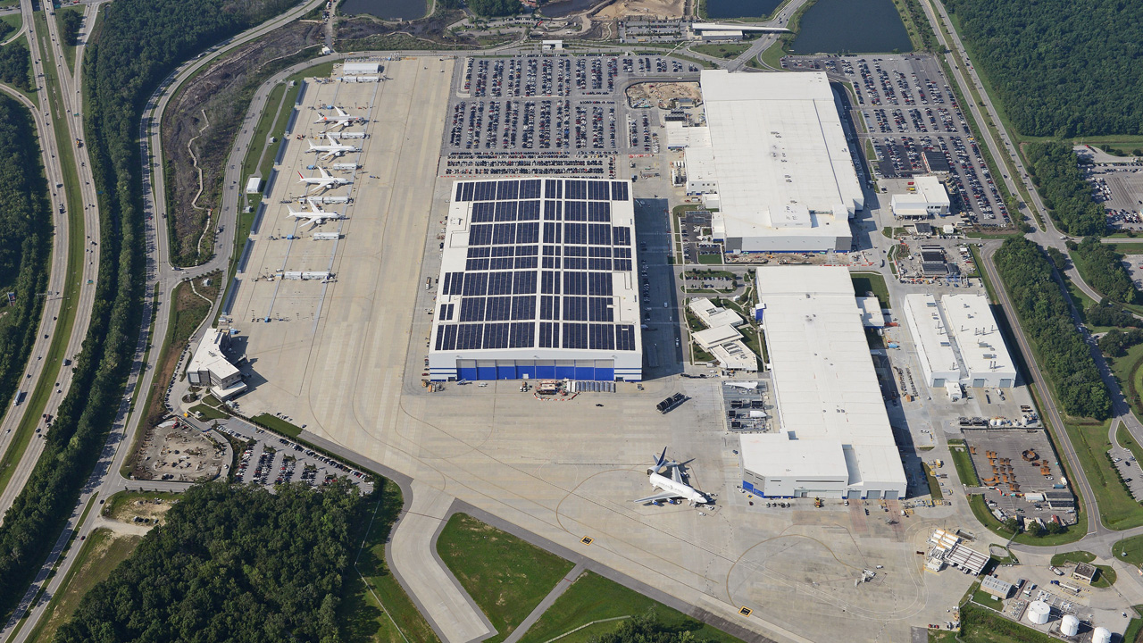

Slide 59
Strategies that are nation-wide
Export-driven growth
Asian Tigers – Malaysia, S. Korea, Thailand, Indonesia
Captured “low-end” manufacturing (e.g. electronics) from Japan
Rapid and sustained development (except 1997-8)

Slide 60
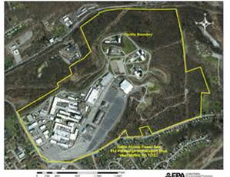
Electronics Plant in Thailand

Slide 61
Commodity Led Growth
Use natural resource base to grow
Common practice in African nations
Coffee, cocoa, minerals, etc.
Problem: Resources prices are unstable – produces unpredictable growth

Slide 62
Industrial Policy
Made famous by MITI
Ministry of International Trade and Industry
Targeted specific industries (steel, shipbuilding) and used trade protection and subsidies to support
Worked very well until early 1990s
Many of these industries then began to shift to lower-cost producers
China, S. Korea
Produced 25 year economic malaise

Slide 63
And not all MITI initiatives made sense
Completely missed out on computer chips
Chose wrong technology (DRAM over RISC)
Also funded a huge initiative on AI that never went anywhere
MITI is now quiescent – spends as much time on import-promotion as on pushing exports

Slide 64
Socialist Model

