Slide 1
Fairfield Senior Center Economic Development in a Changing World
October 2016

Slide 2
Mark S. LeClair Fairfield University
Professor of Economics
Director of MPA Program

Slide 3
If you want Copies of the Slides
Go to my Webpage:
www.faculty.Fairfield.edu/mleclair
Click on Link
Must have Powerpoint on computer

Slide 4
Outline of 5 Sessions
Week 1: What is Developmental Economics as a discipline? What is the difference between Regional and Global Development? What does the world look like right now?
Week 2: Regional Problems and Regional Development Policy
Week 3: Global Development and Global Development Goals

Slide 5
Week 4: Political Economy….How does development policy interact/conflict with politics?
Week 5: Political Systems and Economic Development

Slide 6
Economic Development as a Discipline
Two Distinct parts of discipline
Regional and Global
In U.S., how to we save troubled inner cities? Globally, how do we address poverty and its consequences?
Example: Bridgeport’s issues with poverty, housing, employment, urban decay versus hunger on a global basis

Slide 7
What does the Discipline seek to do?
Identify problems facing urban or rural areas
Design policies to address those policies
Evaluate the effectiveness of those policies
The “stadium gambit” as an example
HarborYard
Bass Pro and the “mall gambit” (e.g. Waterbury)

Slide 8
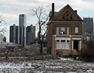
What does World Look Like Right Now?

Slide 9
Some of America’s Poorest Cities
McAllen-Edinburg-Mission, Texas
> Median household income: $33,761
Brownsville-Harlingen, Texas
> Median household income: $30,953
Dalton, Ga.
> Median household income: $32,858

Slide 10
Compare to…………….
San Jose-Sunnyvale-Santa Clara, Calif.
> Median household income: $90,737
Bridgeport-Stamford-Norwalk, Conn.
> Median household income: $79,841
(kind of surprising, but that’s what happens when mixing the very rich and the less so…)
City-data.com gives data specific to individuals cities

Slide 11
What about U.S. States (by per capita income)? Ranked by 2014 Median HH Income
Rank State 2014 2010 2009 2007 2000
1 Maryland $70,004 $69,272 $70,545 $87,080 $72,372
2 New Jersey $69,825 $68,342 $70,378 $84,035 $70,169
3 California $67,458 $67,034 $71,595 $90,967 $81,972
4 Connecticut $65,753 $66,953 $68,460 $81,333 $67,639
DC $65,124 $63,098 $57,214 $52,746 $50,681
5 Massachusetts $64,859 $62,081 $61,401 $59,365 $56,236
6 New Hampshire $64,712 $63,557 $62,731 $61,369 $60,489
7 Virginia $62,881 $61,330 $58,233 $59,562 $55,108

Slide 12
Poorest States (Ranked by 2014 Income)*
44 | Louisiana | $41,734 | $41,725 | $43,614 | $42,367 | $40,676
45 | Tennessee | $41,693 | $41,664 | $42,822 | $41,567 | $40,001
46 | Alabama | $41,415 | $40,489 | $42,666 | $40,554 | $38,473
47 | Kentucky | $41,141 | $40,072 | $41,538 | $40,267 | $38,466
 | Guam | $38,973 | - | - | - | -
48 | Arkansas | $38,758 | $37,823 | $38,815 | $38,134 | $37,420
49 | West Virginia | $38,482 | $37,435 | $37,989 | $37,060 | $37,227
50 | Mississippi | $36,919 | $36,646 | $37,790 | $36,338 | $35,261

Slide 13
Connecticut Cities – Where did all the Money Go?
Median Household Income:
Bridgeport: $42,700 (Median HH Income)
Waterbury: $36,736
Hartford: $27,417
New London: $40,900
Stamford: $72,706
Willimantic: $33,403
New Canaan: $178,371

Slide 14
Median Household Income is representative of all the other issues, such as:
Housing, jobs, etc.
Income disparity in Connecticut may be greater than anywhere, with possible exception of California

Slide 15
The Bigger Picture (CERC)
Population, housing stock, demographics, schools, parks, etc.
www.cerc.com
These are considered development as opposed to income measures
Connecticut is somewhat unique in that all major cities are troubled
All have housing stock issues, educational issues or other problems

Slide 16
Examples
City Population Unemployment Poverty Rate Math Mastery
(2010-14)
New Haven 130,553 9.0% 26.4% 41.2%
Stamford 125,401 5.5% 9.9% 59.6%
Bridgeport 146,680 10.2% 23.6% 33.7%
Waterbury 109,887 10.7% 24.2% 27.1%
Hartford 125,211 12.2% 34.4% 32.5%
------------------------------------------------------------------------------------------------------
State 3,592,053 6.6% 10.5% 65.2%

Slide 17
Summmary
Outside of Stamford, cities in Connecticut are deeply troubled
Yet, urban areas are small in comparison to those in other states
Don’t have a Detroit to try to fix
Amount of money and effort to solve cities’ problems not overwhelming
Persistence of problems represents a policy failure

Slide 18
Global Development
Have to avoid always equating income with development
Although it usually is a strong indicator

Slide 19
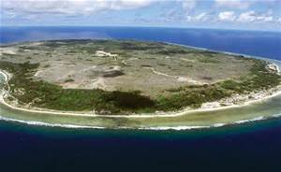
Island Nation of Nauru

Slide 20
GDP per Capita: $15,211
Very high by developing nation standards
Quality of life not so high
Island is made of bird droppings
Mined as phosphate fertilizer
In the process, made island almost uninhabitable
At one point, islanders tried to buy a new island (no one was selling)

Slide 21
Global Differences in Income – GDP/Capita, PPP Basis
1 | Qatar | 132,099
2 | Luxembourg | 98,987
3 | Singapore | 85,253
4 | Brunei | 79,587
5 | Kuwait | 70,166
6 | Norway | 68,430
7 | United Arab Emirates | 67,617
8 | San Marino | 63,104
9 | Switzerland | 58,551
— | Hong Kong | 56,701
10 | United States | 55,805

Slide 22
Other End of the Spectrum
178 | Niger | 938 | 2014
179 | Liberia | 842 | 2014
180 | Malawi | 822 | 2014
181 | Burundi | 770 | 2014
182 | Congo, Dem. Rep. | 746 | 2014
183 | Central African Republic | 594 | 2014

Slide 23
Regional versus Global Development
Global Development seeks to raise living standards AND address development indicators
As in the Millennium Development Goals of the UN
Infant mortality, longevity, educational attainment, health, etc.
Regional development addresses more localized problems, perhaps inside a very rich country/state
Bridgeport or Waterbury
Approaches are very different

Slide 24
Questions?

Slide 25
Week #2 – Regional Problems and Regional Development Policy
What Causes Regional Development Issues?
Departure of an industry or industries
Demographics
Transportation issues (A serious problem in Connecticut)
Failed infrastructure
Natural disaster
Misuse of Resources (Tragedy of the Commons, 1968, Garrett Hardin)

Slide 26
Examples
Departure of industry (too many to name)
Automobile industry leaving Detroit
Steel industry departing Pennsylvania
Textile industry departing New England
Economic issues of the “valley”
Brass industry in Waterbury
Argument is that towns and areas can either sit back and allow decline or try to respond in some way

Slide 27
Demographics and Transportation
Changing demographics may make an area unsuitable for manufacturing
Aging labor force may mean labor is scarcer and more expensive
Transportation is one of Connecticut’s biggest issue at present
Cannot attract new firms if roads don’t work
Unfortunately, State has few options to fix this
Rail system is at capacity. No place to put new roads

Slide 28
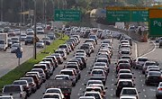
Our joyful morning commute

Slide 29
Failed Infrastructure (Beyond Roads)
Metro North beyond capacity since gas prices rose in 2007
Deep-water ports in State are inadequate (only New Haven is fully operating)
Unlike rest of country, airport is OK (compare Bradley to Laguardia)
State is very careless with infrastructure funds – used dedicated highway money to balance the State budget

Slide 30
Natural Disasters
Famous example of coal industry in Wilkes-Barre
1959 Knox Coal Mine disaster left many mines flooded
No way to reopen
City (and area) went into decline
Coast of Mississippi has never recovered from Katrina

Slide 31
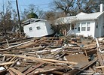

Slide 32
Misuse of Resources
“Tragedy of the Commons”
Shared resources are unpriced (free)
Fishing, mining, timbering
Best strategy of individual is to exploit as rapidly as possible
But, result is destruction of resource
Georges Bank was one of world’s best fishing areas. Now largely off limits to fishing

Slide 33
Timbering
At one point, nearly all large trees in the northeast had been cut down
Reason why the largest trees in Connecticut (in the Pequonnock Valley in Trumbull) are only 155 feet high
Once timber all cut down, industry moved on
Reforestation is now largely complete, but industry never came back
Only in Northwest is there a well-maintained lumbering industry that replants as it cuts

Slide 34
Once Regional Industry Gone, what Comes Next?
Generally, population decline, a drop in household income, deteriorating property prices, and economic decay
In a purely free-market world, you simply move on to the next economically vibrant area
Problem (even from an objective view) is that billions of dollars in assets are destroyed in the process (e.g. housing stock)

Slide 35
Bridgeport as a Case Study
Used to be a vibrant, economically important city
Tourist destination for New Yorkers
Decline of defense industry in the 1950s set off decay
City now has a deteriorating housing stock, a very troubled downtown area (which is getting worse, not better)
Problems with crime, poverty, etc.
Defense industry is not coming back; what does city do?

Slide 36
Regional Development Tactics – the Good, the Bad and the Silly
Common tactics include:
The “stadium gambit”
Enterprise Zones – low tax areas that promote retailing
Intellectual corridors (more regional in nature)
Declare an area a high-tech corridor and use tax breaks to spur investment (Route 128 in Boston)
Growth poles – a regionally-based, industry specific development initiative (e.g. auto industry and suppliers)

Slide 37
What did Bridgeport Try?
The bluefish stadium and HarborYard Arena
Generally acknowledged as ineffective
Isolated on wrong side of 95, no businesses developed around arena
Example of the over-used and rather ridiculous stadium approach
Moving HCC to the old Sears Building
Problem: NO integration with community

Slide 38
Moving police barracks downtown
Nice idea; reduces crime and stimulates some retail trade
Not very impactful
SteelPointe Harbor
First dramatic development project carried out by city
Unfortunately, undertaken in 2008 – put on hold
Now moving forward

Slide 39
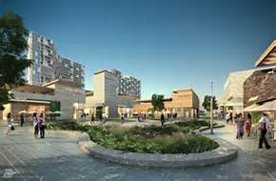

Slide 40
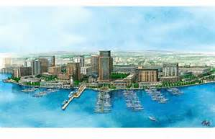

Slide 41
Opening of Bass Pro a major accomplishment
Foresee housing, retail, commercial space once completed
First real attempt at redevelopment
To actually fix city’s problems would need a new industrial base (e.g. financial)
Not sure that is going to happen

Slide 42
Other Local Examples of Transformations
Sleepy Hollow (N. Tarrytown, New York)
GM plant closes – North Tarrytown renamed Sleepy Hollow in order to become a tourist destination
Waterbury, CT
Brass industry departs – open Brassworks Mall as a regional attraction

Slide 43
Major Fail…………………………New London
Gave enormous tax breaks to Pfizer to redevelop New London
Used eminent domain to clear area for Pfizer (see Little Pink House)
Pfizer changed its mind
Left behind a wasteland
Led to passage of state laws that prohibit use of eminent domain for private development

Slide 44
Questions?

Slide 45
Week 3 – Global Development Goals and International Development Policies
To eradicate extreme poverty and hunger
To achieve universal primary education
To promote gender equality and empower women
To reduce child mortality
To improve maternal health
To combat HIV/AIDS, malaria, and other diseases
To ensure environmental sustainability
To develop a global partnership for development

Slide 46
Many of these would be achieved if Incomes were raised – Incomes per Capita in Poor Nations
177 | Rwanda | 1,800 | 2015 est.
178 | Burkina Faso | 1,800 | 2015 est.
179 | Mali | 1,800 | 2015 est.
180 | North Korea | 1,800 | 2014 est.
181 | Haiti | 1,800 | 2015 est.
182 | The Gambia | 1,700 | 2015 est.
183 | Ethiopia | 1,700 | 2015 est.
184 | Comoros | 1,600 | 2015 est.
185 | Sierra Leone | 1,600 | 2015 est.
186 | Togo | 1,500 | 2015 est.
187 | Guinea-Bissau | 1,500 | 2015 est.
188 | Madagascar | 1,500 | 2015 est.

Slide 47
Infant Mortality per 1000 Live Births (2015) – U.S. = 5.80
1 | Afghanistan | 112.80 | 2016 est.
2 | Mali | 100.00 | 2016 est.
3 | Somalia | 96.60 | 2016 est.
4 | Central African Republic | 88.40 | 2016 est.
5 | Guinea-Bissau | 87.50 | 2016 est.
6 | Chad | 87.00 | 2016 est.
7 | Niger | 82.80 | 2016 est.
8 | Angola | 76.50 | 2016 est.
9 | Burkina Faso | 73.80 | 2016 est.
10 | Nigeria | 71.20 | 2016 est.

Slide 48
Life Expectancy – Versus U.S. 79.3 years
Country and Rank Afghanistan | 161 | 60.5
Benin | 162 | 60.0
Burkina Faso | 163 | 59.9
Togo | 163 | 59.9
Democratic Republic of the Congo | 165 | 59.8
Burundi | 166 | 59.6
Guinea | 167 | 59.0

Slide 49
Generalities…….
Much of the remaining global development work needs to take place in Africa, although there are exceptions (Afghanistan)
Infant mortality rates and other measures of development are closely linked to civil unrest and war
Nations that have problems with either (or both) infant mortality and/or life expectancy are commodity dependent in trade

Slide 50
Development Policies – The Regional becomes National
Many of the development goals are best achieved through the UN, World Bank and NGOs
e.g. global vaccination programs, green revolution initiatives, infrastructure improvements
Economic development policy focuses on economic growth as a driver of improvement

Slide 51
Most Important Policy Prescription may be the use of Growth Poles
May be natural or induced
Natural poles are typically a resource (e.g. minable mineral)
Induced – large industrial (or other investment) that has strong linkages to surrounding economy
Sikorsky (although probably too small) provides an illustration
Not only produces helicopters (and jobs), but draws from numerous other sub-contractors who create jobs

Slide 52
Traveling Route I-80 to Midwest
Pass by several modern automobile plants that are the size of cities
Impact on surrounding areas is dramatic

Slide 53
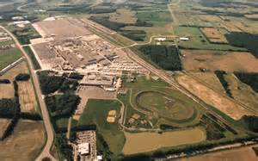

Slide 54
Development Policy may Focus on these Induced Growth Poles
Identify region in distress
Identify regional assets (cheap labor, transportation links)
Propose industrial development that has:
Linkages
Spillovers

Slide 55
Spillovers – positive economic impacts that are a result of presence of growth pole
Increased spending on housing due to increased wages and employment
Linkages – direct economic impacts that come from firm buying inputs to carry out production
Sub-contractors

Slide 56
Case Study……………………………….
Boeing production facility in South Carolina
Produces the 787 Dreamliner
Assembly line is 1000 feet long (3 football fields)
Employs 8,100 workers at very high wages
Much smaller than Seattle plant, but economic impacts still high

Slide 57
Is it a growth pole or just a manufacturing facility…..
Assessment usually based on employment and linkages to other sectors
South Carolina is a borderline case
72,000 employed in Seattle at Boeing – clearly that is driving development

Slide 58
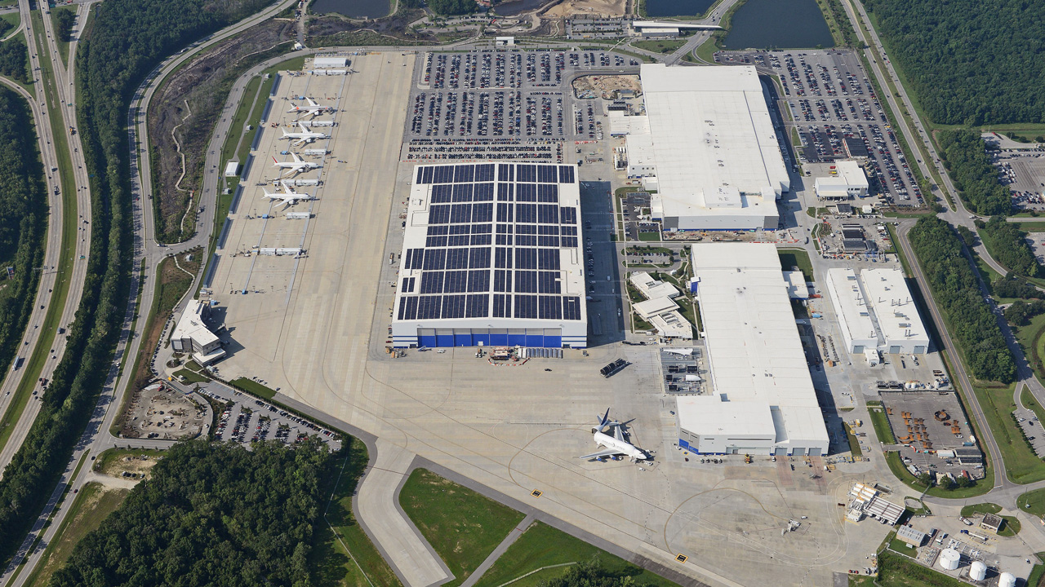

Slide 59
Strategies that are nation-wide
Export-driven growth
Asian Tigers – Malaysia, S. Korea, Thailand, Indonesia
Captured “low-end” manufacturing (e.g. electronics) from Japan
Rapid and sustained development (except 1997-8)

Slide 60
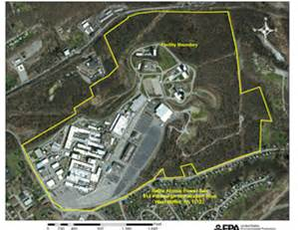
Electronics Plant in Thailand

Slide 61
Commodity Led Growth
Use natural resource base to grow
Common practice in African nations
Coffee, cocoa, minerals, etc.
Problem: Resources prices are unstable – produces unpredictable growth

Slide 62
Industrial Policy
Made famous by MITI
Ministry of International Trade and Industry
Targeted specific industries (steel, shipbuilding) and used trade protection and subsidies to support
Worked very well until early 1990s
Many of these industries then began to shift to lower-cost producers
China, S. Korea
Produced 25 year economic malaise

Slide 63
And not all MITI initiatives made sense
Completely missed out on computer chips
Chose wrong technology (DRAM over RISC)
Also funded a huge initiative on AI that never went anywhere
MITI is now quiescent – spends as much time on import-promotion as on pushing exports

Slide 64
Socialist Model
Industrial development driven by State concerns
As in the former Soviet Union
Tends to focus on heavy industrial (steelmaking, energy)
Separation of economy from market generally produces misappropriation of resources
Nails
Integration of government into the ownership of business makes firms part of public policy (e.g. employment creation)
May lead to very inefficient businesses

Slide 65
Questions

Slide 66
Brexit
Britain was always half in, and somewhat hesitant about EU project
Was not part of five original members of EEC
Joined in 1973
Never joined the monetary union (EMU)
Was part of EMS (European Monetary System)
Left in 1992

Slide 67
In Minds of the Brits
European Union leadership had become increasingly intrusive
European parliament, Court of Justice, European Central Bank
Sovereignty in question
Common Agricultural Policy irritated everyone
Last straw (for the public) was the migrant crisis, and the insistence that all nations open their borders

Slide 68
Trouble Was Already Brewing…….
First sign was in 2005 when the French rejected the EU constitution – leadership was stunned
Surrendering of national character and control had simply gone too far
Never brought constitution up for a vote again
Five stages of integration, and why EU is so different

Slide 69
What does Britain Gain and Lose
Positives (from UK perspective)
Abrogates myriad of regulations on trade, industry, climate change that were both very expensive and opposed by the public
Allows the UK to trade freely with non-EU countries (e.g. Canada)
Banned when part of EU
Recaptures national identity

Slide 70
Negatives:
Loses free access to European markets (although tariff rates low already)
Loses (potentially) right of free movement
Loses voice in future of European integration

Slide 71
Bigger Picture
May lead other nations to consider exiting (Austria)
Migrant crisis has also accelerated this
A partial break up of the EU would be a huge reversal for France, Italy and Germany – the primary architects of the Union

Slide 72
Weeks 4 and 5
Homework……
Suggestions on what Bridgeport could do to spur an economic revival

Slide 73
Political Economy – Interaction and Conflict Between Government and Production
Level of intrusion depends upon economic model:
Laissez-faire free market
State capitalism
Mixed form
Social Democratic model
Socialist Model
“Communist” Model (whatever that is)

Slide 74
Economic
“Communism” Socialism Social Democracy Mixed Economy Capitalism
Less Free More Free
Less Unequal More Unequal

Slide 75
Tension between growth and desire for equality produces push-pull between policies
Pushback against growing involvement of government somewhat of a losing cause
Once programs are in place, we own them
Reagan famously did in the CAB in 1981, but then was unable to eliminate any further government agencies
Despite major questions of their efficiency
e.g. the Department of Energy

Slide 76
Result is Mixed Economy in U.S.
Basic economic model is based on markets
Tempered by government intervention and regulation
Difficult to find an industry/product unaffected by some form of government policy
Food: Agricultural subsidies
Housing: FHA
Automotive: Clean Air Act, NTSA
Less intrusive than in Europe, but costs of regulations run into the hundreds of billions per year
Still, U.S. growth rates exceed those in Europe

Slide 77
Fraser Institute – 2014 – Measure of Economic Freedom (not political freedom)
 | Hong Kong | 90.1
2 | Singapore | 89.4
3 | Australia | 82.0
4 | New Zealand | 81.4
5 | Switzerland | 81.0
6 | Canada | 80.2
7 | Chile | 78.7
8 | Mauritius | 76.5
9 | Denmark | 76.1
10 | United States | 76.0

Slide 78
Europe’s Social Democracies
Germany: 19 out of 50
France: #40 in 2011, no longer on top 50 list
Norway: 31 out of 50
Spain: 46 out of 50 (lower than the figure for Colombia)

Slide 79
Comparative Growth Rates – Economic Report of the President
Country | 1997-2006 | 2013 | 2014 | 2015
United States | 3.3 | 1.5 | 2.4 | 2.5
Euro Area | 2.3 | -0.3 | 0.9 | 1.5
France | 2.4 | 0.7 | 0.2 | 1.1
Spain | 3.9 | -1.2 | 1.4 | 3.2
Germany | 1.5 | 0.4 | 1.6 | 1.5

Slide 80
Comparisons
Long-term growth much slower in Europe
Even German “powerhouse” is barely growing
Makes all decisions about income distribution, taxes, etc. more complex
Social Democratic model is not growth oriented – more about redistribution

Slide 81
What Taxes Pay for in most European Nations
A free (or near free) college education
Free medical care (although usually heavily rationed)
Subsidized housing
Governments are now struggling under the financial burden of so many programs
A significant outcome of this has been the decline of NATO – unaffordable with so many other commitments.

Slide 82
Government Spending as a % of GDP
Nation Gov’t Spending/GDP
Australia 36.2%
Austria 52.5
Belgium 55.1
France 57.3
Germany 44.1
Greece 49.8
Ireland 37.4
United Kingdom 38.0
United States 43.8

Slide 83
General Contention is that Higher Government Spending = Slower Growth
Government “products” are not productive
Generally does not lead to production of other products – although infrastructure can help an already growing region

Slide 84
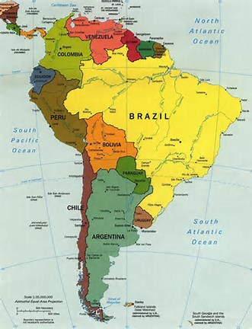
Political Economy and Latin America

Slide 85
Continent has experimented with every form of government imaginable
Chile – Primarily free market, although most recent prime minister was a socialist (in practice, a democratic socialist)
Brazil and Argentina – both emerging from long periods of left-of-center governments
Turning to right of center
Bolivia and Ecuador remain left-of-center
Morales (Bolivia) has managed to produce a stable economy, Correa (Ecuador) has survived politically despite instability
Ecuador achieved much of its success because it dollarized in 2000 (IRONY)
Venezuela continues its experiment with socialism
Rapidly descending into civil war

Slide 86
GDP/Capita (PPP) in Latin America
Nation | GDP/Capita
Brazil | $15,941
Mexico | $18,370
Argentina | $22,459 (DATA REJECTED BY IMF)
Venezuela | $17,430 (PRE-CRISIS)
Chile | $24,170
Ecuador | $11,839
Bolivia | $ 6,530
Honduras | $ 4,849
Costa Rica | $15,534

Slide 87
What Figures Tell Us
Larger economies with economic models that have mirrored those in the West have grown more rapidly
Resource based development (Ecuador) does not seem to produce longer-term growth
Nations with highly corrupt governmental systems (Honduras, Bolivia) are stuck in a prior millennium

Slide 88
African Development is More Complex
Workings of economic models overwhelmed by:
Tribal and other strife
Poor agricultural land and the lack of an agricultural surplus
Desert and rain forest land unfarmable
No way to “release” labor from farming when permanently at a subsistence level

Slide 89
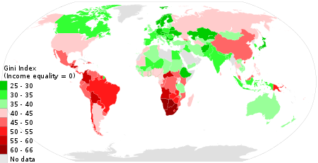
Other Issue - Inequality

Slide 90
Summary
Market model seems to produce higher growth rates and higher standard of living (on average)
Also produces more inequality
Contest between two goals produces tension between government involvement and free markets

Slide 91
Questions?

Slide 92
Week 5 – Market Failure and Economic Development

Slide 93
Tension Between what is Government Responsibility and what should be Left to Markets
Schumpeter believed in “creative destruction”-
Failure of industries as new processes or technologies took over
Problem (as noted in beginning of course) is the loss of assets
Development policy can work against that

Slide 94
Where does Debate end on whether Government should be involved?
“Market Failure”
Parts of the economic structure where markets do not work, or work poorly
Result is under- or over-production of goods
Society made worse off as a result

Slide 95
Represents Other Major Reason for Extensive Government Involvement
Most Common Example: Firm(s) produce a positive or negative impact that is not part of bottom line
Result: will under- or over-produce
And (in the case of negative externalities) try to pass cost onto society
Pollution, noise, congestion, etc.
Positive externalities important also (flu shot)

Slide 96
In Absence of Government Planning and Intervention
Firm will maximize internal profits
May not make sense from a societal point of view
e.g. pollution (paper mill)
If firm can simply dump runoff into nearby river, will do so
“Good Citizens” will go out of business as their costs will rise
The solution is to universally impose a cost on all producers, so that the playing field remains level

Slide 97
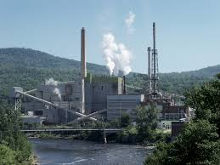
Cannot Make this Clean!

Slide 98
This is what Economists Have always Suggested we do about Carbon Emissions
If we accept that carbon dioxide is leading to warming, then tax it
Instead of complicated subsidies and regulations
Tax will reduce amount of carbon emitted
Money collected can be used to do amelioration
Planting of trees, carbon sequestration, etc.
Consumers will help fund if they buy products that are carbon-intensive

Slide 99
If Negative Externalities Should be Taxed, What do we do About Positive Spillovers?
Should subsidize (we want more of the product)
Best example is flu shots
My “consumption” of the vaccine helps everyone since I am now a poor vector
Therefor, should be zero or near zero in cost
Example 2: Private security at a business deters crime in contiguous area
@ No charge!

Slide 100
What about Congestion?
Probably our biggest planning nightmare in Connecticut
Time-based tolling is one means of addressing this
7:00-7:30 is probably the worst time to be on the Parkway
Have highest toll at this time
Zero toll if you travel at 5:30 when you are alone on the highway

Slide 101
Other Market Failures that may Require Government Intervention
Public Goods
Products that are jointly consumed by everyone
Cannot create a market for this since cannot prevent anyone from using the good
e.g. national defense
Impure cases: Police services, roads
Result will be under-provision, since no one can charge for the good
Must be provided by the government
Case Study: Lighthouses

Slide 102
Professor Dan Wells (University of Arizona)
Bought lighthouse in Bass Harbor, Maine
Figured it was like the insurance business – he could charge those using the harbor a fee
Extensive shipping from Virginia to Newfoundland
130 trips per day
Ships could travel around the clock if the lighthouse resumed operation
Contacted shipping companies – they came up with a fee of $10 for each passage ($1300/month)

Slide 103
Did Math on Mortgage….
Figured he would make about $6,000 per year ($45,000 in today’s dollars)
Fixed up lighthouse – Sent out invoices to all shipping companies
Only 4 paid (a total of $90)
Re-invoiced with a “pay now or else” letter
Still no response. Firms figured lighthouse was now on for the paying customers, so they could use it also.
In 4 months, had to leave the lighthouse business – Turned into a room rental

Slide 104
Called Free-Ridership
Nonpayers receive benefits they have not paid for
No way to exclude nonpayers
Good must be provided for publicly

