Slide 1
Fairfield Senior Center
January 17, 2017

Slide 2
The Fundamentals of Money
Mark LeClair
Fairfield University

Slide 3
To Obtain Copy of Slides
Go to www.faculty.Fairfield.edu/mleclair
Look for Icon at top that says “Fairfield Senior Center”
Must have PowerPoint on your computer

Slide 4
Four Weeks of Class
Week 1: What is money?
Week 2: Money’s Role in the Economy
Week 3: Monetary Policy and the Federal Reserve
Week 4: The International Arena – Gold, The Dollar Standard and the International Monetary System

Slide 5
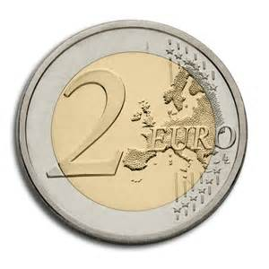
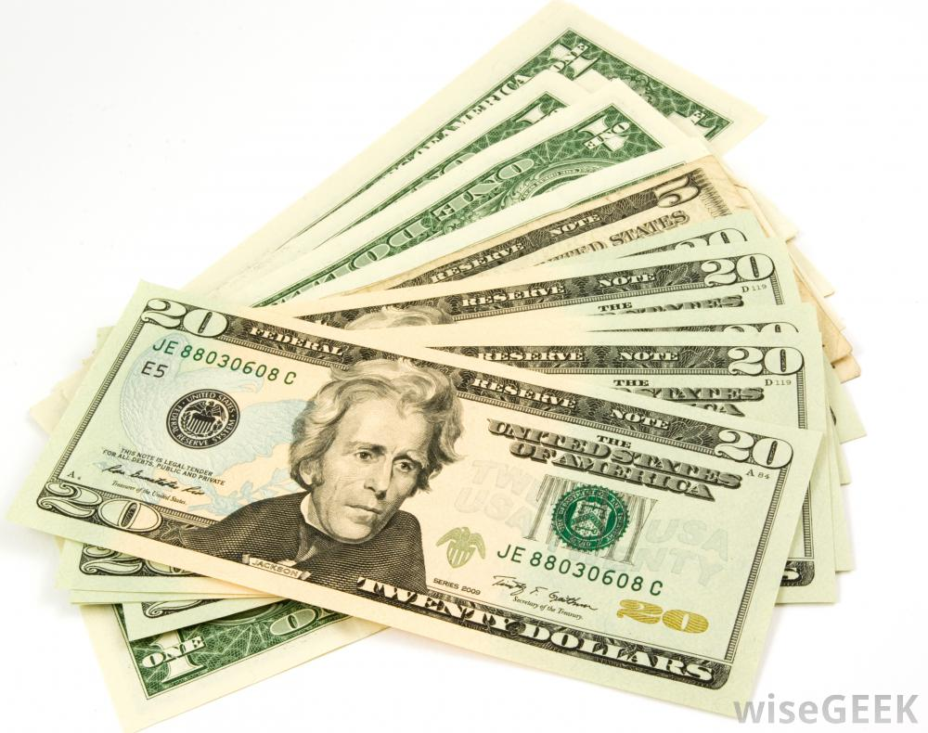
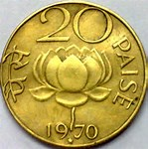
What is Money?

Slide 6
Money Must Fulfill 3 Roles
Must be a Medium of Exchange
Replaces Barter
Must serve as a Store of Value
Hard to retire (or save for college) if you must use physical assets
Serves as a Measure of Relative Value
How would we know a can of tuna is less valuable than a pound of steak?

Slide 7
Types of Money
Money with intrinsic value
Gold, Silver, Copper
Gresham’s Law
Fiat Money (funny money)
What we have now (as does the rest of the world)
I accept it, since I assume the next person will also

Slide 8
U.S. $1 Bill

Slide 9
History of Money in U.S.
Free Banking Era
10,000 different currencies
No official U.S. currency until 1861 when Congress authorized issuance of money by U.S. Treasury
All gold and silver
Coins, and bills backed by gold and silver

Slide 10
Post WW2
World goes on “dollar standard”, U.S. remains on gold standard
Part of Bretton Woods Agreement
To get gold, had to use dollar
French Franc -> Dollar -> Gold ($35/oz.)
Lasted until 1971, when speculative attack hit U.S. dollar
Dollar was devalued ($42/oz.)

Slide 11
Dollar Attacked Once Again in 1973
U.S. leaves the gold standard and joins rest of world with Fiat Money
Explains instability inherent in the system
Once faith in a currency disappears, collapse is inevitable
Germany 1924, Zimbabwe 2009 (inflation = 500 billion percent)

Slide 12
Definitions of Money
Based upon how liquid a “money” is
If completely liquid (currency, checking account deposits) then it is part of M1 (money 1)
If less liquid (e.g. Money Market Mutual Funds) becomes part of money 2 (M2)
But all of M1 is in M2
So…….M2 = M1 + 7 other less liquid components

Slide 13
Creation of Money
Under gold (or silver) standard, money creation was irrattic
Discovery of major gold find altered money supply
Under fiat money, banks create money
Money deposited in a bank is lent out to borrowers and then redeposited to be lent again
Only part that is not lent out is that kept by banks as reserves (vault cash)
Creates long cycle of depositing, borrowing and redepositing

Slide 14
Example – Jane finds $100 in her sock drawer and puts it on deposit at her bank
The bank keeps 10% ($10) and lends out $90 to a borrower who wants to buy a bike
The $90 is deposited by the owner of the bike store
The bank then lends out $81 to another borrower
Continues until amounts too small to continue lending

Slide 15
$100 -> $90 -> $81 -> $72.90-> etc.
All of these are deposits, so they are all “money”
In end, money supply will go up by $1000 due to the initial $100 deposit
Explains how Federal Reserve is able to manipulate the money supply

Slide 16
Recent Experience – Post 2008 Recession
Economy has been very weak
Poor growth (averaging about 1.5%)
Banking system fragile
Federal Reserve acted to prop up economy by buying government debt, essentially directly from the treasury
Called “monetizing the debt”
Was always considered very dangerous – like printing money

Slide 18
As Economy Recovers……….
Federal Reserve must get rid of its excess holdings
No small task, given that it now stands at $2.5 Trillion
“Unwinding” could have negative consequences on the financial system, including higher interest rates

Slide 19
Questions?

Slide 20
Week 2 – Money’s Role in the Economy
Will look at:
Importance of money and near-moneys in the economy
Recent experience in some nations of getting rid of cash transactions
How the amount of money impacts the economy

Slide 21
Last week looked at how money was created
Once created, what happens in the economy?
May seem like the “real” side of the economy would have to change for growth to occur
But, the rise in the amount of money drives up spending
Simplest explanation: More money in banks = lower interest rates

Slide 22
Quantity Theory of Money
Dates back to early 1700s
Recognition that increasing the amount of money in the economy produced inflation (gold was money and money was gold)
Louis XIV and Colbert (France)
Colbert explained how Spain’s economy was damaged by the influx of gold from the Americas
Didn’t produce growth, simply accelerated inflation

Slide 23
Formulation……..
Money Supply * The # of Times Each Dollar is Spent = Total Spending
Total spending is a combination of prices and quantities
Example: If a small economy has $10,000 in circulation, and each is spent 10 times per year, then total spending is $100,000
Is a “tautology”…a relationship that must be true

Slide 24
Formulation used in Economics
Rename the circulation of money “velocity”

Slide 25
Equation of Exchange
Money Supply * Velocity = Total Spending
Introduction of money (usually by a central bank) increases total spending in an economy
Could be just prices (as in Zimbabwe’s case) or could be a combination of prices and real output
This is how an economy can be managed by “monetary policy”

Slide 26
Returning to Discussion of the Gold Standard
Gold was money
When new discoveries, the money supply rose on its own (750,000 pounds of gold in 1849 – worth $10.8 billion at $1200/oz.)
Could either be good or bad for the economy
One reason to exit the Gold Standard is to avoid random increases in the money supply

Slide 27
Modern Situation with Fiat Money
Federal Reserve decides how much money to inject into economy
If the “Fed” decides to raise the amount of money by $1 billion, then:
$1 billion * velocity = change in total spending
Since 1980, the Federal Reserve has used M2 (the broad definition of money)
M2 velocity very stable – M1 velocity kept changing

Slide 28
The 2008 Crash – What Happened
Starts with lock up in credit markets due to perceived risk
TARP (October 2008) was meant to unfreeze credit markets
Eventually worked
Combination of uncertainty and the recession led to a sudden drop in velocity
Drop continues, which is why Federal Reserve is having trouble unwinding

Slide 30
Example
Money Supply = $1 Billion
Velocity = 2.0
Spending = 2 * $1 billion = $2 billion
Velocity drops to 1.5
Spending = 1.5 * $1 billion = $1.5 billion ( nasty recession)
Fed must increase money supply to avoid this
Hence, QE1 QE2, etc.

Slide 31
Despite recovery, velocity remains below where it was in the 1960s
Financial innovation raised velocity (e.g. ATMs, etc.), but the Great Recession eliminated 50 years of rising figures
Not sure what policy would return velocity to its pre-recession figure
People are holding greater amounts of liquid assets

Slide 32
Getting Rid of Cash (?)
Currency is expensive
Costs more than a penny to make a penny, for instance
Dollar bills have relatively short life
Businesses would prefer all transactions be electronic (except for the fees)
Some nations are now banning cash for small transactions

Slide 33
Examples
Norway, Sweden and Denmark are proposing that small transactions be banned
Cuts cost for retailers
Large transactions being banned in most countries due to money laundering fears
Recent case of India eliminating large bills
In U.S., places where cash not accepted (e.g. tolls) are increasing

Slide 34
Raises Issues of Both Privacy and Security
No one ever had their identity stolen through a cash transaction
Some consumers would prefer that their every move is not tracked
Purchases of alcohol, cigarettes, birth control, all become part of financial record
Continued erosion of privacy

Slide 35
Is Bitcoin the Answer?

Slide 36
Bitcoin Transactions per Month

Slide 37
Value of Bitcoin

Slide 38
What is it?
Bitcoins are virtual currency
Each coin has a unique code – Each time a transaction occurs, it is recorded in a ledger
This supposedly prevents anyone from creating bitcoins (counterfeiting)
Over 100,000 places accept bitcoin
Retailers have been slow to join in on this

Slide 39
Benefits
Provides privacy in transactions
Acts as a new “reserve” currency (one that is widely accepted)
Provides a model by which currencies could be digitalized by nations

Slide 40
Major Drawbacks
Instability
Value moves around too much, since speculation may be as important as transactions
Key currency for those conducting illegal transactions
Major player in the underweb
No clear understanding of how many will be issued
Bitcoins are “mined”, and issuance is highly variable
Requires transactions in the quadrillion range to create a new coin
Founder put limits on how many could be created

Slide 41
Corollary at the National Level
Issue virtual currency (pretty much how most transactions take place now)
But, add anonymity
Hard to imagine how one prevents counterfeiting

Slide 42
Questions

Slide 43
Weeks #3 and #4 – The Federal Reserve
Cover:
The structure of the Federal Reserve
How policy is enacted, how it works
Successes and failures – key moments in monetary policy

Slide 44
Physical Structure of the Federal Reserve
12 Regional Banks
Boston, New York, Philadelphia, Richmond, Atlanta, Cleveland, Minneapolis, St. Louis, Kansas, Dallas, Seattle, San Francisco
Carry out bank supervision responsibilities and issue currency
Each has a specialty – St. Louis Fed is the center of data analysis

Slide 45
Most of Connecticut is in the Boston Federal Reserve region
Fairfield County is part of the NY Fed
New York Fed is the dominant of the 12 banks
Contains:
-The room in which monetary policy is carried out (the Open Market room)
-The currency room where the U.S. dollar is managed
-The famous gold vault under the East River

Slide 46
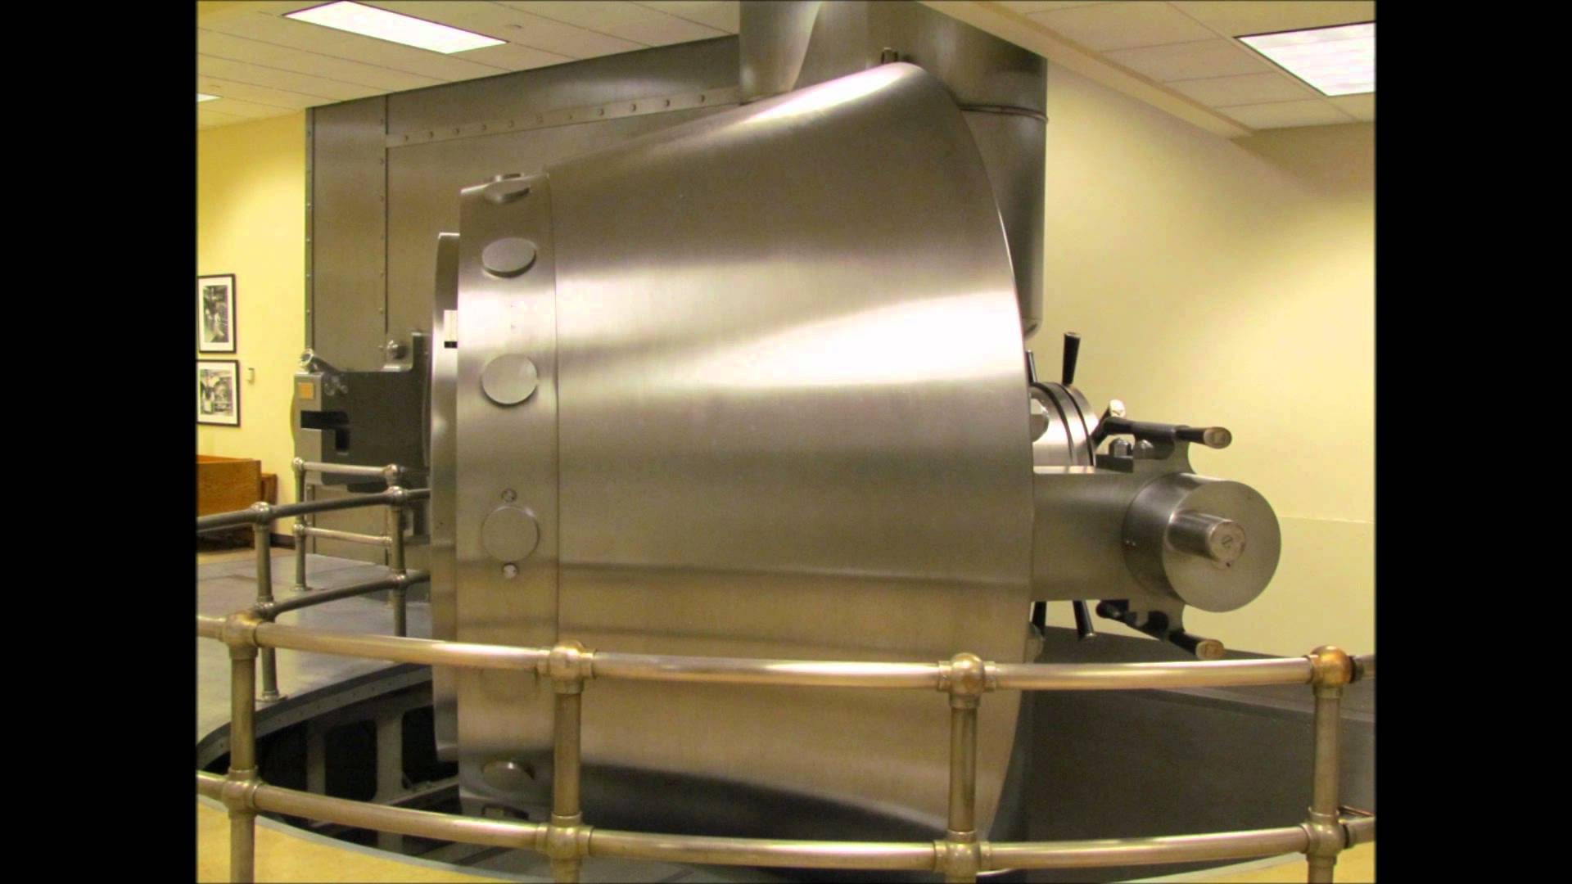
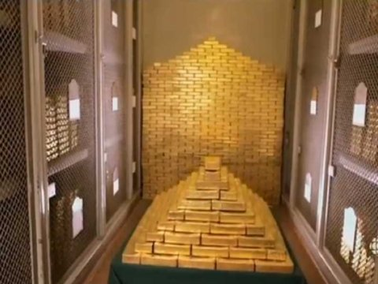
Return to Policy in a moment………
Pictures of Gold vault at NY Fed:

Slide 47
Amount of Gold
7400 Tons in 2012
14.8 million pounds
236.8 million ounces
$284 billion at $1200 per ounce
Owned mostly by foreign countries
Official transactions in gold are carried out by moving the bars around within the vault
Avoids any security concerns

Slide 48
Foreign Currency Room
New York Federal Reserve is responsible for maintaining the stability of the dollar
Does not (normally) try to move the dollar in a direction it does not want to go
Instead, smooths out movements to prevent instability
AND, responds to crises

Slide 49
Policy Tools of the Fed
How the Federal Reserve creates money
Can inject it into the system buy buying assets (U.S. bonds)
Can inject it directly into the banking system by changing the amount of reserves banks must hold
Can encourage banks to lend by offering cheap financing through the “discount window”

Slide 50
The first (known as Open Market Operations) is by far the most common
Conducted on a daily basis
Great tool for making small to moderate adjustments to the money supply
Returning to the creation of money detailed in the first presentation:
Fed buys $1 million worth of bonds – money multiplier takes care of the rest
Note that other two tools impact ALL banks – may be too much medicine

Slide 51
Result of a Purchase of Bonds is more Money in System
More money = more lending
Economy should start to recover
Usually has worked fine (badly applied during Great Depression)
Did not work well in 2008
Current policy is still too “loose” for many people – interest rates near zero for seven years

Slide 52
Controversies
Size of monetary stimulus post-2008
Independent nature of agency
Does not answer to congress, except when Janet Yellen testifies several times a year
Seems undemocratic
Results in calls to “audit the Fed”
Not sure members of Congress are the right people to do this ☺.

Slide 53
Examples of Important Monetary Interventions (or Non-interventions)
1907: No Central Bank
System-wide banking crisis results in bank runs
Large New York banks were acting an unofficial overseers of the system
Declared a Bank Holiday and closed banks that were subject to runs
Gradually reopened the system after crisis past – public was furious

Slide 54
1913: Federal Reserve is created
Major mission was to prevent bank holidays
Also assumed role as monetary authority and supervisor of banking system
1923: Discovered open market operations by accident
Sold some government bonds that were brought during WW1
Money supply promptly dropped

Slide 55
Actions During Great Depression
Sat on sidelines
Allowed thousands of banks to fail – particularly in 1931
Fed was supposed to be lender of last resort
Accelerated Great Depression
Video of Federal Reserve “preventing” a bank run
In end, Roosevelt had to declare a bank holiday – complete fail of Fed’s primary mission
Result was additional safeguards
Deposit insurance, etc.

Slide 56
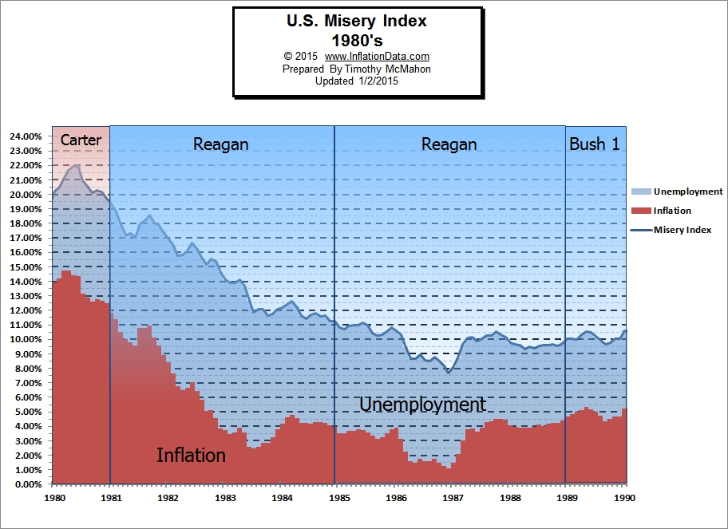
The Great Recession of 1982
Caused by Federal Reserve (under Paul Volker)
Graph of U.S. inflation & unemployment

Slide 57
Volker’s Intentions……
Wring inflation out of economy before it became endemic (as in Latin America)
And, could not control interest rates anymore – higher inflation meant higher interest rates
Had to eliminate inflation to regain control of economy
Deep recession in 1982
Broad successful high-growth recovery in 1983

Slide 58
Graph of Recession

Slide 59
Federal Reserve criticized for actions
Deep recession damaged some industries badly (consumer electronics)
Last time Federal Reserve aggressively intervened until 2008

Slide 60
Reasons
1991 Recession short and shallow
Peak of 7.8% unemployment
Recovery was robust
2001 Recession was not a recession……..
2nd quarter 2001-1st quarter 2002: 2.3% growth, -1.1% growth, 2.1% growth and -1.3% growth
Does not fit definition of recession

Slide 61
Week 4: The International Arena – Gold, The Dollar Standard and the International Monetary System
Cover:
The current monetary system and the role of the dollar
Central banking around the world
The role still played by gold
The IMF and what is left of the Bretton-Woods system

Slide 62
Dollar’s Key Role has Returned
Introduction of the euro was supposed to less reliance on U.S. $
Unending crises have led to diminished use of € as a reserve currency
Despite our loose monetary and fiscal policy
Run-up of debt initially damaged the dollar, but now there is no alternative

Slide 63
Other Reserve Currencies
In addition to dollar and euro:
British Pound, Swiss Franc, Canadian Dollar, Japanese Yen, Canadian Dollar
Australian Dollar also sometimes used
Diminished stature of dollar has caused some countries to use barter to avoid the use of any currency
China and Australia

Slide 65
And, a pseudo-currency…..
IMF “funny money”
Called Special Drawing Rights (SDRs)
Integral part of carrying out IMF policies
Exchangeable into other currencies, but not a medium of exchange
Abandonment of dollar (if that ever happens) might lead to much greater use of SDRs

Slide 66
Why do we Need a Reserve Currency?
Provides a means of setting relative values between currencies
“Value” of Thai Bhat or Malaysian Ringgit has no meaning if it isn’t stated against something else
Trade cannot be conducted in non-reserve currencies
Malaysia does not want Bhat. Contracts generally written in dollars in the Pacific Rim
Euros in North Africa

Slide 67
Central Banking Around the World
Most important counter-part to the Federal Reserve is the ECB
Central bank for the 17 nations that use the euro
Has many of the same functions of the Fed
Bank of England is also a typical central bank
China?

Slide 68
People’s Bank of China
Central bank is similar to Fed
Has 9 branches
Responsible for bank supervision and monetary policy
Problem:
Pegged currency undermines monetary policy
Central bank focuses on maintaining peg, and that overrides domestic policy
Part of so-called “holy trinity” of policy

Slide 69
Ideally, the Following 3 Circumstances Exist
Currency values are stable
Monetary policy is independent
Capital is free to flow into a country

Slide 70
But, Can only get 2 out of 3
By choosing to manipulate its currency, China loses a good deal of control over monetary policy
Central bank is focused on maintaining a value of the Yuan, not domestic policy
A problem for all nations that maintain pegs of some kind
Whether pegged, crawling peg, pegged to a basket (China), or currency board

Slide 71
Case Study: Argentina 1992-2001
Inflation at 5,000% in 1991
In desperation, set up currency board (peso pegged 1:1)
Could not issue any new pesos unless a dollar was obtained:
Export $100 worth of goods ->Payment equals inflow of $100->Issue 100 pesos into domestic economy
Money supply entirely determined by currency inflow – no control
Inflation dropped to 15% in first year

Slide 72
Problem……
Once economic times got tough (2000), could not use monetary policy
Exited currency board in 2001
Ecuador took different route – simply adopted U.S. $ as legal tender (2000)
Federal Reserve runs their monetary policy
Eliminated inflation
Ecuador is now talking about exiting system

Slide 73
Leads into Discussion of “Currency Regimes”
After 1973 (abandonment of dollar standard), a number of regimes have been tried:
Fixed (to dollar or other reserve currency)
Pegged within a band
Crawling Peg
Soft (non-credible) peg
Pegged to a basket – system currently used by China
Freely floating
All have potential problems – search continues for the ideal system

Slide 74
Case Study: The ecu
European Currency Unit
Developed in late 1970s in response to high currency variability after the end of the dollar standard
Created new “funny money” that was not a real currency
Could be deposited, and bonds could be written in ecu
Partially gold-backed
All European currencies were then pegged to the ecu, indirectly pegging them against each other

Slide 75
FF DM BF
B₤ IL DG
ecu

Slide 76
Narrow movement (+/- 2.5%) allowed, otherwise fixed
ecu became precursor to the euro
Near invisibility of ecu made retaining name impractical
Before its replacement, had become an important part of bond market
Also helped form basis of euromoney market

Slide 77
Euromoney Market
Example of how central bank control is weakened
Can make deposits in any hard currency, including dollars
Undercuts role of the Fed
Reserve Ratio is 0% - technically, an infinite amount of money will be created from any small deposit
Restrained by requirements of Basel Accords
Still worrisome to Federal Reserve

Slide 78
Does Gold Still Play any Role?
Sometimes used to settle official accounts
Country on country transactions
Not used as a currency, although may be used as a means of shoring up a poor financial situation
Nation using gold holdings as a means of working against a decline in its currency or an undesirable outflow of assets
No real means of returning to a gold standard
Not enough physical gold to support

Slide 80
Thank You!

