Slide 1
EC 12 - Macroeconomics
Current Economic Conditions

Slide 2
Macroeconomics Versus Microeconomics
Macro is economy-wide
  Gross Domestic Product, inflation, unemployment, interest rates, housing, etc.
  Principle focus is on inflation and unemployment (the twin macroeconomic problems)
    Related to business cycles
  Also concerns about economic growth (a long-term issue)
    What determines rate of growth in U.S. and other economies

Slide 3
Pre-Pandemic and Post-Lockdown
Best U.S. economy since the 1960s
  Unemployment at 3.6%, inflation at 2%
  GDP growth -> 3%
  Federal Funds Rate = 2%
Post-Lockdown
  Unemployment rose to 14% (now at about 7%, but starting to rise again)
  Inflation at or near zero
  Federal Funds rate at 0.25%

Slide 4
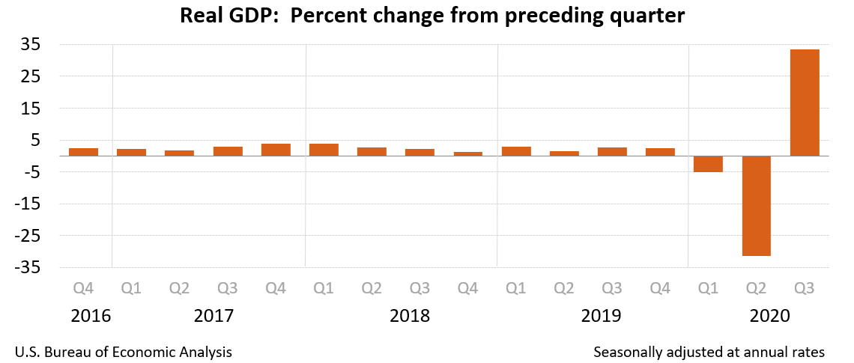
Graphically from Bureau of Economic Analysis

Slide 5
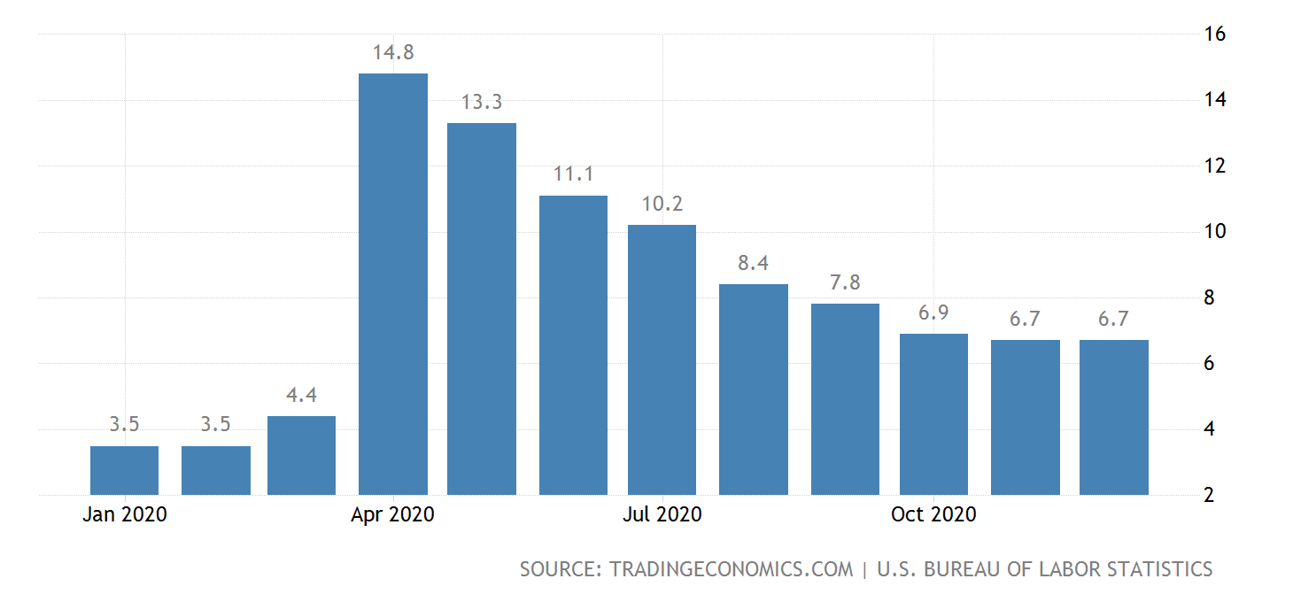
Unemployment

Slide 6
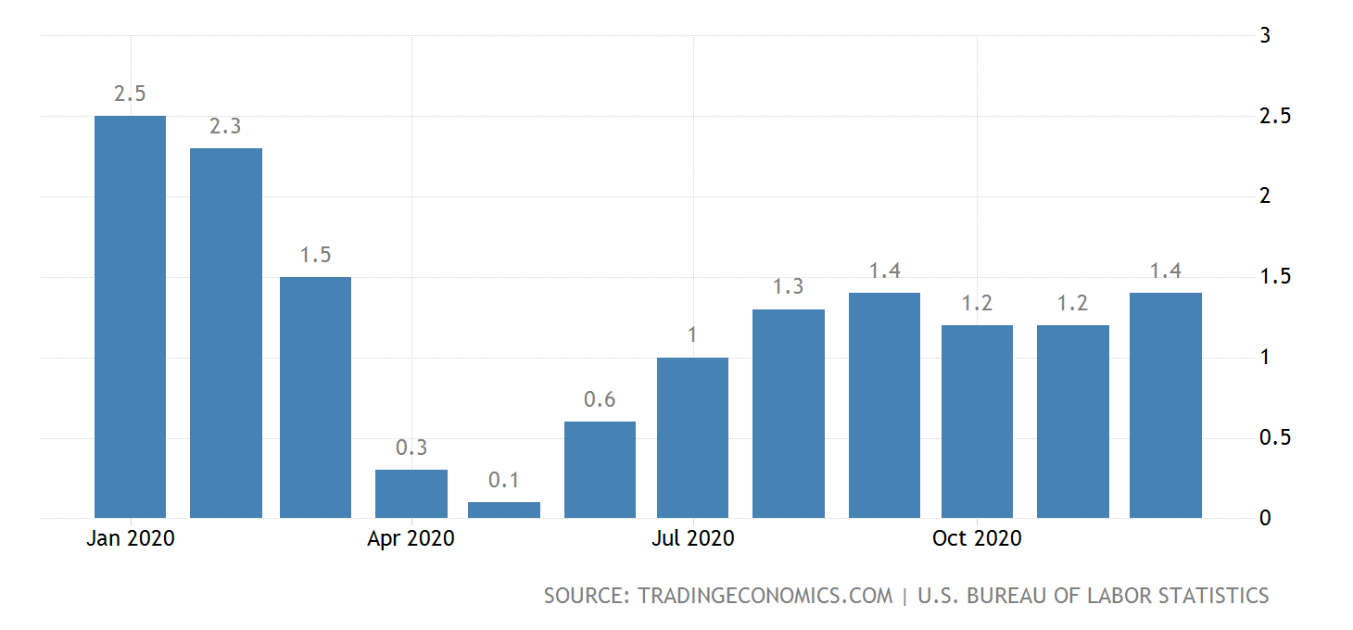
Inflation Rate – Bureau of Labor Statistics

Slide 7
Trade and Financial Markets
Trade deficit was declining, now on the rise again
  $600 billion per year, mostly due to China
Federal deficit out of control -> Trillions per year into the foreseeable future
  May cripple use of fiscal policy later on -> debt too high to run deficits
Stock market continues on its inexplicable upward path->
  Mostly due to an absence of any other way to make money (interest rates near zero)

Slide 8
Strange and Permanent Changes in the U.S. Economy from Pandemic
De-urbanization – Massive failures in the commercial real estate business
Abandonment of public transport
Destruction of large segment of restaurant business
  Particularly in states with hard lockdowns
Massive failures in higher education (don’t worry, Fairfield isn’t in trouble)
  Forbes article – “Dawn of the Dead”
Some business models nonviable -> building maintenance, clothing stores
Remote work and isolation

Slide 9
Economist Joseph Schumpeter called capitalism “creative destruction”
  Pandemic has brought about changes that would have taken years or decades
  Impact on economic growth unknown
  Short-time impact likely to be negative, unless lockdowns are eased

Slide 10
Unemployment v. Inflation
Unemployment (currently 6.7%)
  3 types
    Frictional – Job Change unemployment
    Structural – No skills or outdated skills
    Cyclical – Business cycle unemployment
  Inflation
    Types
    Measurement
      Fixed Market Basket
    Price Index
    GDP Deflator

Slide 11
Inflation
Measurement
  Fixed Market Basket
  Example:
  Year 1 EXP Year 2 EXP
    2 gallons of milk $3.40 6.80 $3.80 7.60
    2 lbs. of apples $1.80 3.60 $2.00 4.00
    1 loaf of bread $2.40 2.40 $2.20 2.20
    Total 12.80 13.80
    Inflation Rate = (13.80-12.80)/12.8 = 7.8%

Slide 12
Other Measures of Inflation
Price Index
GDP Deflator
Types of Inflation
  Cost-push
  Demand-pull
Who wins and loses

Slide 13
Circular Flow
  Representation of income and expenditures in an economy
  Foundation for two methods of calculating GDP

Slide 14
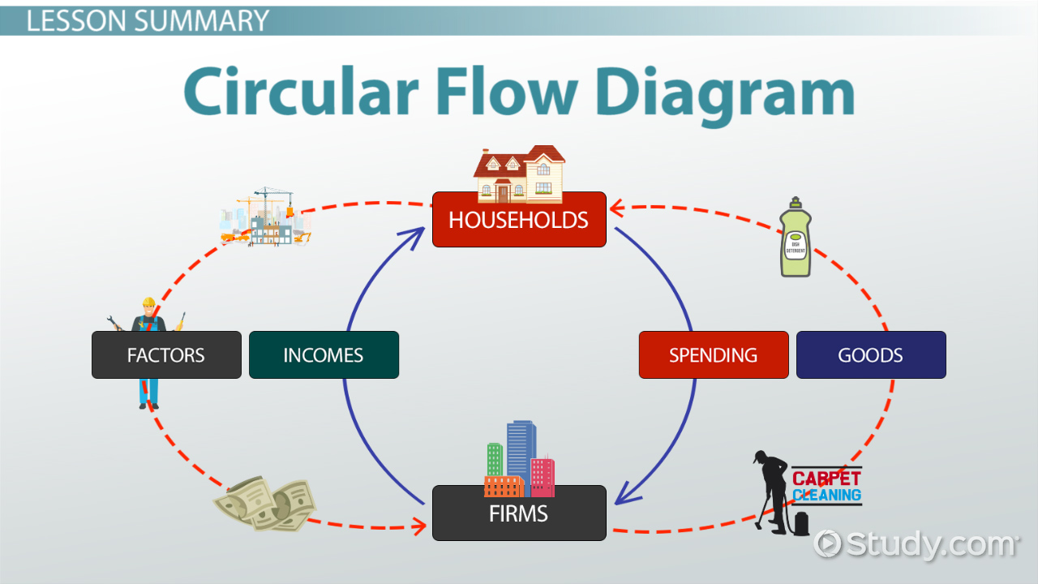
GDP Accounting
Circular Flow

Slide 15
Expenditure Approach
  Consumption
  Investment
  Government Spending
  Net Exports

Slide 16
Income Approach
Wages and Salaries
Proprietors’ Income
Interest Income
Rental Income
Corporate Profits
=National Income

Slide 17
National Income
  +Indirect Business Taxes
  =Net National Product
NNP
  +Depreciation
  =GDP

Slide 18
Errors
Self-produced goods
Barter
Underground economy

Slide 19
Measure of Welfare?
Key exceptions
  Leisure
  Externalities

Slide 20
Business Cycles
Diagram
Theories:
  Sunspots
  Keynes – Durable Goods Cycle
  Consumer Sentiment
  Long-run:
    Schumpeter – waves of innovation
    Malthus – Resource constraints
    Marx

Slide 21
Macroeconomics – Range of Viewpoints
Marxian Socialism Mixed Economy Free Market Libertarianism

Slide 22
Debate….Keynes v. Hayek
https://www.bing.com/videos/search?q=keynes+v.+hayek+second+round&view=detail&mid=0E3266689796E9D7ACDF0E3266689796E9D7ACDF&FORM=V

Slide 23
Current Economic Conditions
Unemployment report – only 49,000 jobs created in January
  200,000 is minimum to maintain unemployment #s
  -10,000 in manufacturing sector
    Unemployment rate DROPPED to 6.3%, which means a rise in discouraged workers
  Service and travel sectors will only come back when lockdowns are over
    Talking about return to “normal” about a year from now

Slide 24
Onset of the Great Depression
Crash of 1929
Dustbowl
Banking Crisis of 1931
Smoot-Hawley (1932)

Slide 25
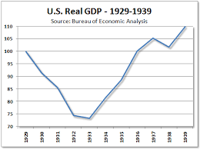
FDR Administration Response
WPA
Income stabilization schemes (Social Security 1935)
GDP recovered, but slowly

Slide 26
Great Depression Ended with Lend-Lease in 1939/1940
No Theoretical Basis to Understand Failed Economy
John Maynard Keynes (British Economist) proposes use of government spending to offset recessions
  Argues that, at low levels of income, demand determines output (versus Jean-Baptiste Say)
  As an aside, “invented” macroeconomics

Slide 27
Basic Framework of Keynsian Economics
Used C+I+G+(X-M)
  Primary focus is on consumption
  Keynes divided consumption into autonomous and induced
    Graphically

Slide 28
Uses C+I+G
Ignore export sector until later
Consumption graph

Slide 30
Define Marginals and Averages of Consumption and Savings
Ave. Propensity to Consume = C/Y
Ave. Propensity to Save = S/Y
Marginal Propensity to Consume = ∆C/∆Y Y = income
Marginal Propensity to Save = ∆S/∆Y

Slide 31
Numerically………………
Disp. Y C S APC APS MPC MPS
0 200 -200 ----- ----- ----- ------
500 650 -150 1.3 -0.3 0.9 0.1
1000 1100 -100 1.1 -0.1 ↓ ↓
1500 1550 - 50 1.03 -0.03
2000 2000 0 1.00 0
2500 2450 50 0.98 0.02

Slide 32
Employment GDP C I Agg. Exp. Inventories S
500,000 100 115 5 120 -20 -15
600,000 150 155 5 160 -10 -5
700,000 200 195 5 200 0 5
800,000 250 235 5 240 10 10
900,000 300 275 5 280 20 20

Slide 33
Equilibrium in Private Economy
Y = C + I
Y-C = I –or-- S = I
Graphs
  S= I
  Y = AE

Slide 34
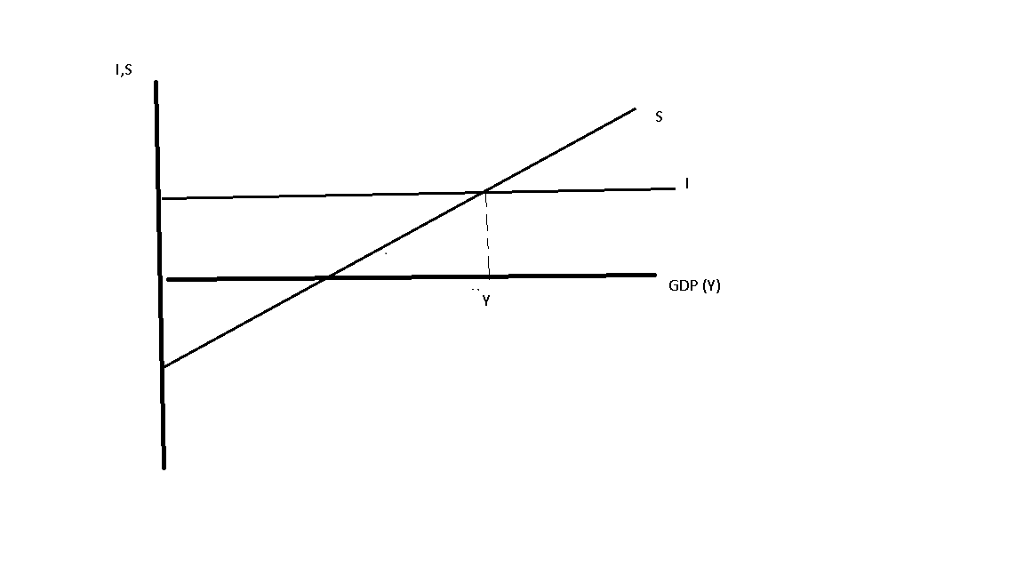

Slide 35
Completed Keysian Model
Income | Consumption | Investment | Govt Spending | Aggregate Expend | Savings
0 | 100 | 50 | 50 | 200 | -100
400 | 400 |  |  | 500 | 0
800 | 700 |  |  | 800* | 100
1200 | 1000 |  |  | 1100 | 200
1600 | 1300 |  |  | 1400 | 300

Slide 36
Basic Keynsian Policy
GDP gap = Potential GDP – Actual GDP
Required ∆GDP = multiplier *∆G (or ∆T)
  In above, if full employment was $1200
  Gap = 1200-800 = 400
  400 = 1/(1-mpc) * ∆G
    400 = 1/.25 * ∆G -> ∆G = 100

Slide 37
Other Related Issues
Automatic Stabilizers – Unemployment Compensation, Corporate Taxes, Social Security
Criticisms of Keynsian Policy
  Crowding out
  Lags
    Recognition (must know economy is in recession)
    Policy (have to design a policy to address recession)
    Implementation (putting policy in place can take months)
  A new issue has arisen – Govt spending generally targeted at infrastructure
    In post-Covid world, need for roads, trains, bridges way down.

Slide 38
Introduction to Money
Reasons for Holding Money
  Medium of Exchange, Store of Value, Measure of Relative Value
History of Money
  Gold standard -> Fiat Money
Current Definitions of Money (M1 v. M2)
  M1 = currency + demand deposits
  M2 = M1 + savings accounts + small CDs + MMMFs + MMDA + euromoney +…..

Slide 39
Money Creation
Role of Banks and Federal Reserve
Asset-Liability Sheets
Example with $1000 deposit and an RRR of 10%
Assets Liabilities Assets Liabilities Assets Liabilities
R100 DD 1000 R 90 DD 900 R 81 DD 810
L900 L810 L729

Slide 40
Total change in Money Supply =
  1/(reserve ratio) * Initial change = 10*1000 = 10,000
As reserve ratio ↑, multiplier smaller
  Federal Reserve intervention must be greater

Slide 41
Quantity Theory of Money
Very old relationship-> Money supply multiplied by the # of times each dollar spent = total spending
  MV = PY
    Tautology (must be true)
  Debate about quantity theory has been around since early 1700s
  Since relationship must hold, argument is about velocity

Slide 42
Initial Basis of Monetary Policy
Money Supply * Velocity = the Price level * Real GDP
  MV=PY
  As noted, velocity is the number of times each $ spent
Classical version: V fixed and GDP fixed
  Increases in money supply = rising prices only
  No means of managing business cycle
Modern Monetarist:
  Velocity predictable – Known impact on P*Y

Slide 43
M1 Velocity
Fed abandoned M1 as a target due to instability
  Particularly during “financial innovation” in the 1980s
Now uses M2 – was stable for a very long time
  Collapsed in Great Recession and still has not recovered\
  Explains the response to the Great Recession and QE1, QE2 and QE3.
    History of intervention (QE1 was November 2008), QE2 was November 2010, QE3 was September 2012

Slide 44
Keynes argued velocity unstable
  Moves in opposite direction of money supply
  Negates Federal Reserve intervention
Hence, rejection of monetary policy as a tool

Slide 45
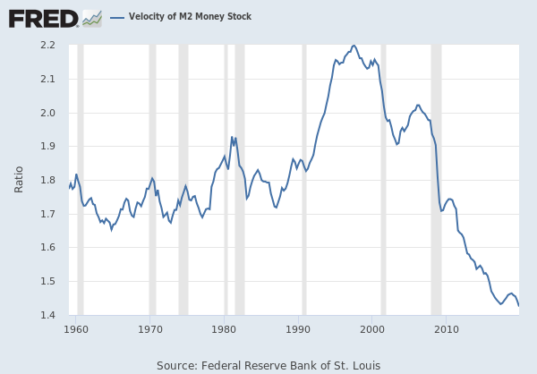
M2 Velocity – Note Collapse After Great Recession

Slide 46
End Result…..
Massive rise in T-bond holdings by Federal Reserve
  Still exceeds $5 trillion
  Attempts to push onto open market will raise interest rates
    Global recovery still viewed as too weak
Does this mean monetary policy does not work?
  During economic crises, the intervention must be much larger as V↓

Slide 47
Federal Reserve Policy and the Money Supply
Federal reserve can move money supply in 3 ways:
  Open-market operations -> Buying & selling of bonds
    Purchase bonds -> money supply up
    Sell bonds -> money supply down
  Reserve Policy
    Federal Reserve sets amount that banks MUST keep as reserves (vault cash and on deposit at the Fed)
    Raise RR -> Less lending occurs and money supply drops
    Drop RR -> More money available and Ms rises
    Reserve policy almost never used….too powerful

Slide 48
Third Policy ->
Discount Policy
  Member banks can borrow from the Fed at the discount rate
  If low, encourages borrowing and lending
  If high, banks restrain lending to avoid borrowing
  Problem -> tied up with issue of bank solvency – rarely used as a money supply tool
    Example -> Bank of New York near collapse

Slide 49
Type of Money Demand (as opposed to supply)
Money held for transactions purposes
  Related to income (car payment higher with more expensive car, etc.)
Speculative demand – Money and bonds are substitutes
  At low interest rates (r), hold money
  At high interest rates hold bonds
  Note that changing interest rates change bond prices and increase exposure

Slide 50
Leads to debate about slope of money demand curve (versus r).
  If not responsive to interest rates – vertical Md
  If responsive, horizontal
    Determines whether policy works

Slide 51
Graphically - Monetary Transmission Mechanism

Slide 52
Example (When Monetary Policy Works)

Slide 53
If, Md vertical and investment demand relatively flat, a change in the money supply has big impacts
If Md flat, and investment demand more vertical, little change from raising or lowering Ms.

Slide 54
Aggregate Supply/Aggregate Demand
EC 12 Macroeconomics

Slide 55
Different from supply and demand
  In price versus real gdp space
AD: P↑ -> Money supply (real)↓->Lower Real GDP
AD: P↑ -> Real wage ↓ ->
Employment ↑ -> GDP (real)↑

Slide 56
Graphically

Slide 57
Examples of Movements
Government spending ↑
Money Supply ↑
Price of Oil ↑
  Description of 1970s
Wage-Price Freeze
Supply-Side Policies

Slide 58
Natural Rate Theory
Friedman
Long-run real GDP fixed
  Policy impacts temporary
  Graphically -> in long-run, price level higher, but back to same real GDP
  Strong critique of policy

Slide 59
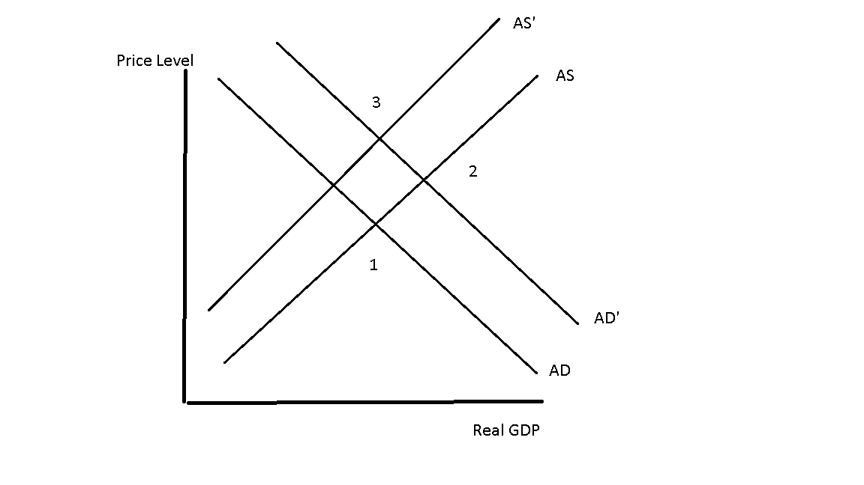
GRAPH

Slide 60
Criticisms of Monetarism
Poor application
Lags
  Recognition
  Policy – Near zero
  Implementation – Near zero
  Effectiveness – Key issue – takes time for people and businesses to respond to new environment

Slide 61
Rational Expectations
Keynsian assumptions about labor
  “ignorant” – labor focused on securing countervailing power
Shift in modern economy
  Labor becomes “rational” -> as informed as management
Lucas (1977) argues Keynsian argument is false
  At least during periods of high inflation

Slide 62
Labor Markets – Reaction of Workers and Employers
Keynes assumed workers were “ignorant”
  Ill-informed (not stupid)
  In early industrialization, mass of assembly line workers – lunchtime talk was not about federal reserve policy
  If workers NOT fooled, policy will not work
    Push for higher wages will offset expansionary effect
    Result will be inflation only, no impact on output
  Graphically

Slide 63
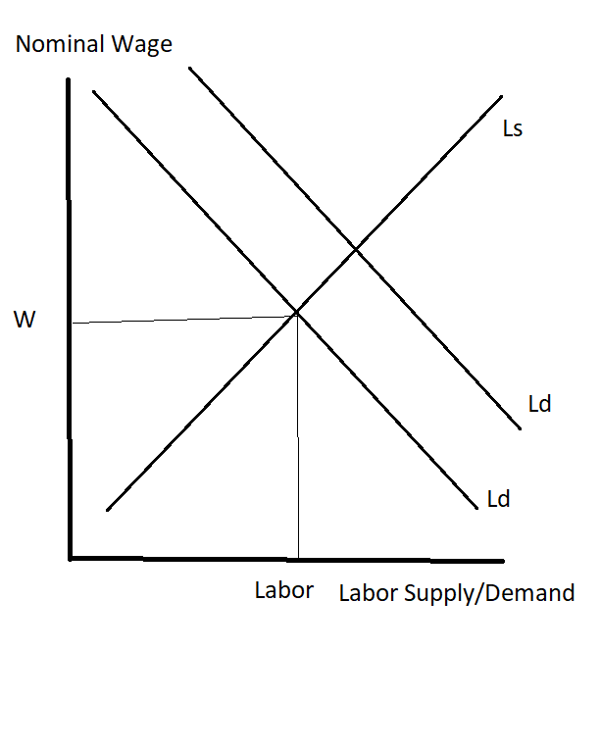

Slide 64
Explanation
Fed raises the supply of money -> Produces a rise in the price level and a fall in the real wage (W/P)
  Workers (not aware of what is happening) do not respond
Real wage falls -> employment rises and policy works
  Workers may eventually realize that the nominal wage increase they received doesn’t seem to buy very much
  By then policy has had impact

Slide 65
Modern Labor Market
Workers generally as knowledgeable as management
  No one would ever go into a meeting on wages without knowing the CPI
  Labor also ended up putting inflation directly into contracts (COLAs)
  The Keynsian idea that workers fooled in a HIGH-INFLATION environment seems silly

Slide 66
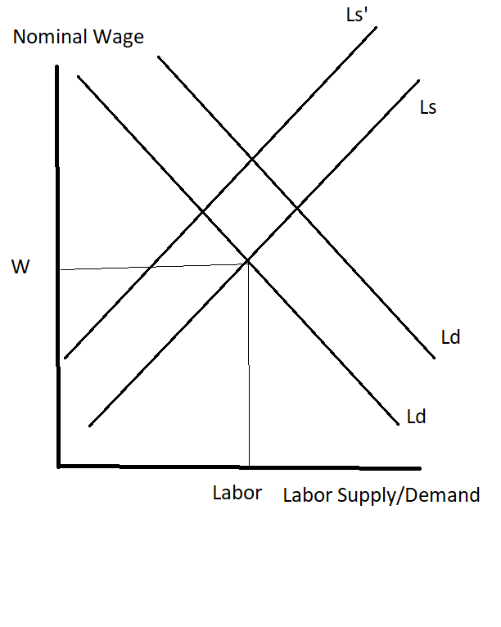
Now graph looks like this…….

Slide 67
Lucas Supply Function
Y = Y(LR) + Ƴ (P – Pexp)
  Output = long-run output + a multiple of the difference between prices and expected prices
  If workers fully rational, P = Pexp
Policy will have no impact, even in the short-run
RE tested well empirically in 1970s
  Not applicable to long inflation environment, so would not expect to work well right now
Exceptions
  Long-term contracts
  Monetary “surprises”

Slide 68
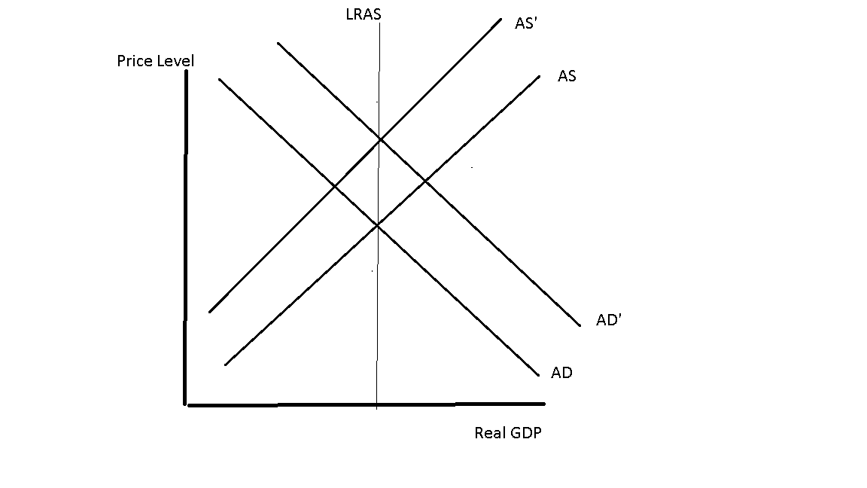
Graphically – Move straight up LRAS curve

Slide 69
EC 12 – Phillips Curves
Expression of Unemployment/Inflation Tradeoff

Slide 70
Graphing of Unemployment v. Inflation
Presumed downward shape

Slide 71
Menu of Points
Policy used to attain point that is wanted
  Kennedy Administration and Kennedy Tax Cut
Curve became scatter plot post-1968
  Use of policy ineffective
  Increase in government spending missed target, producing less of a reduction in unemployment and a greater increase in inflation

Slide 72
Explanations
Monetarist
  Natural Rate Theory -> Impact temporary
  In long-run, end up on new curve, with same unemployment
Rational Expectations
  Policy producers no impacts – no longer a down-sloping relationship
Supply-Side Shock (e.g. Price of oil↑)
  Rise in cost of inputs lead to back shift of AS
  Real GDP ↓, but inflation ↑

Slide 73
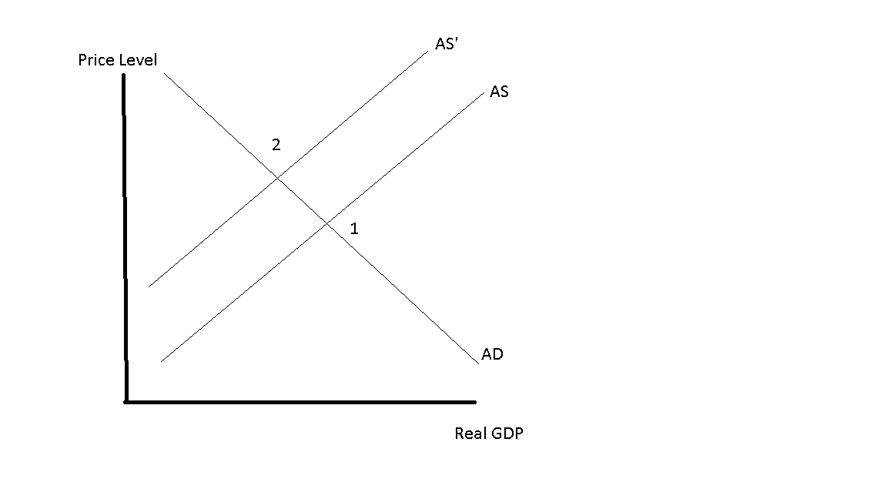
Graphically

Slide 74
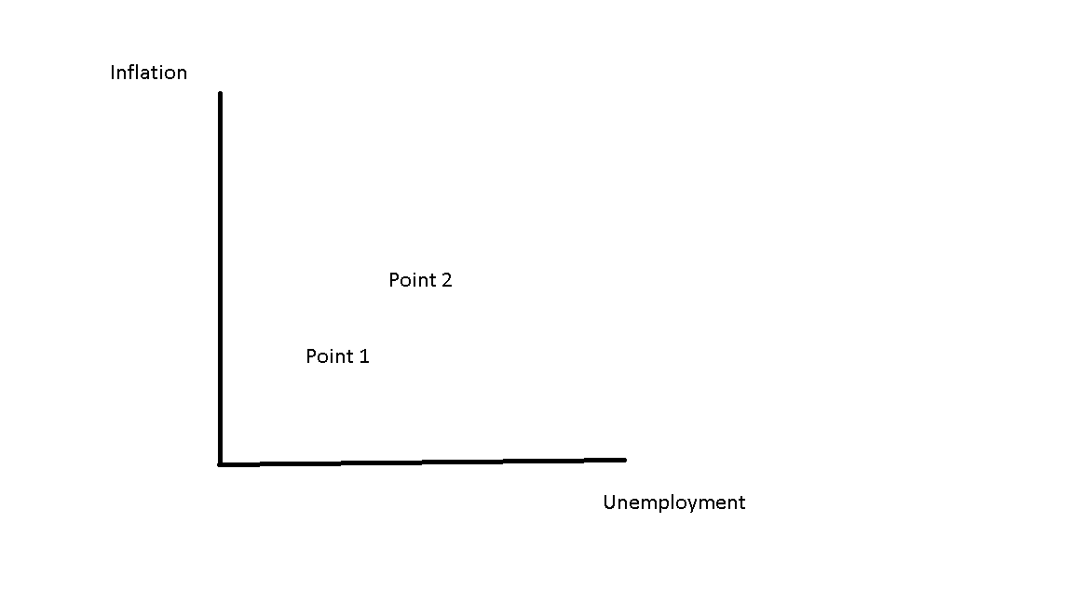

Slide 75
Role of Expectations
Curve may be shifting as policy is implemented
  If people expect higher inflation, it may be self-fulfilling
  Curve may shift outwards as a result

Slide 76
Final Topic – Growth Theory
Economic Growth -> Long-term path of real GDP
  For U.S., used to average 3-3.5%
  Rule of 72 -> 72 divided by growth rate = number of years to doubling
    At 3% growth, economy doubles in size every 24 years
  Growth rate has fallen to 2-2.5%, standard of living not rising as fast

Slide 77
Factors that Influence Growth
Inputs -> capital, labor, raw materials
  Add technology, human capital, etc.
Y = F(K, L, Raw Materials, Technology, Hum. Capital)
  All have a positive impact on output

