Slide 1
EC 11 - Microeconomics
Fall 2021

Slide 2
First Week
Production Possibilities
Supply and Demand
Watch videos on web page:
  www.faculty.Fairfield.edu/mleclair
Powerpoint slides also on Webpage

Slide 3
Production Possibilities
Conveys
  Trade-offs between production of two goods
  Opportunity cost – Amount given up of one good to get more of other
  Diminishing Returns - Closer to axes, the amount that is surrendered rises (misapplication of resources)
Points on graph are efficient
  Points inside PPC are inefficient – not full use of resources

Slide 4
Textiles Versus Food

Slide 5
Shifts in Graph/Points Inside or Outside
Shifts
  Change in resources – Shifts graph symmetrically
  Change in Technology – Shift is asymmetric
Points inside
  Underutilization
Points outside
  Unattainable, except through trade with other countries

Slide 6
Examples
Now v. Later
  Japan in the 1970s and 1980s – High savings rate
Medical Care v. All Other Goods
Example – Shifts in the PPC
  Wheat v. Timber
    New hybrid wheat
    Selling off part of land
    Letting land lie fallow (unused)
    Decision to grow more wheat and produce less timber

Slide 7
Methods of Deciding What to Produce
Market
Government – Socialism -> Government ownership of means of production
Mixed – Government regulations and interventions in markets

Slide 8
Introduction of Supply and Demand
Law of Demand - P↑→Q↓
  Limits of slope
Example – Demand for Pizza
Shifts
  Consumer Tastes
  Income
  Prices of Related Goods
  Taxes/Subsidies
  Number of Buyers

Slide 10
Supply -
Law of Supply - P↑→Q↑
  Limits of slope
Shifts in Supply
  Change in Resource Costs
  Change in Technology
  Taxes/Subsidies
  Number of Sellers

Slide 11
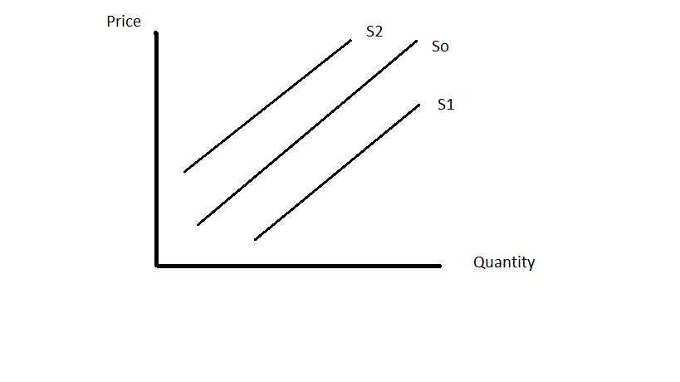

Slide 12
Equilibrium

Slide 13
Interference in Markets (Direct)
Price Controls
  Ceilings – Price is held below equilibrium by government mandate
    Example – rent control
  Floors – Price is held above equilibrium by mandate
    Example – Agricultural price supports

Slide 14
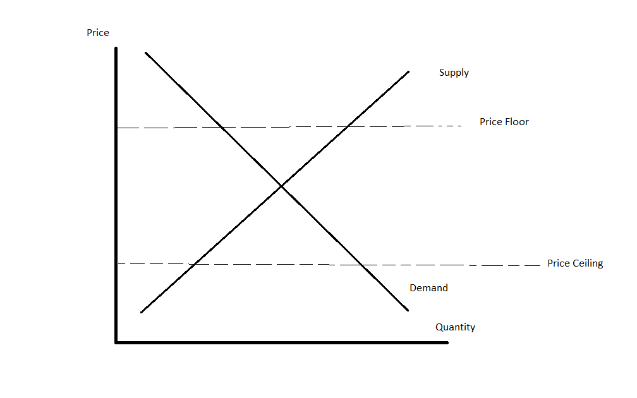

Slide 15


Examples
Demand and Supply of Owned Housing
  Rise in the cost of construction (S back)
  Increase in income (D↑)
  A price ceiling on housing to increase affordability
  A rise in the cost of renting (D↑)
Demand and Supply of Pizza
  Cost of alternative fast food rises (Subway) (D↑)
  Cost of cheese goes up (S back)
  A price floor is placed on pizza
  A decrease in the population (D↓)

Slide 16
Extended Example - Single-Payer Healthcare
Perceived problems with U.S. system
  Hodgepodge of services (Medicare, Medicaid, private insurance, free care at nonprofit hospitals
    Cumbersome
  Expensive – 18% of GDP
  47 million without insurance – Not true, but this was number thrown around in 2010 (see Mankiw, Beyond those Healthcare Numbers, New York Times (https://www.nytimes.com/2007/11/04/business/04view.html)
ACA provisions
  Mandatory health insurance
  Standardization of plans
  Taxation of Cadillac plans

Slide 17
Alternative Systems
UK, Canada
Rationing done through wait times rather than expense
  Humans wait 5 months for an MRI in Canada
  Dogs can get them in 24 hours
Markets in Everything – Canadian Healthcare
  Explains how Canadians flee system to U.S. to avoid delays
https://mjperry.blogspot.com/2010/03/markets-in-everything-market-based.html

Slide 18
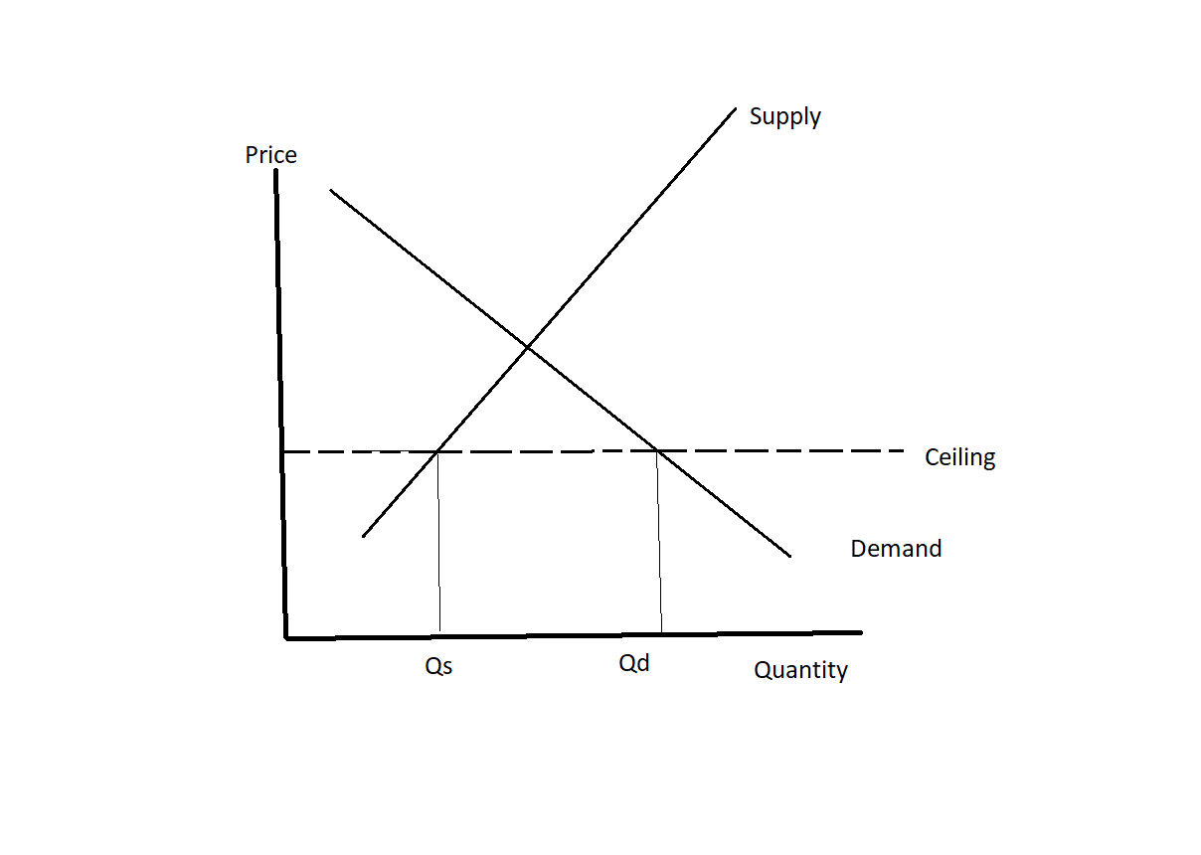
Graph

Slide 19
Most of progress under ACA was expansion of Medicaid
  Poorly serves patients – wait times are long
Broad dissatisfaction with ACA – was being dismantled piece by piece by Trump Administration
Nearly all Democrats who ran for the presidency endorsed single payer (Medicare for All)
  Unlikely to be any different than programs in the UK or Canada:
    Lower cost, no fee at service point
    Very long wait for care (referrals are, on average 5 months), which impacts outcomes
  Philosophical question: If Canadians come to the U.S. to avoid lines, where do we go if we nationalize healthcare?

Slide 20
Elasticities
Measures responsiveness of one variable to another
Demand → %change in Qd/% change in price
  Data:
  Price Quantity
  ------ -----------
  5.00 50
  6.00 40
  7.00 30

Slide 21
Calculation…..
Point elasticity:
  (Q2 – Q1)/Q1
  -----------------
  (P2 – P1)/P1
  Or………... (40-50)/40
  -------------- = (-1/4)/(1/5) = -5/4
  (6-5)/5
  Redo with points 1 and 2 reversed (ϵ = (1/5)/(-1/6) = -6/5

Slide 22
Point elasticities sensitive to which is point 1 and 2
  Replace with ARC elasticity
  ϵ = (Q2 – Q1)/(Q2 + Q1)/2
  ------------------------------
  (P2 – P1)/(P2+P1)/2
  = (-10/45)/1/5.5 = -55/45 = -11/9
Note: All demand elasticities are negative due to the law of demand

Slide 23
Types of Elasticities
Demand
Income: %change in Q/% change in Income
Cross-Price: %change in Qx/% change in Py

Slide 24
Examples…………………
Price (drop negative sign – know all are negative)
  If ϵ = 0 perfectly inelastic, some forms of medical care
  0< ϵ < 1 inelastic
  ϵ = 1 unitary elastic
  ϵ > 1 elastic (responsive), goods with many substitutes

Slide 25
Income (don’t drop sign)
  ϵ < 0 income inferior good
  0 < ϵ < 1, normal good
  ϵ > 1, income superior
Cross-Price
  ϵ < 0, complementary
  ϵ > 0, substitute

Slide 26
Sample Problems
Calculate the following income elasticity. What type of good is this?
  Income Quantity
  ---------- -----------
  $2000 40
  $2500 60

Slide 27
Calculate the following cross-price elasticity:
Price of Y Quantity of X
------------ -----------------
$6.00 30
$7.00 25
What is the relationship between these two goods?

Slide 28
Actual Numbers…..
Price: Gasoline = 0.1 (short-term)
Beef = 0.92
Wheat = 0.08
Haddock = 2.20
Women’s Hats = 3.00
Cross-Price : Beef v. Pork = 0.28
Butter v. Margarine = 0.67
Natural Gas v. Fuel Oil = 0.44

Slide 29
Income Butter = 0.42
  Flour = -0.37
  Margarine = -0.20
  Restaurant Consumption = 1.48
  Dentists’ Services = 1.41

Slide 30
Tax Incidence
Back-shifting and forward-shifting
Graph at two extremes………………..

Slide 31
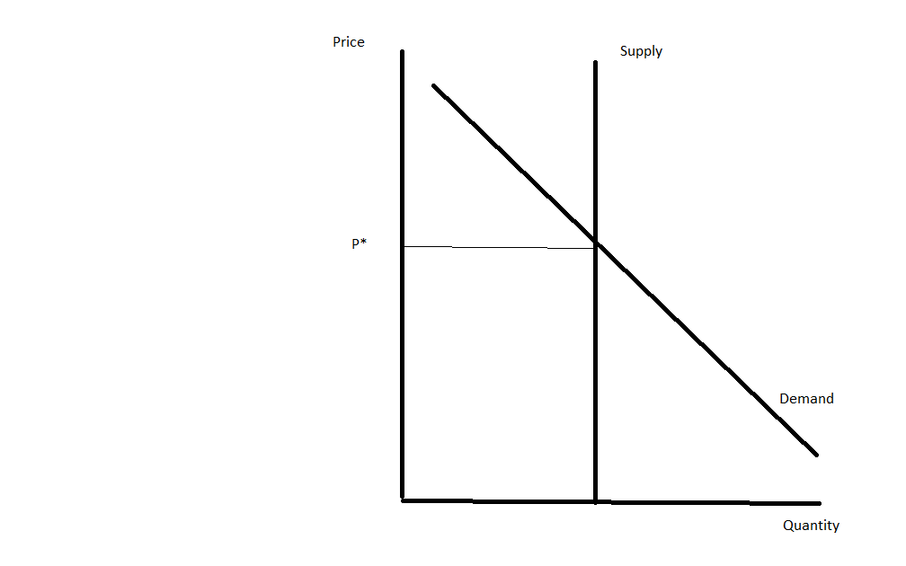

Slide 32
Scenario 2 – Inelastic Demand

Slide 33
EC 11 - Microeconomics
Fall 2020 – Consumer Utility

Slide 34
Meeting #5 – Consumer Utility (Satisfaction)
Consumers are assumed to maximize utility
How to measure the unmeasurable
Why utility per dollar is the concern, not utility
  Example:
    Can of tuna = $1.00 -> utility = 40
    Pound of Steak = $15.00 -> utility = 300
    Utility/$ higher for tuna, so buy tuna instead of steak
Marginal utility diminishes are Q goes up

Slide 35


Example – Coffee and Donuts
Quantity (C) Utility (C) Quantity (D) Utility(D)
0 0 0 0
1 20 1 80
2 35 2 140
3 45 3 180
4 50 4 200
5 50 5 200
Price of coffee = $1.00, Price of donut = $2.00, Budget = $7

Slide 36
EC 11 – Product Theory

Slide 37
Model of Firm
2 inputs – Labor and Capital to Produce an output
  Q = F(K, L)
  Could add other inputs, but amount used varies with K,L
  In short-turn, K fixed
    Firm decides how much labor to use

Slide 38
Observe two regions for a typical firm
  Change in Q/Change in L rising (specialization)
    Example
  Change in Q/Change in L falling (diminishing returns)
  Third region - Q↓ as L↑ can be justified theoretically, but not practically

Slide 39
Example…….
Labor Output
------- ----------
0 0
1 10
2 25
3 50
4 65
5 70
6 70

Slide 40
Calculate Average Product, Marginal Product for each Level of Output
Labor Output AP (Q/L) MP (ΔQ/ΔL)
------- ---------- -----------
0 0 -----
1 10 10 10
2 25 12.5 15
3 50 16.7 25
4 65 16.2 15
5 70 14 5
6 70 11.7 0

Slide 41
Graphically

Slide 42
Where Firm Produces
Region 1 – Gains to specialization, must exhaust these
Region 3 – Marginal Product is <0, Add labor, get reduced output
Therefor, must operate in Region 2
  If wages are high and prices are low, MP must be high, and firm operates at beginning of Region 2
  If wages are low, and prices are high, can operate at end of Region 2

Slide 43
Brief Introduction to Behavior of the Firm
Assumptions
  Firms profit-maximize
    This is what empirical data supports
  Firm faces two kinds of costs, fixed and variable
  Fixed costs are sunk costs, and are irrelevant to the choice of where to produce
  Firms face both gains to specialization and diminishing returns

Slide 44
Additionally…….
Economists address signaling problem of profits by dividing up costs into explicit and implicit costs
  No way of knowing if a certain level of profitability if “good” unless you compare it to something else
  Profits of firm in economics = Revenue – Explicit Costs – Implicit Costs
    Implicit Costs are what would be made in the next best industry
      If > 0, firm should remain where it is
      If < 0, firm should change industries

Slide 45
Introduction to Costs
Separate out fixed and variable costs
  Those that don’t vary with output and those that rise with output
  Once again, for simplicity, use labor as the sole variable input

Slide 46
Example (Let the cost of labor = $100/unit)
Labor Quantity Variable Costs Fixed Costs Total Costs
0 0 0 200 200
1 5 100 200 300
2 15 200 200 400
3 30 300 200 500
4 50 400 200 600
5 65 500 200 700
6 75 600 200 800
7 80 700 200 900
8 80 800 200 1000

Slide 47
Redefine Curves as Averages and Marginals
AFC = FC/Q
AVC = VC/Q
ATC = TC/Q
MC = ΔTC/ΔQ = ΔVC/ΔQ

Slide 48
Example (Let the cost of labor = $100/unit)
Quantity VC FC TC AVC ATC MC
0 0 200 200 ----- ----- -----
5 100 200 300 20 60 20
15 200 200 400 13.3 26.7 10
30 300 200 500 10 16.7 6.7
50 400 200 600 8 12 5
65 500 200 700 7.7 10.8 6.7
75 600 200 800 8 10.7 10
80 700 200 900 8.8 11.3 20
80 800 200 1000 10 12.5 -----

Slide 49
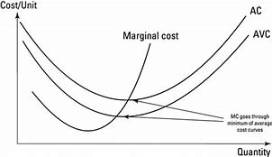
Graph…………..

Slide 50
Profit-Maximization – Let P =$20
Quantity VC FC TC Revenue Profit (TR-TC)
0 0 200 200 0 -200
5 100 200 300 100 -200
15 200 200 400 300 -100
30 300 200 500 600 +100
50 400 200 600 1000 +400
65 500 200 700 1300 +600
75 600 200 800 1500 +700
80 700 200 900 1600 +700
80 800 200 1000 1600 +600

Slide 51
Market Structures
Perfect Competition
Monopoly
Monopolistic Competition
Oligopoly

Slide 52
Assumptions Underlying Perfect Competition
Homogeneous product
Free entry and exit
Many producers
No one producers is a substantial part of the market

Slide 53
Market v. Firm
Price determined at intersection of supply and demand
  Individual firm then takes as given
  Price set by interaction of thousands of demanders and thousands of producers – Firm cannot influence

Slide 54
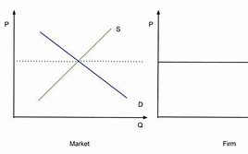

Slide 55
Price and Marginal Revenue (ΔTR/ΔQ)
Price Quantity Revenue Marginal Revenue
$10 10 $100 100/10 = 10
$10 20 $200 100/10 = 10
$10 30 $300 100/10 = 10
$10 40 $400 100/10 = 10

Slide 56
Conclude: MR = P
Profit-maximization at MR = MC
  Therefor, at P = MC

Slide 57
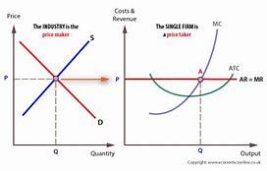

Slide 58
Three Possible Outcomes
P>ATC -> profits
P<ATC -> losses
P = ATC -> zero profits (LT equilibrium)

Slide 59
Five Critical Points
P > ATC -> profits
P = ATC -> zero economics profits
AVC < P < ATC -> firm loses money, but stays open in the SR
P = AVC -> indifference point
P < AVC -> Shut-down

Slide 60
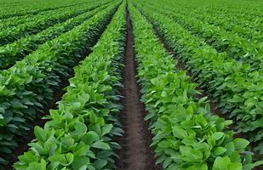
Long-Run Adjustment
Free entry and exit

Slide 61
Positives and Negatives of Perfect Competition
Market highly efficient
  Produce at P = MC (social efficiency) in both short- and long-run
  Produce at technical efficiency in LR (minimum ATC)
Negative
  Does not promote innovation
  Highly competitive environment does not produce resources necessary for innovation

Slide 62
Market Structure #2- Monopoly
Market Characteristics
  Single firm
  Strong barriers to entry
  No close substitutes
  Firm and market are the same

Slide 63
Demand and Marginal Revenue
Price Quantity Revenue Marginal Revenue
50 0 0
40 10 400 40
35 20 700 30
30 30 900 20
25 40 1000 10
20 50 1000 0
15 60 900 -10

Slide 64
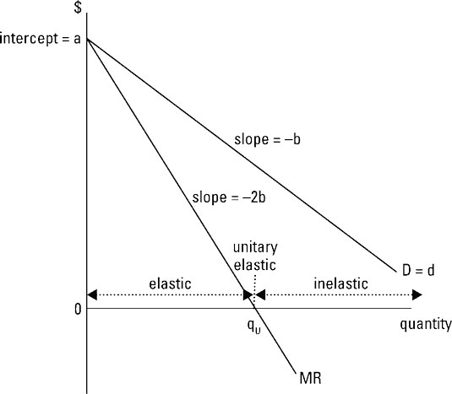
Graphically

Slide 65
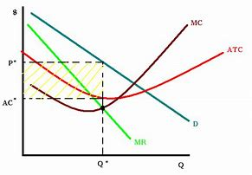
Equilibrium

Slide 66
Causes of Monopoly
Legal
  Post Office
  Patent Monopolies
Economies of Scale
  Microsoft, Google (not a true monopoly)
  Natural Monopolies
Geographic monopolies
  Joe’s Last Chance Garage

Slide 67
Antitrust
Federal law seeks to prevent monopoly through antitrust actions
  Federal Trade Commission
  +Justice Department if illegal (collusion)
Alternative is to allow monopoly and then regulate
Antitrust also addresses cartels, which are pseudo-monopolies
  Firms that band together and set prices and quantities

Slide 68

Problems with Monopoly
Firm under-produces
  Consumers face lower Q and higher P

Slide 69
Lose both technical and allocative efficiency
  And, these two desirable points are at different Qs
    Impossible for firm to produce at both points
  Can regulate to one of two points if natural monopoly
Balanced by tendency of monopoly firms to innovate

Slide 70
Monopolistic Competition
Characteristics
  Many firms
  Weak Barriers to Entry
    Licensing, safety/environmental regulations, health codes
  Differentiated Product
    Some product loyalty, but not at expense of very large price differentials

Slide 71
Examples
Gas Stations
Banks (branches)
Hair Stylists
Convenience Stores
Liquor Stores
Ice Cream Parlors
Delis
Coffee Shops

Slide 72
Note distinction between local and global “face” of some businesses
McDonald’s as a corporation is an oligopoly firm
  Each restaurant is a monopolistically competitive firm
People’s Bank is a large corporate entity, but each branch competes with other bank branches in a MC market

Slide 73
Short-Run Equilibrium
Profits can occur in short-run
  Due to product differentiation
In long-run, since barriers to entry are weak, profits will be eliminated

Slide 74
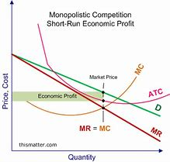
Short-Run Monopolistic Competition

Slide 75
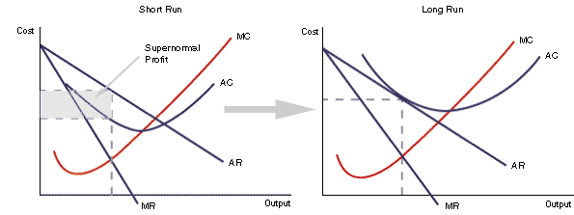
Transition to Long-Run

Slide 76
Key Things to Note….
Zero profits in long-run (similar to perfect competition)
Not at minimum ATC or P = MC
  Do not achieve either form of efficiency
Trade-off -> Consumers willing to pay extra for differentiated products

Slide 77
Oligopoly
Market dominated by 3 or 4 large firms
  Measured by concentration ratio or Herfindahl Index
Strong barriers to entry
Product can either be differentiated or homogeneous (pure oligopoly)
  Automobiles v. Steel
Price leadership

Slide 78
Game Theory
Video
https://www.bing.com/videos/search?q=youtube+beautiful+mind+bar+scene&view=detail&mid=F3E04B2319DE14334FE1F3E04B2319DE14334FE1&FORM=VIRE

Slide 79
Profits in 2 Firm Game
 | High Price (Firm 1) | Low Price (Firm 1)
High Price (Firm 2) | $100m (I)/$50m (2) | $150m(1)/$30m (2)
Low Price (Firm 2) | $50m (I)/$80m (2) | $70m(I)/$40m (2)

Slide 80
Alternative – Graphical Model
2 Demand Curves
  Proportional and Perceived
    Assumptions behind each
      Proportional assumes that all firms follow a price change -> relevant for price CUTS
      Perceived assumes no firms follow a price change -> relevant for a price increase

Slide 81
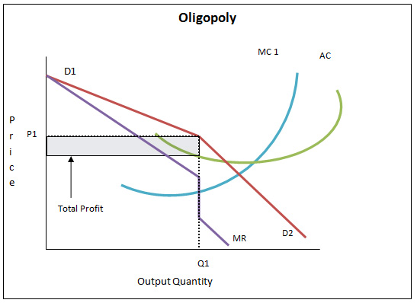

Slide 82
Cartels…..
Covered under material for Oligopoly, since cartels can only exist when there are a small number of firms
  Involves collusion between producers to fix prices
  Other conditions:
    Product must be homogeneous
    Barriers to entry
    No close substitutes
    Non-perishable

Slide 83
Examples…..
OPEC -> Organization of Petroleum Exporting Countries
International Sugar Agreements
International Coffee Agreements
Etc.
  Most fail in some way to conform to the requirements of a cartel and eventually failed -> OPEC is still with us
  Recent “rebirth” of cocoa cartel in Africa
Industrial cartels common in Europe – Hundreds of them
  Pop up faster than EU Commission can shut them down

Slide 84
Why Cartels Fail….
Incentive to cheat when prices are raised
  If a nation violates if production quota, it makes extra profits
  As long as it doesn’t get caught
    Result was continual breakups of OPEC over the years
  Graphically….

Slide 86
Market Failure
Instances where markets fail
  Or, where markets are impossible
Such circumstances apply to instances of pollution, including CO2 emissions – Referred to as externalities
  Usual government response is a prohibition
  Economists would instead support a market-based system that internalizes costs that the firm considers external
    Can be applied not only to pollution, but also noise or noxious smells

Slide 87
Also, what about Public Goods?
Goods that are consumed by everyone
  My consumption does not impact your ability to consume the good
  Street-lighting is a common example
Markets will not work, since I cannot stop someone from consuming something they did not pay for
  Cannot use a market to determine how much of the good we want?

Slide 88
Begin with Pollution and other Externalities
Negative Externalities are costs that are external to the firm
  We assume that businesses maximize profits, but if they ignore costs imposed on society -> the dirty river, the bad air or noise from a private business that prevents “quiet enjoyment”, then the output is wrong (too high)
Can also have positive externalities (frequently ignored)
  Flu shots -> reason they are free or covered by insurance, as they have substantial benefits to everyone
    Same reason explains why shingles shots are NOT covered

Slide 89
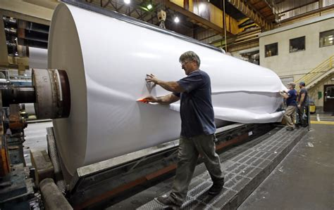
Traditional Example is a Paper Mill

Slide 90
Notorious Polluters if Left Unregulated
A mill will maximize profits ignoring the damage done to waterways
  Regulation that is efficient will reimpose the external costs back upon the firm
  If each ton of paper produces $50 worth of environmental costs, then $50 should be added to the cost
    The best operating point of the firm will then occur at a lower quantity
    In economics jargon, the incremental (marginal) cost is higher

Slide 91
Graphically

Slide 92
Explanation
The down-sloping line (demand) represents the incremental revenue of the firm
  The curved line represents the costs (incremental cost)
  The firm will output where the two lines cross to maximize profits
    If we add a tax, the incremental cost line will shift upwards
    The quantity produced will decline and the price will rise

Slide 93
Why Should we like this Outcome?
The imposition of the tax on all paper mills reduces output, reducing the amount of pollution
  The tax internalizes what was an external cost
The tax is paid for by those who should pay for it->
  The firm makes lower profits (constrained optimization)
  Consumers pay a higher price, as output is lower (if we want white, bleached paper, should pay more)
The tax creates a pool of money to use to address remaining pollution

Slide 94
Application to CO2 Emissions and Climate Change
Approaches taken in Kyoto and Paris won’t solve problem
  Major emitters (India and China) are excluded in both agreements -> will simply move production out of U.S. and Europe
  U.S. actually has accomplished the most towards its Paris commitments
    In the Irony department, fracking has resulted in a wholesale shift to natural gas and away from coal
    Natural gas has MUCH lower CO2 emissions (even lower than oil) 210 lbs/million btu (coal), 157 lbs/million btu (gasoline) 117 lbs/million btu (natural gas) -> Source: EIA

Slide 95
Economists Approach
Impose a tax on CO2 and a whole bunch of things will happen to reduce emissions
  Energy switching will accelerate -> more natural gas, less petroleum
  Viable alternative energy (wind/solar) will expand (only 1.4% of total U.S. energy despite billions in subsidies
  Energy efficiency measures will make a lot more sense to homeowners and drivers
  A pool of money will be created to further address problem….

Slide 96
For Instance, very Little Attention has been Paid to Ways to Remove CO2 without Cutting Energy Use
The most common approach is planting trees – many, many trees (tens of millions to offset a large-scale power plant) – Questions about emissions when forests age and decay
Carbon-Scrubbing (UK) liquifies CO2 and injects it into underground storage – Very expensive
Most effective means of removing CO2 is to use lime
  5 cubic kilometers of lime would remove all CO2 released in a given year

Slide 97
Amelioration
More recent variant – Use CO2 produced by generating power to make cement -> “permanently” embeds the gas in the cement (Scientific American, August 7 , 2008)
  As the joke in physics goes…Fusion power is 50 years off (its always 50 years off), so by the time the cement decays we will have zero-CO2 energy (unless fusion is still 50 years off)
Some very common minerals (olivine) readily absorb CO2 and could be used in a similar manner
  https://www.sciencedirect.com/science/article/abs/pii/S0196890496003111

Slide 98
Why So Important?
If a meaningful carbon tax is in place, producers will adopt these methods to avoid the tax
  And tax money collected can be put to use in those circumstances that make less commercial sense
This avoids one of the more worrisome aspects of carbon “caps”
  A country such as Brazil could only comply by tamping down growth, leaving much of the population that is already poor permanently so
A reasonably instituted tax would avoid a gigantic new bureaucracy
  Only the dispensation of the tax revenue would be directly under government control

Slide 99
Public Goods
A public good is a product that is:
  Jointly consumed by everyone
  Is non-exclusionary -> I cannot prevent someone from consuming it
  My consumption does not impede on your consumption
    Goods subject to “congestion” are thus imperfect cases

Slide 100
Examples (Pure Cases)
National Defense, street lighting, fresh air, fireworks
  Attempt to set up a market will fail
  Individuals will “free ride” on providers
  And, if you try to get individuals to reveal how much they want, they will lie if a fee is attached
Anecdotes about street lighting and lighthouses

Slide 101
Imperfect Cases
Police, fire departments, roads
  Can usually identify these because there are “private” examples of the public good:
    Police -> private security
    Roads - > Toll roads (sort of) and private roads
  And, my consumption DOES impede your consumption
    If I call the police multiple times per week, they are busy with my problems and may not be able to respond to yours

Slide 102
Solution
Since pure public goods must be provided by the government, the incremental cost should = the incremental benefit to society
  A difficult criteria to achieve (think national defense)
Large, heavily funded, projects with poor mandates might fail this test
  Dept of Energy -> set up to respond to the oil crisis of the 1970s (formed in 1977)
  What is role now? If to promote alternative energy, that is being done by multiple agencies (consolidate?)

