Slide 1
Official Financing Agencies
Global and U.S.

Slide 2
Start at Home….
Most visible is Export-Import Bank
  Services:
    Exporter and importer financing – Seems odd, but that includes giving $$s to foreign buyer to buy U.S. goods
    Protection against nonpayment by foreign buyer
    Provide working capital
    Export credit insurance
    Loan guarantees, etc.
  Has been criticized for being focused on the largest firms
    At one point, seemed to simply be an arm of Boeing Corporation to promote plane sales

Slide 3
Who can use EX-IM Services?
U.S. exporters
  Must be in business for at least three years and must have a positive net worth
  Must have at least one full-time employee :)
  In practice, obtaining EX-IM funding is complicated enough that mostly large firms are involved
Lenders – including support for letters of credit
Insurance Brokers
Regional export promotion agencies
  Entities that promote intra-regional trade can seek funding from EX-IM

Slide 4
Protecting against Nonpayment a Critical Service
EX-IM has affordable insurance against nonpayment
  In the very rare case that a Letter of Credit goes bad, very important
  If importers bank fails during the brief period that transaction is underway
    A very unlikely case, but possible
  Or, if business conducted without a LOC for some reason
    At that point, EX-IM insurance is promoting Moral Hazard
    Unless, transaction is between large, established corporations where LOC’s are not used

Slide 5
Goal is to Increase Level of Trade, Particularly Exports
Complexities of system results in most businesses that use EX-IM being large organizations
  Hence, the defunding (temporary) of the agency in 2019
  Focus on large ticket items helps Boeing and other large firms, but does little for small- to medium-sized firms
Small Business Administration has some services for firms seeking to export, but programs are small

Slide 6

For Developing World, World Bank (IFC) Provides Similar Services
International Finance Corporation
  Provides loans of 7-12 year duration to businesses
  Not necessarily exporters, but much of the demand
  is in that sector
  Specifically:
    Trade and supply chain finance
    Direct investment in firms (equity purchases)
    Advisory services to assist both domestic producers and exporters
  IFC important since most financing arrangements targeted at corporations in industrialized world

Slide 7
Note the Significant Difference here…
Methods discussed above are short-term – strictly designed to smooth international trade
  IFC is focused on much longer-term projects
  Financing of this kind can have a similar effect, since export businesses can secure funds to develop products and markets

Slide 8
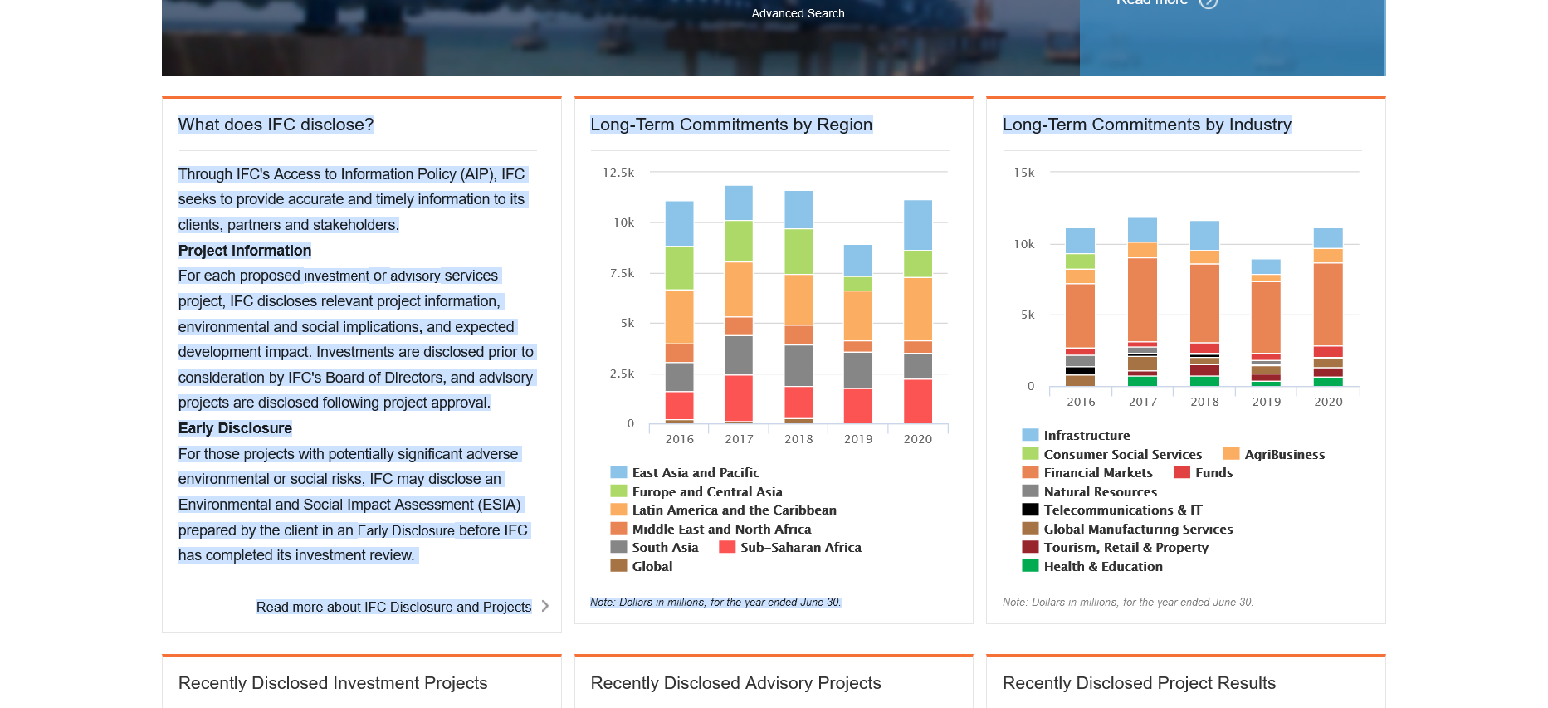

Slide 9
In addition to IFC, have Development Banks
Financed and “owned” by nations in a particular region
  Latin American Development Bank was founded in 1970 and currently has 19 member states
  Funds (mainly) projects with a public component
    On webpage -> Green, infrastructure, digital infrastructure, sanitary systems
    Green and digital funding inevitably support businesses
  Loans are in the range of $75 m to $500 million
    Offered at reduced interest rates to spur investment
  Also promotes microlending
    Small loans for startups and expansion of small business

Slide 10
Similar institutions cover the rest of the development world
  Asia Development Bank
  African Development Bank
  Caribbean Development Bank
Impact on global financing significant, given the size of some of the loans
  Emphasizing, however, that this is long-term, project-driven financing
  Very different from short-term methods previously discussed
Development banks have been criticized for allowing too much borrowing (and debt)

