Slide 1
EC 233 – International Finance – Fall 2020

Slide 2
Overview of Course
Topics Covered:
  Balance of Payments
  Currency valuation
  Spot and Forward Markets
  Supply and demand for currency and valuation
  The euro
  The East Asian Financial Crisis
  Interest Rate Parity
  Purchasing Power Parity

Slide 3
  Short-term Financing
  Long-term Financing
  Direct Foreign Investment
  Developing Nation Debt Crisis
  How trade is financed

Slide 4
Balance of Payments
Balance of Trade Major Driver of Finance Flows
  Deficit = inflows, Surplus = outflows
  Begin with Merchandise Trade Account (just goods)
  Credit Debit
  -------- -------
  Export of Goods/Services Import of Goods/Services
  (currently minus $524 billion)

Slide 5
Balance on Current Account
Credit Debit
Exports of Goods/Services Imports of Goods/Services
Unilateral Transfers to the US Unilateral Transfers Abroad
Approximately -450 Billion in 2016
=2.37% of GDP

Slide 6
Relationship Between Trade Deficit and Capital Flows
If trade deficit is <0, financial account is a positive
  Money must “flow” back into U.S.
  Capital Inflows (+) Capital Outflows (-)
  Short-Term Inflows Short-Term Outflows
  (stocks, bonds) (stocks, bonds)
  Long-Term Long-Term
  (Real Estate, DFI) (Real Estate, DFI)
  If Current Account balance large and negative, capital account balance will be large and positive

Slide 7
Basics of Paper-Writing
A. Constructing an outline:
-Introduction
-Review of Literature
-Model
-data
-Results
-Implications

Slide 8
B. Academic Honesty-
-Read statement in catalogue
-key parts:
-Must work independently
-Cannot appropriate someone else’s work as your own:
-Cannot use text without citation
-Do not use long blocks of quotes to create a paper
-Cannot duplicate tables, graphs, figures from copy-righted material without permission – note sources that may be OK
-give examples of bad form (table with all sorts of data…only part relevant to your paper)

Slide 9
Other Issues…….
C. Finding literature – how to use Academic Onefile
D. Finding data – useful sources in our library
-On-line sources
-International Financial Statistics
-Federal Reserve Economic Data (FRED)
Citation style – use APA guidelines
Paper submitted through email, as we will not be doing in-person classes at that point

Slide 10
Reading Currency Valuations
Major currency ratios:
  $/€ = 1.106 $/£ = 1.2349 ¥/$ = 108.04
  Ratios Flipped: €/$ =0.9042 £/$ = .8097 $/¥=0.0093
Non-reserve currencies
  Cited against a “reserve” currency
    Mexican pesos/U.S. $ or $s per Mexican Peso
    19.6 pesos/$
Reserve Currencies:
  U.S. $, Canadian $, U.K. £, €, ¥, Swiss Franc, Chinese Yuan??

Slide 11
Triangular arbitrage:
  Opportunity to create large, instantaneous rate of retrn
  $/£ * £/C$ must = $/C$
  If not equal, sets up arbitrage opportunity

Slide 12
Example
$1.20/euro
$1.30/pound
1.12 euro/pound
Equilibrium: $/euro * euro/pound = $/pound
  $1.20*1.12 should = $1.30 (actually = 1.34)
  Not in equilibrium
$1 million example: Buy $1 m worth of Pounds →0.769 Pounds→0.923 euro→$1.034 (3.4% ROR)

Slide 13
2nd Example
Yen/$ =110
C$/$ = 1.3
Yen/C$ = 88
Show not in equilibrium
  Demonstrate how to make money using disequilibrium

Slide 14
Currency Forward Markets
Can lock in 30- 60- 90- and 180-day rates (others if institution willing to sit on other side)
  (Why not for years – risk too high)
Forward market – actually want currency (firms)
Options market – can be just attempt to make money
Mechanism: Agree to buy (Call) or sell (Put) currency at a future date
  Since it is an option, can just let it expire (lose fee)

Slide 15
What Determines “Fee”
Length of contract, as well as riskiness
  Longer contracts are more expensive
  Variability of prices↑ results in higher fees
European v. American options
  European – specific date that option must be exercised or allowed to expire
  American – Can exercise at any time during “strike period”

Slide 16
Cost of option (premium cost) varies by length of contract, risk, etc.
If you own a call on a currency, and that currency rises in value, you can sell the option at a profit before the Strike Period
Example: $/£ = 1.28, buy six month call, assuming that pound will go up in value
  Buy 100 pounds @ $1.30 (market also assumes pound will rise in value)
  Pay $.10 fee for each contract
  If pound rises to $1.35 – Make .05 per pound or $5.
  But, paid $10 for contract
    Only make money if pound rises above $1.40

Slide 17
If Pound Goes Down in Value
Allow contract to expire, and lose entire $10
  Caps losses off at $10
Reason puts/calls popular – leverage investment
  Only invested $10 to buy $130 worth of pounds
  RORs can be very high
  If pound went to $1.45, make 5 cents per pound or $5 on a $10 investment (50% ROR)

Slide 18
Puts are a Bet Against
Investor is bearish on currency
  If pound at $1.28, agree to SELL pounds at $1.25
  If pound drops further than that, buy at lower price and immediately resell
  Once again, fee is sacrificed, so change has to be large enough to offset lost fee
Class exercise: € = $1.15, buy put on euro at $1.11
Invest $2000. At end of period, euro is at $1.00,
fee = 4% of total contract

Slide 19
Answer….
Get $25 out for every dollar put in
  $2000 buys $50,000 worth of euro @$1.11 = €45,872
  Buy at $1.00 @ end of period, immediately sell at $1.11
  Make .11 per euro or $5,046
    Take off fee of $2000 = $3,046 net on $2000 investment (52.3%) ROR

Slide 20
Introduction to Exchange Rate Determination
Use supply-demand Model
  Supply and demand for foreign currency
  Shifts determine how “e” changes
Vertical (y-axis) is value of foreign currency (e)
  Inverse of value of the dollar

Slide 21
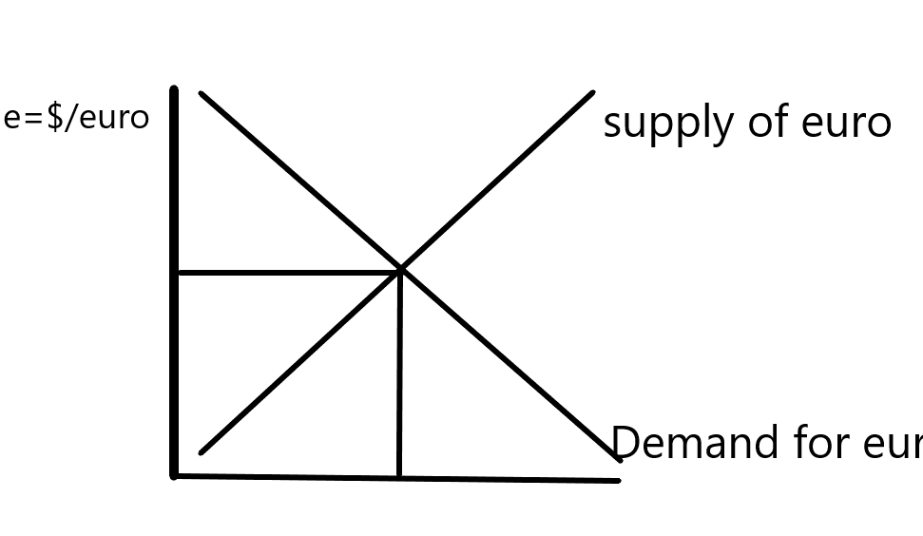
Supply and Demand for euro

Slide 22
Influences that Change Supply and Demand
Changes in the Inflation Rate (double shift)
Changes in the Interest Rate (double shift)
Changes in Growth
Trade Barriers
Government Spending

Slide 23
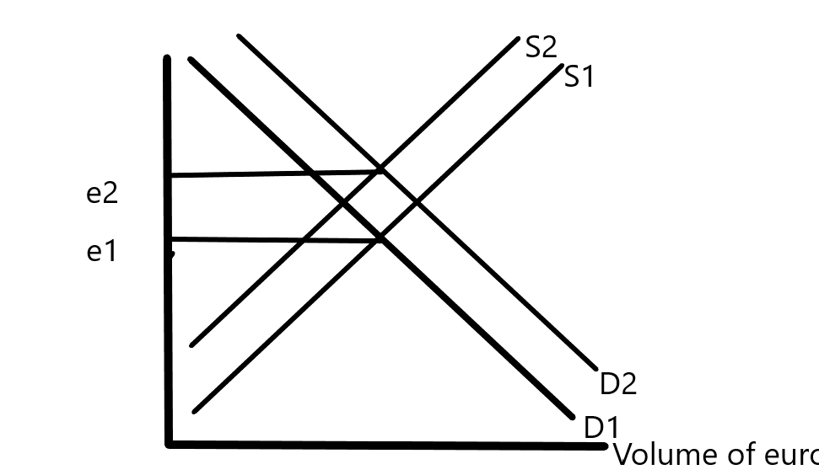
Example – Rising inflation in the U.S.

Slide 24
Explanation:
  US residents will seek out more UK goods
    Need more British Pounds
  UK residents will seek out fewer US goods
    Need fewer US $s

Slide 25
Rise in U.S. Interest Rates

Slide 26
Explanation:
  Brits buy US dollars to invest in US market
    Increases supply of British pounds
  US investors keep money at home, so don’t need Pounds
    Demand declines

Slide 27
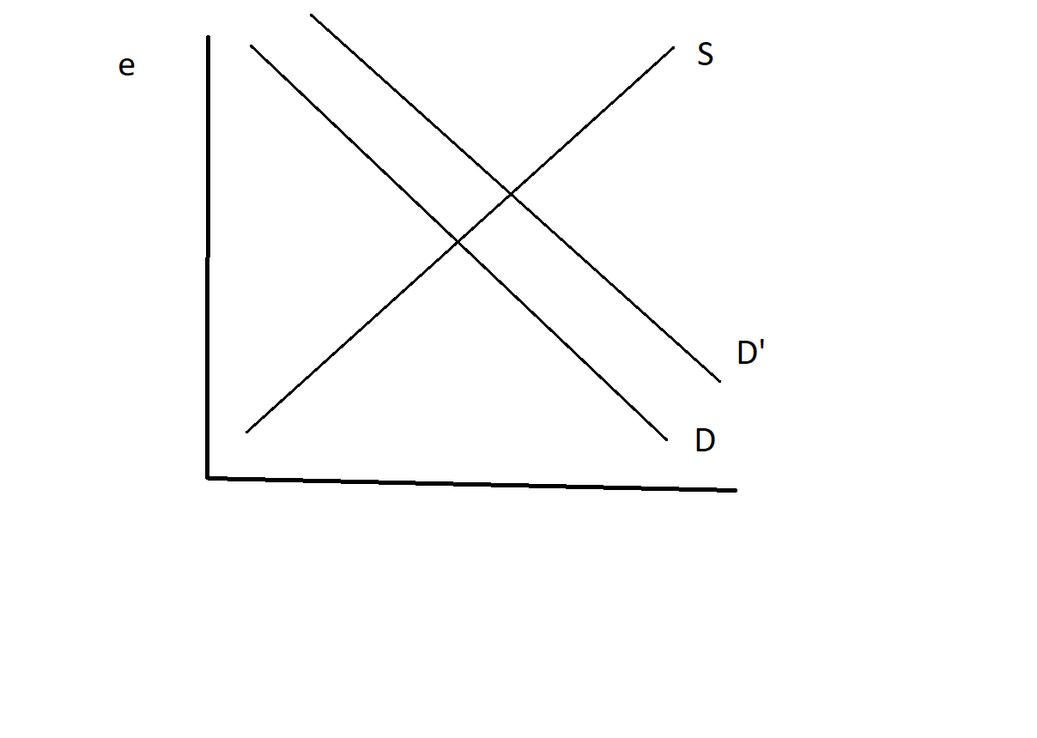
Example 3 – Single Shift – Growth in US Economy

Slide 28
When US economy grows, about 15-16% goes to imports
  Marginal Propensity to Import
  No shift in Supply in this circumstance, only demand
Leading up to pandemic, US growth greater than that in Europe or elsewhere
  Imports ↑ -> trade deficit ↑

Slide 29
Government Influences on Exchange Rates
Two Channels
  Intervention by Fed
    Direct (ST)
    Through interest rates
  Government spending
    GDP↑ leads to imports↑ which will depress currency
  Exchange Rate Policy – e.g. “strong dollar” (2001)

Slide 30
Also have to Consider what Happens if Value of Dollar Fixed
So that “e” cannot move
  Shifts in curves now cause a disequlibrium
  Supply and demand do not equate
This is the circumstance faced by nations that peg their currency
  Have to be ready (and able) to intervene to support peg
  Have to have adequate official reserves

Slide 31
New Topic – Currency Arrangements
Also known as “regimes”
Can peg to a currency ($ or €), freely float, use a crawling peg, peg to non-currency (SDR), dollarize, etc.
Pre-Great Depression, pegged to precious metal, usually gold
  Collapse of system led to Post-War arrangement known as Bretton-Woods

Slide 32

Bretton-Woods NH

Slide 33
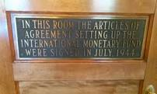

Slide 34
Currency Arrangements Post Bretton Woods (1944)
U.S. on gold standard – world on dollar standard
To get gold from FF: FF->U.S. $->Gold
  U.S. dollar fixed at 1/35 oz. of gold
  Mechanism: U.S. runs trade deficit ->gold outflow->U.S. money supply↓->Fall in U.S. GDP->Imports↓
    Adjustment on REAL side
  Became unstable in early 1970s due to spending on Vietnam War
    Smithsonian Agreement (1971) devalued dollar (1/42 oz. of gold)
    System collapsed completely in 1973 – exchange rates floated

Slide 35
Since 1973, Numerous “Regimes”
Fixed, floating, hard peg, soft peg, pegged to a basket, pegged to a non-currency (SDR), crawling peg, etc.
Some highly unstable (soft pegging)
Hard peg ties nation’s currency to another
  Along for the ride
  May over-value or under-value currency
Crawling peg

Slide 36
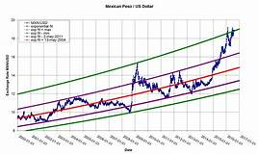
Graphically

Slide 37
Pegged to a Basket – Why significant
Should reduce variability
  Since currencies don’t move perfectly together
  One currency ↑ while other ↓
    Offsetting
This is (supposedly) the current Chinese system
  Pushed to get off straight peg to $
  But, Yuan almost never moves against dollar, so basket is probably mostly dollars

Slide 38
Innovations
Bartering: China and Australia
  Avoid use of any currency
Commodity Money
  Currency “buys” a package of commodities
  If value of commodities ↑, commodities worth more than currency – trade in currency to get commodities, forcing price of commodities back down and stabilizing currency
    And vice-versa

Slide 39
Currency Board (Argentina 1992-2001)
Inflation rate at 5000% in 1991
  Adopts dollar as “currency”
  To print a peso, must obtain a $ (1:1 ratio)
    Inflation immediately dropped to just over 10%
    Cannot have monetary policy under this system
  By 2000, every government action dictated by need to maintain one:one ratio
    Exited currency board during deep recession (needed monetary policy)

Slide 40
Full Dollarization
Ecuador, Panama
  U.S. Dollar is legal tender
  No domestic currency (except coinage in Ecuador)
  Monetary policy run by Federal Reserve
  Provides stability, but (again) no monetary policy
Exiting difficult
  Peru is talking crypto-currency (?)

Slide 41
Currency Integration – The euro (€)
No real corollary to the euro
  Replaced 12 currencies by one (now 18 members)
  Forced coordination of monetary policy
    Agreed to limits on fiscal policy – violated extensively
  Introduced in 1999 a Unit of Account
    Became full currency in 2002
    All other currencies removed from circulation my April 2002

Slide 42
Caribbean Community (CARICOM) is Attempting Currency Integration
Only partially there
  These are tiny economies – risk much smaller and process much easier
Similarly, Western African nations (4) have adopted a common currency
  Besides these, no other integration movements have attempted currency integration
    Even ambitious movements (e.g. Mercosur)

Slide 43
Innovative Disasters - Venezuela
Four different currency values (2019)
Rate 1: 6.5 Bolivars/dollar (importation of food and medicine)
Rate 2: 12/$ and 50/$ for importation of other goods – rate available only sporadically through an auction process
Newest rate: 200/$ -> for purchase and sale of foreign currency to individuals and businesses
System impossible to navigate – in the presence of 800% inflation, value of Bolivar will continue to deteriorate

Slide 44
New Section - Interest Rate Parity
Covered Interest Arbitrage
Relationship between interest rates and exchange rates
Formula:
  p = (1 + i_{h})/(1 + i_{f}) – 1
  Expected appreciation/depreciation of foreign currency is equal to 1 + the domestic interest rate divided by 1 + foreign interest rate minus 1
  Logic -> if domestic rate higher, foreign currency must appreciate to equate

Slide 45
Let A_{n} = final total amount if invested overseas = (A_{h}/S)(1 + i_{f}) F
A_{h} = initial amount
S = spot rate
F = Forward rate
F = S (1 + p) -> initial spot rate times 1 + appreciation/depreciation
Therefor: Above = (A_{h}/S)(1 + i_{f}) S (1 + p)
Cancel out “S”s = (A_{h})(1 + i_{f}) (1 + p) = A_{n}
_{Rate of Return =} (A_{n} – A_{h})/ A_{h}

Slide 46
Therefor: ROR = {(A_{h})(1 + i_{f}) (1 + p) – A_{h}}/ A_{h}
This must be = to domestic interest rate
Dividing by A_{h} -> (1 + i_{f})(1 + p) -1 set = to i_{h}
Rearranging leads to p = (1 + i_{h})/(1 + i_{f}) – 1

Slide 47
Examples
What is predicted forward value of £, $/£ = $1.30
    U.S. r = 1.7% (6 month)
    GB r = 3.4% (6 month)
    p = (1.017)/(1.034) – 1 = -0.01644
    $1.279 = predicted forward value – if not equal to actual forward rate, profit opportunity

Slide 48
IRP Line and Graph

Slide 49
Numerical Example
Let r (US) = 1.55%, r(France) = 3.12% (6 month)
$/€ = 1.14
What is predicted forward rate of $/€ if IRP holds?
Prove that the ROR is same in both France and the US if IRP holds – use a $1 million investment

Slide 50
Example 2
If C$/$ = 1.28
Interest rate (3 month) = 1.05 (US), 2.20 (Canada)
Find predicted value of C$/$ and prove that a $5 million investment returns the same amount in both Canada and the U.S. if IRP holds

