Slide 1
EC 231 – International Trade
Spring 2021

Slide 2
Comparative Advantage
Trade occurs due to differentials in skills, resources, etc.
One nation outperforms the other in terms of opportunity cost of producing a good
In general, most two-nation couplings produce a comparative advantage for each

Slide 3
Example – U.S. v. China/Soybeans v. Textiles
U.S. production resulting from a “unit” of resources (a bundling of capital, labor and raw inputs)
Soybeans: 50 bushels
Textiles: 100 yards
China:
Soybeans 30 bushels
Textiles 120 yards

Slide 4
Opportunity Cost
U.S.: One unit of resources makes 50 bushels of soybeans, so 1/50 unit makes 1 bushel – that would make 2 yards of cloth
OC of soybeans is 2 yards of cloth, OC of cloth is ½ bushel of soybeans
China: One unit of resources = 30 bushels of soybeans, so 1/30 = 1 bushel, that would make 4 yards of cloth
OC of soybeans is ¼ yard of cloth, OC of cloth is 4 bu soybeans

Slide 5
China has lower opportunity cost for cloth, U.S. is better at soybeans – specialize and trade
Suppose each nation has 100 units of resources devoted (equally) to two goods:
U.S. production = 2500 bushels of soybeans, 5000 yards of cloth
Chinese production = 1500 bushels of soybeans, 6000 yards of cloth

Slide 6
World Production = 4000 bushels of soy, 11,000 yards of cloth
Now specialize: U.S. produces 5000 bushels of soybeans, China produces 12,000 yards of cloth
World production rises and both nations can be made better off

Slide 7
In-Class Exercise
Laptops v. shirts: U.S. v. Ecuador
Production per unit of resources:
U.S.: 10 laptops, 25 shirts
Ecuador: 4 laptops, 30 shirts
Find the opportunity cost in each case, and determine which country should produce the good

Slide 8
Part II
Given your answer, show how production of each good changes with specialization. Assume:
Each country has 100 units of resources and devotes them in equal quantity to each good under autarky

Slide 9
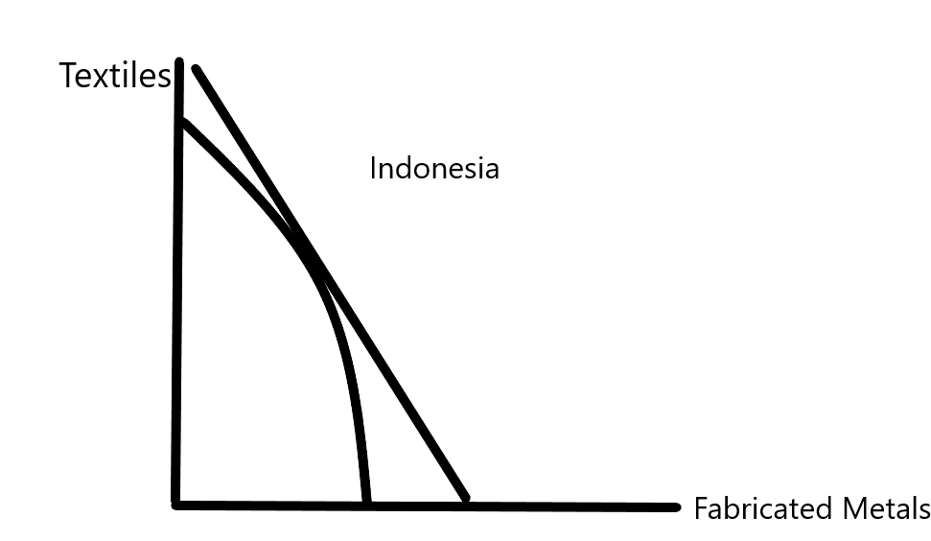
PPCs and Trade

Slide 10
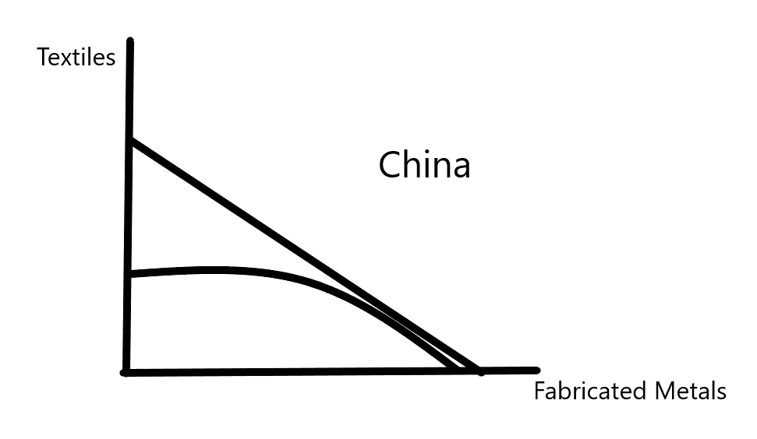

Slide 11
Hecksher-Ohlin Model
Also known as factor endowments model
Trade occurs due to relative endowments of labor, capital, raw materials, land, etc.
Based upon production theory and isoquants (graphs of equal output)

Slide 12
Isoquants….
Fixed level of output with varied levels of inputs (notably capital and labor)
Includes diminishing marginal product
Nations then choose efficient points to operate
Relative abundance of inputs produces specialization

Slide 13
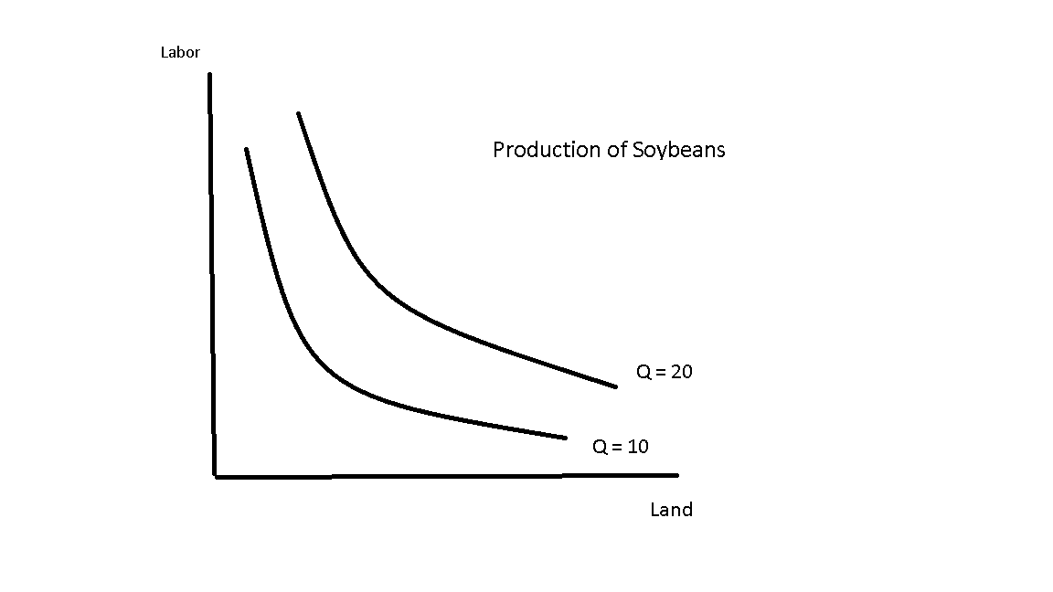
Illustration

Slide 14
Specifics about Graph
Shape conveys diminishing marginal product
Bowed inward
Isoquants skewed towards one axis, based upon production
Intensity of input use
Determines how much of each good produced

Slide 15
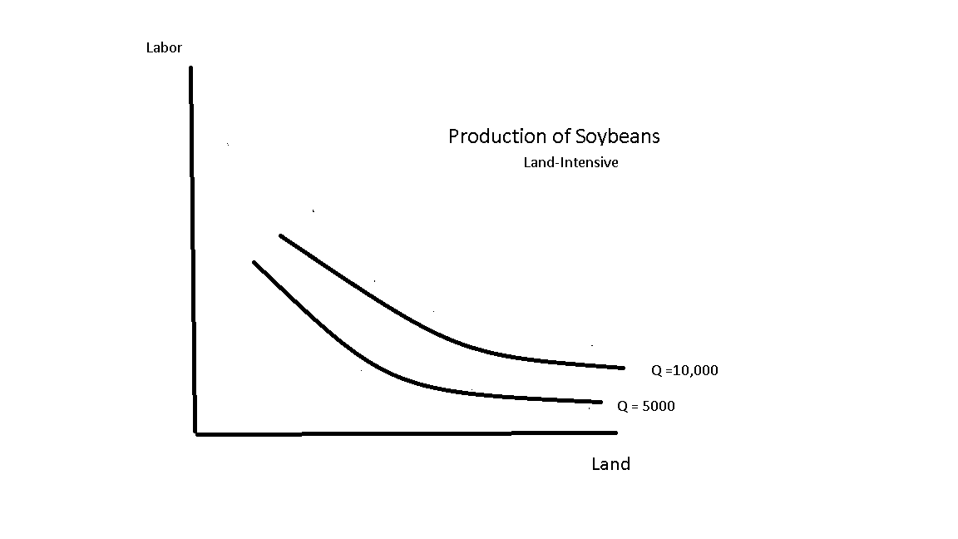
Hecksher-Ohlin Model Assumes Input-Intensity Different for Different Goods

Slide 16
For other Good, Assume Labor Intensive
Result is an Edgeworth Box
2 nations, 2 inputs, 2 goods
Nations specialize in the good that requires more of abundant resource
Then trade->

Slide 17
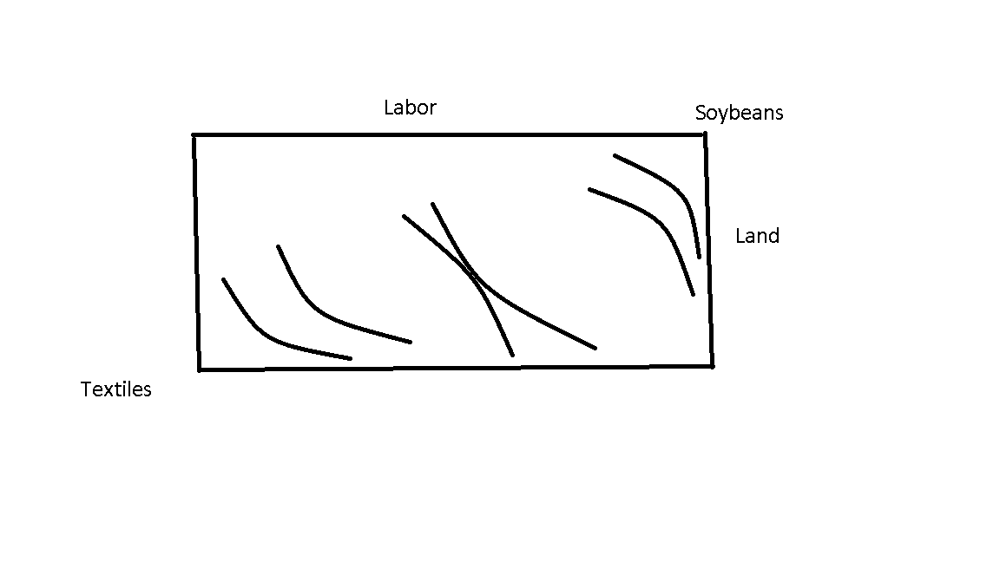
Graphically – For Labor-Rich Country

Slide 18
For Land-Rich Country
Box is an elongated rectangle, with Land axis longer than Labor
Output of two countries is greater in the aggregate if each specializes
Long way to get to gains to trade…

Slide 20
End of Material on Theories of Trade – Address Applications
Trade Protection -> impacts from imposition of tariffs or quotas
Both produce a dead-weight loss
Depending on slope of demand, loss can be large or insignificant
Depends upon economic concept of consumer surplus
Policies that produce a large net loss (dead-weight loss) should be avoided

Slide 21
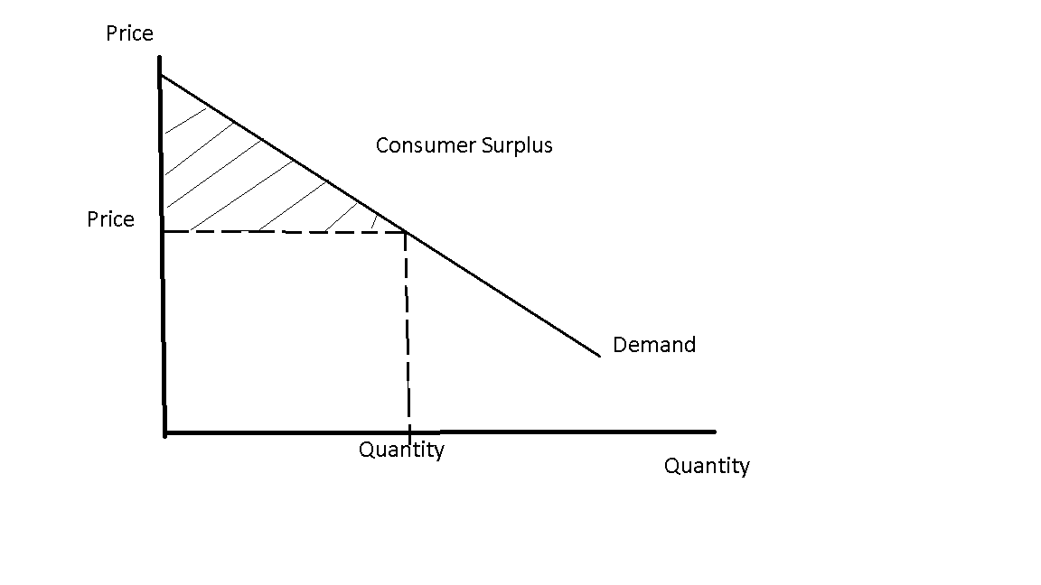

Slide 22
Imposition of a Tariff

Slide 23
Explanation
Initial price = world price
Domestic producer produces up until S-curve hits world price
Importer picks up rest (Qtotal – Qdom)
After tariff, price rises (by tariff) -> imports fall, domestic production rises
Trapezoid 1-2-3-4 is total loss in consumer surplus

Slide 24
Partial redemption
A is new producer surplus (area above the supply curve but below price)
B is tariff revenue
2 small triangles disappear (dead-weight loss)
Can evaluate competing tariffs by looking at DWL

Slide 25
Answer……

Slide 26
Continued
Loss in consumer surplus = ½ (5m + 4m)*$20= $90m
Tariff revenue = 2m *$20 = $40m
Rise in producer surplus = ½(1+2)*$20 = $30m
DWL = ½ (1m)*$20 + ½(1m) *$20 = $20m
-or- $90-$40m-$30m = $20m

Slide 27
Imposition of a Quota as Alternative (US VER on Japanese Cars

Slide 28
Analysis
Total demand falls when quota imposed
Domestic producer (lowest cost) takes first part of demand
Then imports pick up until quota reached at “imports with quota”
Supply then reappears for domestic producer, who sells until point 2
Loss in consumer surplus is again the trapezoid
A+A = gain in producer surplus, B = transfer to FOREIGN producers (a negative of quotas), C = DWL

Slide 29
Example
Imports without quota = 60 million units
Total demand = 100 million units
Price pre-quota = $50, post-quota = $70
Total demand = 90 million units post-quota
Imports = 40 million

Slide 30
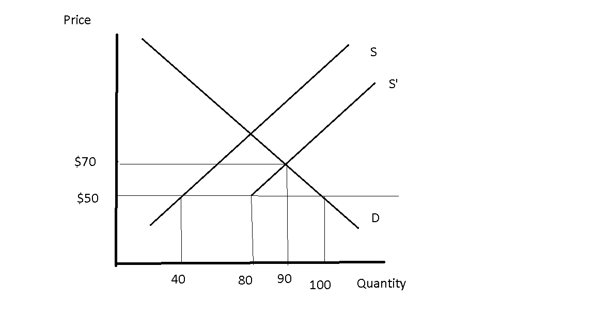

Slide 31
Math….
Loss in consumer surplus = ½ (90 + 100)*$20=$1900
Transfer to foreign producers = 40*$20 = $800
Transfer to domestic producers = 40*$20 = $800
+ ½ * 10 * 20 = 100 (total of $900)
Deadweight loss = 2[1/2*10*20]=$200

Slide 32
Justifications for Trade Restrictions
4 major arguments
Cheap labor -> U.S. wages are too high to compete
Ignores increased capitalization of production, which gives advantage to U.S. (capital inexpensive and available)
If we tariff all labor-intensive products, we slow growth in developing nations
Essential goods argument -> product is sensitive – particularly if needed for defense
Some validity here – cannot build aircraft carriers out of plastic if U.S. steel industry is destroyed (also, DRAM issue during Reagan Administration)
Very widely applied, however, including to GARLIC (not kidding)

Slide 33
Retaliatory tariffs -> An accepted argument by the GATT/WTO
Primary method by which trade disputes are settled
President Bush (2) imposed tariffs on steel, European nations were permitted to impose parallel tariffs on U.S. goods by the WTO
Anti-dumping tariffs -> also some legitimacy
Dumping (pricing below MC) is illegal

Slide 34
China and U.S. Trade
Most complex trade relationship (even before President Trump)
Large, and increasing, trade deficits produce problems for U.S.
Exports to China-> $80b, Imports from China ->$450b
Whole segments of U.S. industry have been decimated

Slide 35
History
Largely closed to trade until 1980s
Autarky model
Began opening to trade in eighties – admitted to WTO in 1994 – Acceded to the GATT/WTO in 2001

Slide 36
Statistics
https://wits.worldbank.org/CountryProfile/en/CHN

Slide 37
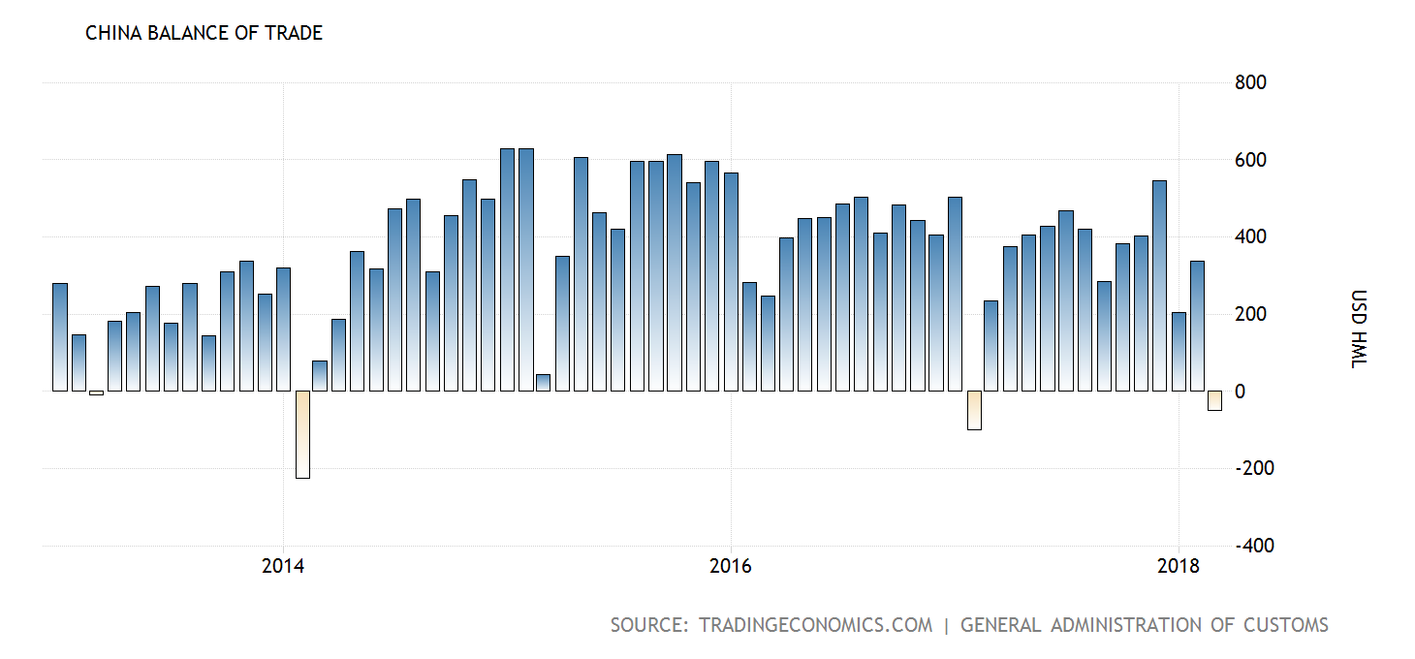

Slide 38
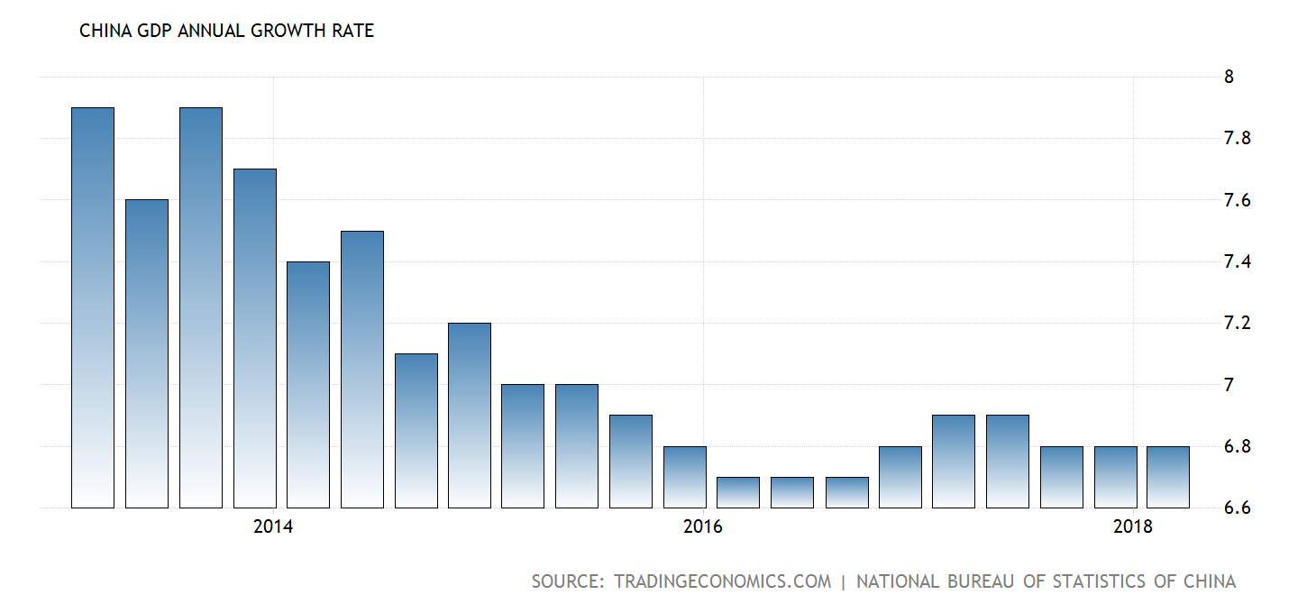
Growth Rate has been Exceptional, Although Slowing Somewhat

Slide 39
Issues
Consistent Trade Surplus
Sanitized by using reserve currencies to buy official debt
Keeps value of Yuan/Remnibi from rising
Tariff and non-tariff barriers are high
WTO compliant, but that just means all are subject to high tariffs

Slide 40
Technology Transfer
Acts as either significant non-tariff barrier (firms refuse to export) or as a means of supplanting a producer
To get access to market, must agree to joint production
Chinese firm then “borrows” technology and dispenses with foreign firm
Rate of intellectual property theft is very high (software, etc.)

Slide 41
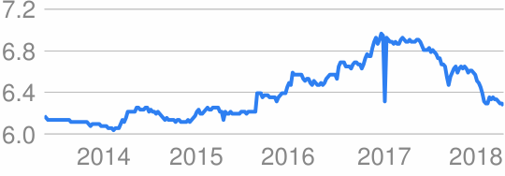
Currency Manipulation (Yuan/$)

Slide 42
One Belt, One Road Initiative
Attempt to integrate Asian/East Asian economies into one trading bloc
Control flow of goods and flow of resources
Involves heavy investment in infrastructure, education, basic materials, etc.
In Africa, fears have arisen that China is attempting to capture commodity markets and close out other nations

Slide 43
Appears as a Strategic Alliance with Economic Overtones
As for above, fear is that China will eventually close off the region to FDI and trade
Or, emphasize strategic trade only
Means of forming PTA w/out formally doing so
Great economic power of China induces countries to join alliance

Slide 44
U.S. Response……….
Hard push to open markets
Steel tariffs
Use WTO to eliminate technology-sharing requirement – approach as unfair trade barrier
Continue pursuit to label currency pegging as an unfair trade practice

Slide 45
EC 231 – International Trade
Commodity Prices and Terms of Trade

Slide 46
Terms of Trade
Ratio of export prices to import prices indicates terms of trade
How much has to be exported to fund imports
Could use simply Px/Pm
Trend is more important:
Redo as: Px(2)/Px(1)
------------------
Pm(2)/Pm(1)

Slide 47
Example
Price of Sugar:
Year Price/lb.
0 $0.75
1 $0.80
2 $0.84
Price of imported manufactured good:
Year Price/unit
0 $500
1 $550
2 $625

Slide 48
Price of Sugar is Rising, but is it rising Fast Enough to Support More Expensive Imports
Formula:
0.8/0.75 1.0667
= ----------- = --------- = 0.9697
550/500 1.100
If TOT < 1, then terms of trade are deteriorating
TOT = 1.12/1.25 for entire period
= 0.896 -> significant fall off in TOT

Slide 49
GATT/WTO system - Introduction
Formed in 1947 to undo damage from Smoot-Hawley Tariffs
SH Tariffs raised average tariff rate from 15% to 60%
U.S. negotiating country by country (bilateralism)
Painfully slow – Would have taken years
General Agreement on Tariffs and Trade (GATT) provided a mechanism to speed up process

Slide 50
Tenets of the GATT
Multilateralism – A tariff cut for one is a tariff cut for all
Even nonmembers – something which turned out to be a mistake
Uniformity of Treatment -> Similar idea – all nations are treated the same
All forms of trade barriers are open to consideration

Slide 51
The GATT’s Work is done in “Rounds”
Formal meetings that address a particular aspect of trade
1947 (initial round) -> Massive tariff cuts by industrialized nations
2 Rounds in the 1950s (Torquay and Geneva) - Not much accomplished
1962 Kennedy Round -> Also massive cuts in tariffs (U.S. acting to head off European Common Market)

Slide 52
Rounds that Addressed Non-Tariff Issues
1977 Tokyo Round
Intellectual Property Rights (big issue for U.S.)
Non-tariff barriers -> industrial standards, sanitary standards
And, totally capricious barriers, such as “quality” checks imposed by Japanese
1994 Uruguay Round
Created the WTO and continued work on non-tariff barriers

Slide 53
Result
Average tariff rates now in the low single digits for the U.S., Japan and Europe
Hides some very high tariffs on individual goods (e.g. textiles)
These are measured as trade-weighted rates (think carefully about why this might be a problem)
Many of the most egregious non-tariff barriers are now gone

Slide 54
Critiques
Continued use of multilateralism enabled developing nations to take advantage of tariff cuts without making any of their own (until 1994)
Counter-argument -> developing nations feel their voices are not heard
Ban on the theft of intellectual property poorly enforced -> has cost the U.S. market share and jobs
Production processes have been routinely stolen, particularly by the Chinese (fabricated metals industry)
WTO has failed to address issue of competitive devaluations
This may eventually blow up on the organization

Slide 55
Death of the Negotiation Process
“Doha Round” launched in 2001 -> went nowhere
Partly due to diminishing returns
Most tariffs very low, most other trade barriers gone
Unlikely another round will ever occur -> focus is now on regional agreements
The WTO’s primary role is now as a dispute body
Nations “sue” when faced with trade barriers they judge to be illegal under the WTO framework
Steel under Bush Administration, for example
Portuguese agriculture tariffs
Also appropriate way to handle dumping complaints (Japanese DRAMs in 1980s)

Slide 56
Regional Integration
Parallel movement towards freer trade
Referred to as “bilateralism” since not all nations are granted tariff cuts
European Union the most obvious example
European Coal and Steel agreement ->Treaty of Rome (1957) creating an FTA->European Economic Community (1964-1981)-> European Community (1981-1991)-> European Union
For U.S., USMCA -> U.S./Canada/Mexico
In Latin America:
LAIA – Latin American Integration Association
Mercosur – Southern Market
Argentina-Brazil FTA
CARICOM – Caribbean Community

Slide 57
Africa: East African Community (6 nations)
Made it to Customs Union stage in 2010
Free movement of capital and (surprisingly) labor
Continent is moving towards a complete common market in the future

Slide 58
Only in Europe did the process proceed to a full economic union
Despite lofty goals, regional integration rarely proceeded beyond free trade
Loss in autonomy accelerates as process continues
Attractiveness -> GATT/WTO system requires opening nation to all
Developing nations fear that will leave them at a disadvantage

Slide 59
Five Stages of Regional Integration
Step 1 -> Free Trade Area (FTA)
Dropping of all tariffs and other trade barriers
NAFTA, LAIA, Mercosur, etc.
Step 2 -> Customs Union
Synchronized tariffs -> regardless of where good enters region
Nation loses right to set its own tariffs
Step 3 -> Common Market
Free flow of capital and labor (+above)
Nation gives up control of immigration and capital movement

Slide 60
Step 4 –> Monetary Union
Common currency -> euro in the EU; West African CFA Franc in Africa (8 nations)
Nations surrenders independent monetary policy and seigniorage
Step 5 -> Political Integration
Common political institutions, such as European Parliament, European Commission, European Court of Justice
Surrendering of much of what is considered political voice
Note that failure of EU Constitution in France in 2005 stopped the process

Slide 61
Conflict Between GATT/WTO and Integration
Pursuit of regional integration undoes WTO process
Conflicts with Uniformity of Treatment and “a tariff cut for one is a tariff cut for all”
Had to add new provision to the GATT accords to permit regional integration
Only supported if “trade creating” not trade diverting
U.S. sued when Portugal entered (1986) -> tariffs went UP on agricultural goods
One reason no WTO accord after 1994 is focus has shifted to bilateralism

Slide 62
Trade of Developing Nations
Integrated into world trading system as commodity producers
Leftover of European colonialism
Europe wanted sugar, tea, cocoa, coffee from Africa and Latin America, so production skewed in that direction
Still the case – despite some manufacturing development – that small nations in Africa and Latin America are commodity dependent

Slide 63
Key Products

Slide 64
The “big seven”
Sugar, coffee, cocoa, tin, bauxite (aluminum ore), natural rubber and petroleum
Others: tea, cotton, groundnuts (peanuts), etc.
In some instances, 80-90% of trade confined to 1 or 2 commodities
Great vulnerability to price shocks

Slide 65
Commodity Price Instability
Peak and Valley Prices for Key Commodities during
Commodity Boom and Bust
Petroleum:$2.11/Bbl (1970) 36.7/Bbl (1980)
Cocoa: $ 978.3/mt (1993) $4,038/mt (1977)
Tin: $5,584/mt (1991) $16,743/mt (1980)

Slide 66
Planning nearly Impossible
No means of knowing from year to year how much could be imported
Led to delayed, cancelled construction projects, slow economic growth
Easiest response was diversification
A mix of cocoa, coffee exports has a lower price variability than either product alone.
More complex for nations to move beyond commodities

Slide 67
Commodity Cartels
Started as early as the 1930s by industrialized nations
Accelerated in 1960s (e.g. OPEC, sugar controls)
Movement legitimized by UNCTAD (UN Commission on Trade and Development) with 1976 Proclamation (Group of 77)
Supported cartels in 27 markets
7 eventually tried – most failed
Some recent attempts to revive cartel in cocoa

Slide 68
5 Conditions for Cartelization
Few Producers
Homogeneous Product (e.g. petroleum, sugar)
Barriers to Entry
No Close Substitutes
Non-Perishability

Slide 69
Evaluation of 7 Major Cartels
Petroleum -> Fits all conditions in 1970s into 1980s
Since that time, Non-OPEC producers (Mexico, Norway, Russia, US, Brazil) have grown – OPEC’s power gone
International Sugar Agreements -> Too many producers, controlled only cane sugar production – not sugar produced from beets
Coffee cartel (1970s) -> Too many producers (50) and product differentiated (Arabica v. Robusta)

Slide 70
Cocoa -> Fits all criteria…very few producers, can only be grown in rain forest, no substitute, homogeneous, and storable in the medium-term
Bauxite -> also fits all criteria
Natural Rubber -> Fits 4 of 5. Failed due to production of synthetic rubber
A near-perfect substitute (except for car tires)
Tin -> Fits, except very few uses that require tin (e.g. solder) – limited ability to raise prices

Slide 71
Fair Trade as a Response
Fair Trade is an alternative distribution channel
Workers join a cooperative, which ensures products in FT channel are contained in that channel
FT organizations in the U.S. and Europe then pay higher prices for the output
Equal Exchange, Oxfam, Ten Thousand Villages, Shared Interest, etc.
Coffee was primary focus at first -> expanded to chocolate, sugar, nuts, wine, textiles, nuts, etc.
In general, prices have been somewhat higher and more stable

Slide 72
Certification Very Difficult to Get
6-7 year process
Involves commitment to a long list of things not related to trade
Environmentalism, water usage constraints, global warming, labor rights, etc.
Most coops eventually failed due to high cost of compliance
Result was fracture in movement -> FT certifications given to products by two groups, one with lower standards (Fair Trade USA)

Slide 73
Critical Evaluation
Advantages
Stabilized prices for those in FT
Sometimes only provided in-kind
Provided technical and marketing support
Disadvantages
Creates a dual class of commodity producers (those in FT and those out)
Only impacted a small fraction of international markets, even in coffee
Incentivizes continued reliance on commodities

