Slide 1
EC 185 – Regional Economic Development
Course Introduction

Slide 2
Overview
Syllabus
Expectations
Service Learning
  Potential Tasks
What is Regional Economic Development?

Slide 3
Why Regional Development
Addresses:
  Declining urban areas, particularly those affected by loss of critical businesses (Connecticut – Mills)
    Derby, Naugatuck, Ansonia
  Details development plans that impact output, employment, quality of life, etc.
  Emphasis is usually on infrastructure, but need not be

Slide 4
Bridgeport as local example
History
  Home of major defense industries
    Sikorsky is what is left
  Vibrant downtown
    Major vacation destination for New Yorkers
  Post-WW2 – rapid decline in defense sector
    Downtown destroyed by arrival of malls that drew businesses out of area

Slide 5
Result
Stagnating Population – 147,000 people (State’s largest city), but population is up only about 2% in last decade
  Poverty rate = 21% - Median HH income = $44,841 ($117,000 in Fairfield)
  Deterioration in housing stock (median value - $147,000, $397,000 in Trumbull)
  East End largely abandoned in some areas
  One of poorest cities in the U.S. (surrounded by wealth)

Slide 6
Attempts at Revival
Bluefish Stadium and HarborYard
Movement of HCC downtown
Police Barracks
SteelPointe

Slide 7
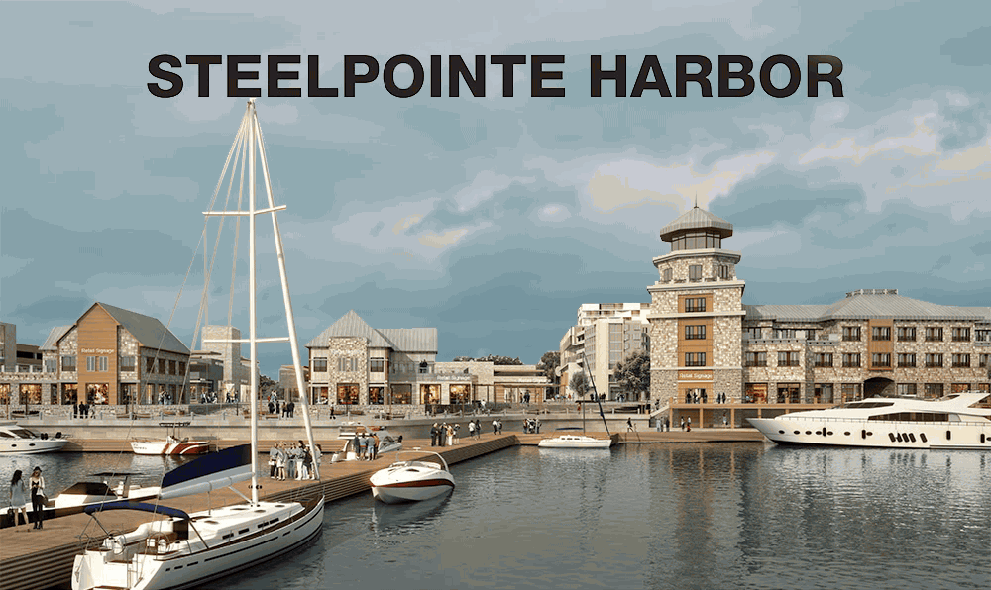

Slide 8
First Serious Attempt at Redevelopment
Has shopping (Bass Pro, etc.)
  Supposed to have apartments, commercial space, etc.
  Originally $1 billion investment was planned
Almost went casino route instead (problem with this)
  Golden Hill Paugussets sought land claim to set up casino
  Abandoned when courts did not agree

Slide 9
Currently…..
City remains challenged by any measure
  Low per capita income, poor housing stock, poor schools
    Expenditure per pupil relativelyhigh (state, not local money), but outcomes poor (about $14,000 per student)
  Magnet Schools are having some impact
    CT’s response to lawsuit over school funding (Sheff v. O’Neill)

Slide 10
Notes on Reading
Notes are taken from Stimson, Stough and Roberts, except as indicated on syllabus
Stimpson, Chapter 1
  Reconsideration of “Regions” in a global economy
  Development planning – Is it actually “anti-market”
    At its best, planning, planning facilitates (speeds up) economic changes that provide positive benefits to a community
    At its worst, it can act against the inevitable, resulting in large expenditures that accomplish little
      e.g. trying to save the U.S. textile industry in a world where the cost of manufacturing textiles in the U.S. is many times that in the developing world

Slide 11
  Skip “core theories” – will be covered in detail at later time
  Sustainable Development unfortunately means whatever person using the word wants it to mean
    Discussion – what is a useful paradigm for “sustainability”?
  Finally, SSR covers how we measure outcomes:
    Employment, production, resurgence of a city?
    Sometimes outcomes difficult to assess – Development policy may slow down decline rather than produce obvious resurgence
      Detroit?

Slide 12
Lecture #2
Coates Article:
Coates, D. (2007), Stadiums and Arenas: Economic Development or Economic Redistribution?, Contemporary Economic Policy, 25, 565-77.
Key Points of Article:
Subsidies make stadiums a poor investment
  Returns (employment, income) are small – giveaways usually large
  May be somewhat offset by “psychic” benefits (hometown pride in team)
Application: Bridgeport’s Bluefish stadium and HarborYard Arena
  Benefits
  Costs
    Why less effective than predicted
    What to do now?

Slide 13
Examination of Development in State of Connecticut
Background:
  State of Connecticut lagging behind other states in terms of growth
      Particularly post-2008
    Used to be one of fastest growing states
      Had highest per capita income
      In top 3 in terms of accumulated wealth

Slide 14
Reasons for Decline
Industry outdated and defense based
  What’s left is Sikorsky, Pratt-Whitney, Electric Boat
  “modern” sectors that support growth elsewhere are missing
    e.g. technology-based industries

Slide 15
Present (2015) back to 2011
 | Maryland | $75,847 | 73,971 | $72,483 | $71,122 | $70,004
 | District of Columbia† | $75,628 | 71,648 | $67,572 | $66,583 | $63,124
 | Hawaii | $73,486 | 69,592 | $68,020 | $66,259 | $61,821
 | Alaska | $73,355 | 71,583 | $72,237 | $67,712 | $67,825
 | New Jersey | $72,222 | 71,919 | $70,165 | $69,667 | $67,458
 | Connecticut | $71,346

Slide 16
Key Concerns…..
Disparate incomes
  Near highest in the nation v. issues in Norwalk and Stamford
  Lack of manufacturing employment removes one of standard means of achieving middle class status
Much of income growth is spillover from New York City
Dependency leaves State vulnerable

Slide 17
Measures of Well-Being in Cities Local to Fairfield
Connecticut Economic Resource Center (CERC)
Town Median HH Income Manufacturing Employ
Fairfield $120,100* 636
Norwalk 80,896 2,495
Stamford 81,600 3,786
Westport $166,307 455
Greenwich $119,500 224

Slide 18
Out-Migration as a symptom
Connecticut is losing residents as job opportunities are better elsewhere
Problem: State spends resources to educate students – take embodied talent with them when they leave
  Cost of living too high to lure job-seekers to State (particularly housing)

Slide 19
Example
“Moderately-priced” housing market in Trumbull
  Entry-level is $300,000
Same house in Ohio might be $100,000

Slide 20
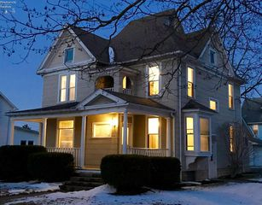
Tiffin, OH (College Town), $108,000 buys you this:

Slide 21
Result is Stagnant or no Growth
Creates funding problems for cities
  Particularly now that the State as a whole is in a budget crisis
    2017 budget disaster
  Incumbent upon cities/towns to pursue growth policies
Such initiatives have been common in other states:
  RTE 128 technology corridor in Boston, Fairfax, VA, etc.
  Tolland, CT has its OWN corridor
  State itself is very late to the game, which increases the challenge

Slide 23
Week #3
Central Place Theorem/Market Areas (SSR 1.5)
What is a Central Place?
  A large, usually urban center that drives economic activity in an area
    Periphery is organized around “pull” from Central Place
  Usual U.S. situation:
    Large city (e.g. Chicago) where concentrated economic activity takes place
      Surrounded by regions of high economic activity (suburbs)

Slide 24
Why Important?
Economic Activity is driven by vibrancy of city
  Activities and available services (?)

Slide 25
Rudimentary
  Banking, shopping, restaurants, etc.
Secondary
  Transportation services (bus, rail)
  Hospital(s)

Slide 26
Fairfield v. Bridgeport
Fairfield – shopping, banking, restaurants, other services
  No hospital, rail transportation
Bridgeport – Ditto, although generally not in city center (North Bridgeport)
  2 hospitals, rail, bus lines

Slide 27
Bridgeport might be considered a Central Place, but not in the way in which major cities are considered a CP
  Fairfield is not, although the unique difficulties facing Bridgeport make Fairfield a more vibrant economic area
Central Place theorem inevitably implies a degree of reliance
  If I want to take Amtrak, I have to go to Bridgeport

Slide 28
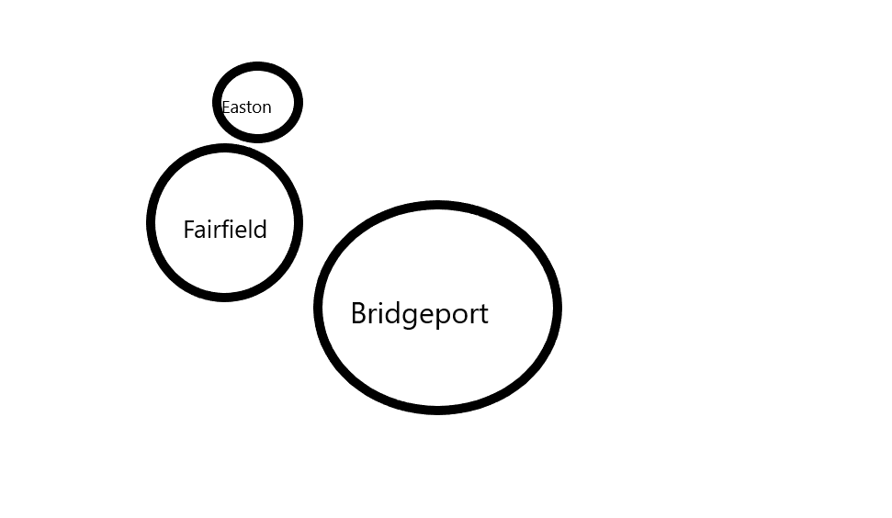
Services and City/Town Relationships

Slide 29
Descriptive
City, suburbs and periphery
  Far “periphery” would be farmland – Affect of cities small
  In Connecticut: Few cities have this kind of affect
    Large cities – Stamford, Bridgeport, Hartford, Waterbury, New Haven, New London
      By national standards, these are very small cities
      Bridgeport’s population is only 144,000
        Spillover effects small – is a major issue for development in the State

Slide 30
Growth Poles
Large economic areas that influence growth across a region
  Deliberate or natural
    “Natural” refers to poles that arose without deliberate policy
      Example: Large cities that formed due to available transportation resource (river)
        Or, formed due to existence of significant natural resource (minerals)

Slide 31
Deliberate Growth Poles
Government investment in a region to spur growth
  Common example at moment might be energy investments
  Ideally, resources poured into area then spill over into other parts of the region, spurring growth
    Should target relatively poor areas or those experiencing decline
      Discussion: Detroit and other post-industrial cities

Slide 33
Parr Article
Review and Assessment

Slide 34
Alternative to growth poles
“Corridors”
  Typically high-tech or some other sector with similar spillovers
    Route 128 in Boston (failed)
    Connecticut very late to the game here
      Way behind other states
        With GE departing, suddenly interest in trying to find a substitute (also UBS departure from Stamford)
          Business environment in the State is very bad – hard to overcome that
    Discussion

Slide 35
Class Presentation by Fairfield University Staff Member (TBA)

Slide 36
Detailed Overview of Class Project
Internal information from Fairfield
  Financials, employment, student spending, internships, service-learning
    May have to use survey data to measure student spending
      On goods, housing, transportation, social life, etc.
        Much of money is “external” (from households out of state)
        Has larger impact
    What other influences might be important?
How to break up project into manageable pieces?
  Assignments will allow me to grade individual contributions

Slide 37
Groups of 4-5 people
(Group 1) Internal financials and employment
(Group 2) Mapping out economic influences – which businesses likely to see demand
(Group 3) Spillovers and linkages to other sectors
(Group 4) Nontraditional effects (internships, service-learning)
(Group 5) Initiatives – The possible and the reasonable

Slide 38
Preparation Must Include Map of Area
Gonzaga report should provide general outline of what report should look like
  In addition, should prepare for Service-Learning Appreciation Day in late April
  Need visuals, etc. for event

Slide 39
Week #4 – SSR, Chapter 2
Evolving focus of planning models and evaluation
  Planning used to be entirely reactive
    Local example: GE decides to leave state, now what do we do?
    Too late to address problem in any way that is helpful in the near- to medium-term
    Pages 56->
      New focus of development planning:
        From No. of jobs to quality jobs (employment)
        From natural resource assets to quality environment (location)

Slide 40
      (Knowledge) – from trained labor force to knowledge as an economic generator
      (Sectors) – from individual sectors to new institutions
  Basis of policy:
    From regional focus to more general focus (Bridgeport versus greater region (SMSA)
Planning can be viewed as “anti-market”
  But, can act against negative economic trends to quicken adjustments
  Should not be used to actively work against the inevitable – will fail
SSR lists initiatives carried out by U.S. government
  Most are public/private initiative – many have a regional focus, but some are nationwide
  Primarily through federal grant-making process

Slide 41
Biggest Failure of Planning May be its Reactive Nature (as noted)
Development policies undertaken after major firm departs or major business failure
  Too late to head off major problems
  Authors differentiate between reactive and proactive planning (p. 61)
    Reactive usually does not work well
  Development process (p. 63)
    Notes that organization of resources is starting point

Slide 42
Regional Audit
Resource inventory
  Natural resources
  Labor Force (Skill set)
  Location advantages (ports, rail link)
Development projects should fit inventory
SSR also note that impediments to development should be inventoried

Slide 43
Required Components (SSR, page 86)
Business (capital), catalysts, infrastructure, Agency
  Concentric presentation is meant to illustrate development planning starting at the center and moving outward
    In this model, infrastructure is a necessary first step
      Assumes it is provided for by government, does not need to be
    Catalysts represent actions that pull resources together to facilitate project (may be public or private)
      e.g. financing

Slide 44
Skip to Case Study on Page 83
Cairns region of Australia
  Issues facing the region
    A growing regional trade imbalance
    Capital outflows (savings leaving region)
      Profits exiting region
    Lack of corporate identity
    A decline in capital inflows (particularly foreign)

Slide 45
Specifics
Population: 250,000
“State” product Error in text (# way too low)
Growth rate 6%
Focus on tourism (environmental preservation)
International/national economic related activity equal to 45% of output

Slide 46
Page 95 – Structure of planning process and institutions
  May be unnecessarily complicated
  Focus on “industry clusters” most successful part of initiative
    Integration of various sectors of economy led to more rapid economic growth
      This is a model that Bridgeport might have been able to utilize years ago
        Tie Sikorsky into machine tool and resource industries in city to a greater degree
        Try to integrate “civilian” industries into structure – those that use similar products
Also case study on Singapore – read on your own

Slide 47
Example 2 – Failed Development Experiment: New London, Pfizer and Connecticut College
Kelo v. New London (supreme court)
  Susette Kelo was owner of home in New London
  Pfizer (with extensive support from the president of Connecticut College) sought to acquire property to set up a “campus” in New London
    State Supreme Court narrowly approved use of eminent domain to seize property – supreme court eventually affirmed
      Issue: Was eminent domain meant for use by private developers?
        Approval for public projects long accepted

Slide 48
Outcome
Kelo lost case. City gave Pfizer millions of dollars in tax breaks to stay in New London
  Site was demolished, including the “Little Pink House” owned by Kelo (now the title of a book)
    Shortly after the decision, Pfizer changes its mind and left (2009) eliminating 1400 jobs
    Result: gigantic empty lot that is now an eyesore
      Case led many state legislatures to pass new laws restricting the use of eminent domain

Slide 49
Comparisons to SteelePointe in Bridgeport not Appropriate
SteelePointe is abandoned industrial land
  If eminent domain was used at all, it was not opposed
    City leaders hope that project succeeds and redevelops that part of city

Slide 50
Returning to Semester Project
(Group 1) Internal financials and employment
  Annual Budget of University
  Employment – faculty and staff
  Where employees reside (not sure can get this)
  Student population and where they reside
    Survey: how often do students leave campus and where do they spend money
  Tax offset from State provided to Fairfield

Slide 51
(Group 2) Mapping out economic influences – which businesses likely to see demand
  Inventory of restaurants, banks, markets, drug stores, gas stations, etc., including businesses that deliver to campus
  These should be mapped out, since (obviously) businesses closer to campus see more demand
  Must include expenditures by faculty, staff, administration also

Slide 52
Continued
(Group 3) Spillovers/linkages to other sectors/land use
Businesses (e.g. food service) that directly benefit from University
  Contractors (heating, cooling, etc.)
  Need list of businesses that University utilizes
Linkages tend to be weak for academic institutions
  What businesses might thrive as a result of Fairfield’s presence
    In manufacturing, this is the machine tool businesses that exist to service a firm
    e.g. Sikorsky
Land preservation and open space – what if the 120 ace campus was all houses?

Slide 53
Continued
(Group 4) Nontraditional effects (internships, service-learning)
Survey departments and schools about internships
Melissa Quan’s office can provide figures on service learning
Also need to address volunteer work hours (e.g. Prospect House)
  And student organizations that do service in the community (COSO as source)
Of Equal Importance: Aspects of University made available to town residents
  Use of the library, the Quick Center, Public Events (at Bookstore)

Slide 54
Continued
(Group 5) Initiatives – The possible and the reasonable
Are they ways that the University can increase its positive impact on the community?
  As a nonprofit, this is a legitimate question
  Example: Utilization of local resources (nearby food)
  This aspect of project will be part of brainstorming by entire class

Slide 55
SSR Chapter 3 – Tools Used in Examining Regional Development
Tools for analyzing (measuring) economic development
  And, measuring impact of development policy
    Measure:
      Proportion of economic activity that is related to locality, versus part related to regions external to area
      Assess regions performance relative to other regions
      Determine which industries are important to economic output in the region

Slide 56
Location Quotient
Measure of relative importance of an industry to a region
  LQ = Employment in Industry “j” in region “i”/Employment in
                Region “i”
              ___________________________________________________
              Employment in industry “j” in country (or state)/total employment
  Example:
  Construction employs 100 people in Stratford, where 12000 people work. Construction employs 200,000 people in CT, where 1.8 million people work
  LQ = (100/12000)/(200,000/1.8 million) =

Slide 57
The higher the LQ, the more important the industry is to a region
  Example on page 109 of SSR: LQs for northern Virginia
    Computer rental and leasing is far more important than security service (12.46 to 2.83)
  Changes in LQs provide a means of envisioning changes in a region (page 111)

Slide 58
Shift-Share Analysis
Skip the mathematical derivation
  Important part of concept
    Measures the changing importance of sectors in an economy
    Indicates declining industries that may need attention, as well as new growing industries
      Indicator to planning officials about both opportunities and challenges
      (Share of sector in total output/total output)
        Change over time is important part
  Rest of chapter inappropriate for an introductory course

Slide 59
Preparation for Midterm Exam

Slide 60
Core Versus Periphery
Established approach to economic development on both regional and national level
  Core is usually a central city
    Periphery is the economic area around that city
      Can be suburban ring and then rural area
        Common patter that does not necessarily imply a development “problem”

Slide 61
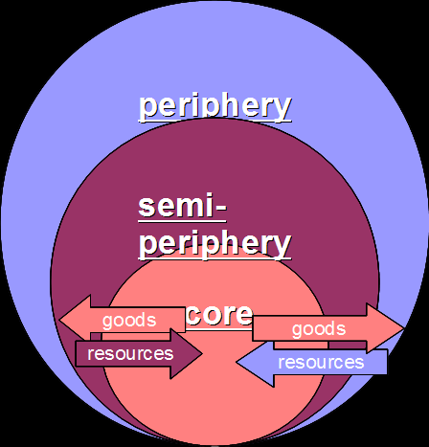
Diagram

Slide 62
Other Use – Global Development
Industrial countries are the “core”; developing nations the periphery
  In this model, the periphery is generally regarded as disadvantaged
    U.S. versus Latin American Nations
    Europe versus African Nations
      Leads to policy-based models of how periphery can be developed
      And discussion of how development criteria are established

Slide 63
Returning to Regional Models
Although not necessary, core-periphery models do emphasize the “inferior” situation of the periphery
  Services (e.g. hospitals, large financial institutions, large stores) are in the core
    Services in the periphery may be limited
    May result in dependence
      Does not fit Connecticut situation very well
      Cities (Bridgeport) are not regarded as very good models of development, although they do contain essential services

Slide 64
More Appropriate would be Boston
  Large central city with every imaginable service, surrounded by successful suburbs
Use of Core-Periphery Model
  Attention is on how to promote growth in periphery and how to ensure that essential services are available in periphery
    Recognizing that those that choose to live in rural areas are, by choice, separating themselves from such services

