Slide 1
EC 11 – Fall 2021
Market Failure – Congestion and
Consumer Protection (asymmetric information)

Slide 2
Congestion – Considered its form of Market Failure
Can refer to road congestion or any other situation where one individual’s consumption of a good interferes with another
Another good example is rail system (Metro North)
In Connecticut, road system is unfixable
Traffic jams the norm, at least pre-covid
Placing further roads an impossibility
State has focused on providing better mass transit and (silly) proposals to funnel traffic off highly used roads to back roads
Favorite – Push traffic off I-95 during traffic jams onto Route 1 (that will work)

Slide 3
Debate about Tolls goes back to Horrific Accident in Stratford in 1983
Truck plowed into toll plaza – seven killed
Magnitude of tragedy led to removal of toll stations across state
At current driving speeds (75 MPH+) tolls on Merritt Parkway (designed for 45 MPH) would be dangerous
Governor Lamont ran on idea of bringing back tolls to fix CT roads
Multiple proposals in Hartford – all shot down
Not even sure it would help with roads
No place to put new roads in State

Slide 4
Problem – Congestion is an Externality (and its Ignored)
My consumption of road “services” interferes with your consumption (and vice-versa)
Yet, no additional cost
If I paid more to use road during high use periods, possibility I would alter my behavior
Only means of doing that is tolling (As noted, not particularly popular in Connecticut)
The cost of me using the road at 5:00 AM going south is only the wear and tear on the road
By 7:00, congestion costs are rising, and peak at 8:00 (or so)
Northbound reverse, with peak at 5:00 PM and near zero cost at 9:00 AM

Slide 5
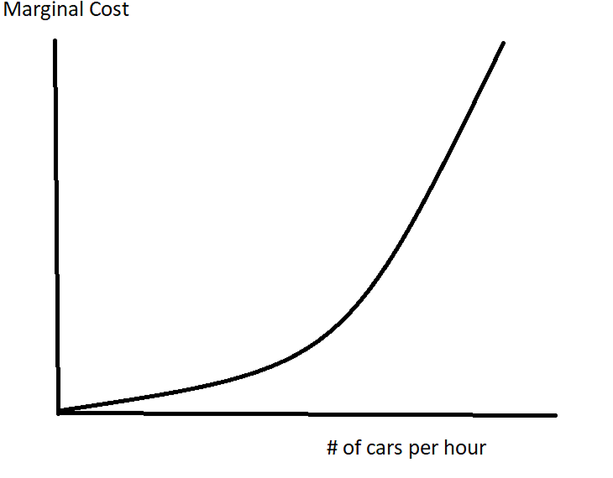
Graphically

Slide 6
Explanation
At low traffic volume times (7:00 AM heading north on the Merritt, 7:00 PM heading south) incremental cost is near zero
As volume increases, cost of congestion rises
By right hand side of graph, external cost very high
Solution -> Time-based tolling
Toll at off-peak periods should be near zero, rising to significant toll at peak times
Accomplishes two major goals -> Should reduce traffic at peak times AND created revenue to try other solutions to traffic problem
Note similarity to externality issue – No “seller” and “buyer” in this case, which makes it a unique case

Slide 7
Public Infrastructure and Transportation
Amtrak (a public entity) charges according to time of day of travel
Attempt to get riders to utilize trains during low demand travel times
Airports use same pricing mechanism
Airlines charge higher prices for tickets during peak times
Goal is to spread out demand over course of day
Capacity of airports (e.g. air traffic control and runways) is limited
Costs are kept down if travel spread out over course of day so that new capacity is not needed
All efficient solutions to congestion problems involve a pricing mechanism

Slide 8
Final Topic - Lack of Information as a Market Failure
Notably consumer protection
Multiple products for which buyers are unable to judge safety and efficacy
Essentially equivalent to buying a product without knowing its characteristics
Common examples:
Prescription and OTC drugs
Air travel (safety)
Food
In absence of governmental oversight, no way to know if products are safe (and effective, in the case of drugs)

Slide 9
Regulatory Agencies
Food and Drug Administration (FDA) -> food and drug safety
Assisted in food safety by USDA
Airline safety – Federal Aviation Administration (FAA) -> certifies safety of airlines through maintenance requirements and oversight
Safety of consumer products – Consumer Product Safety Commission (CPSC)
Benefit somewhat less clear here, since extensive product testing (and threat of lawsuits) generally ensure safety
Safety of Railways, airlines, highways, etc. – National Transportation Safety Board
Somewhat different mandate – investigates major incidents, but recommendations come out of conclusions

Slide 10
Role of FAA Hard to Argue Against
Consumers unable to judge safety of aircraft
Story of flight back from Zurich
In absence of FAA, fliers would have to judge airlines on safety record, a very bad idea
Eventually market would shake out the bad companies, but the toll might be substantial
Consumer Product Safety Commission (CPSC) less supportable
Most “failed” products do not involve death or major injury
Consumers better able to judge risks themselves
And, private organizations (UL) do same work at no cost to government

Slide 11
Generalization -> Initial Regulation Likely the most Beneficial
As further regulations imposed, costs rise and benefits fall
Should exist an “ideal” level of regulation
Marginal benefit of regulation equals the marginal cost
The MC must include costs of agency and increased prices of all goods arising from regulation
Suggests expensive regulations that have low incremental benefits should not be undertaken
e.g. a certain number of people die each year from hairdryers falling into a bathtub
Do we ban hairdryers or force them to be battery powered or have them encased in plastic so they are waterproof?
If cost excessive, no more hairdryers produced

Slide 12
Graphically….

Slide 13
Explanation……………
“Easy” work done first -> safety regulations on products that are hard for consumers to evaluate and can cause real harm
Once these products are taken care of, marginal benefits begin to fall
Likewise, incremental costs are low at first, as obviously dangerous products or services are regulated
As more and more regulation is imposed, costs rise
Eventually, marginal benefit no longer exceeds marginal cost and further regulation does not make sense
This notion escapes most in Washington

Slide 14
Honest Evaluation of Agencies must Include whether Actions keep Products off Market
That outcome may not be costless in terms of safety and consumer welfare
Best approach is to use cost-benefit analysis and only pursue regulations that make sense under this criteria
Costs of regulation include costs of agency, increased costs to consumers of new product standards, elimination of products that don’t meet standards
Benefits include fewer injuries/deaths -> end up having to put a price tag on these
Only support regulations that pass this test
In the case of the FAA, little doubt that agency would meet this test
What about FDA – it is presumed we must have a drug regulator, but what are the costs and benefits?

Slide 15
Analysis of FDA……
Noted problems with assumption that FDA regulations guarantee drug safety
Clinical trials are of limited length (3 years), some drugs (NSAIDs) do not present side effects (heart attacks) until longer time frame
FDA will miss inter-generational dangers (“DEH, the Wonder Drug Women should Wonder About”)
Although production standards are in place, much of drug output occurs in developing world, outside of FDA direct scrutiny
May have situations where temporary issues arise with a medication
FDA does not regulate supplements market – a morass of problems
Even with these caveats, still seems regulation a necessity

Slide 16
FDA’s Triumphant Moment was in the 1950s
Thalidomide introduced as a treatment for morning sickness in pregnant women
Widely distributed in Europe
Kept off the market in U.S. by FDA for further testing
Only U.S. cases were from women who had traveled while pregnant and been offered the drug
Within months, birth defects (severe) began appearing in babies born to women who had taken drug
Thousands of cases, as well as thousands of miscarriages
FDA lauded for preventing a wholesale crisis in U.S.

Slide 17
Other Issue is Potential for FDA to Delay Products
In some cases, harm may seem minor
After “scandal” with cyclamates (1970), FDA was gun-shy about approving further artificial sweeteners
Products can be important for diabetics, etc.
When Searle came up with Aspartame – Nutrasweet – FDA delayed approval for 10 years
Convinced that, once again, something dangerous would be found
Finally determined that the only way to injure rats with Aspartame was to bury them in it until they suffocated
Now the most widely used artificial sweetener in world
Case is “only” about a sweetener, but what if it was a treatment for cancer

Slide 18
Game Theory can be used to Model FDA Behavior
Bureaucrats have option of approving drug or delaying/denying
Highest risk is approving something like thalidomide and having a health catastrophe result
But also have to consider case where bureaucratic “fear” delays drugs that have significant benefits
 | Approve Drug | Deny Approval
Drug is Safe and Effective | Dominant outcome | Some in need of treatment die or are harmed
Drug is Harmful | Worst outcome – Drug injures/kills | Also a dominant outcome

Slide 19
Bureaucrat at FDA facing these choices….
Riskiest outcome is lower left – the one to be avoided at all costs
Could create very public scandal
Although upper right also bad, affects fewer people and lack of approval unlikely to be known to very many patients, except those who participated in clinical trials
Conclusion – Fear will lead to delayed treatments and loss of life or lower quality of life
Underlies the Trump Administration’s Right to Try policy that allowed terminally ill patients to take experimental treatments

Slide 20
Conclusion
Appropriate amount of regulation is based upon relative returns in terms of safety and efficacy
Compared to relative costs
Regulatory environment can lead to bureaucratic stalling – delaying the approval of a product out of fear
Reforms have addressed some of this at the FDA, but drug approval times remain very long

Slide 21
Asymmetric Information and Agency
Extension of market failure represented by consumer protection
As noted, underlying reason for agencies such as the FDA and FAA is that consumers are unable to judge safety/effectiveness of products
Solution is to have agency guarantee safety and effectiveness on behalf of consumer
Can extend to situations involving private contracts
One party has superior knowledge of circumstance and can take advantage of other party
Can affect a variety of commercial and even political scenarios

Slide 22
Specific Definition of an Agency Problem
An Agency Problem is a conflict of interest that arises when one party is supposed to act in the best interest of another party, but has a monetary or other incentive not to do so
A situation in which an individual “hires” someone to act on their behalf, but the interests of the two parties do not match
In general, this will result in the individual not getting what they wanted
Note that this arises both because the individual has surrendered control and because the person acting on their behalf has superior information

Slide 23
Stockholder/Stockbroker Problem
Most common example of Agency Problem is stockbroker/ stockholder relationship
Stockbroker can, if hired to actively manage an account, seek own self-interest rather than the interests of investor
Tie salary of broker to financial outcome for stockholder
Broker still makes money “churning” account, but loses money when this reduces the rate of return to the investor
Incentive to misbehave reduced
This is now common practice for most reputable brokers
Reiterate that the problem here is both insufficient information and the fact that broker has more information

Slide 24
Other Examples……
Doctor-Patient relationship
Doctor has greater knowledge of patient’s condition and possible treatments that patient can have
May prescribe treatment that is in self-interest
Dentist who crowns a tooth that needs a filling
Surgeon who replaces a hip when painkillers would have worked
Homeowner-Contractor Relationship
“Your chimney needs repair”
Homeowner not only does not know if repair done properly, but doesn’t even know if it was needed in the first place.

Slide 25
Automobile owner – Mechanic (my favorite)
Incentive for repair shop to “find” most expensive repair and little consumer can do about it, since cannot diagnose him/herself
Some potential solutions….
Medical care example -> 2nd opinions
Insurance also acts as a barrier
Will not grant approval for procedures that are not warranted
Warranties for repairs
Note that this does not fix problem – only guarantees that work that may have not been needed is covered

Slide 26
Nonprofits
Donors give and are (essentially) forgotten
For philanthropic work that is far away, contributor will never know whether donation did what it was supposed to do or nothing at all (drilling a well in Africa)
Of examples of Agency Problems this is the one most difficult to solve
Difficult to provide donors with specific information regarding what their donation accomplished
Long list of examples of nonprofits that misdirected or misused funds

Slide 27
Outside of Commerce -> Voter/Politician
Politician acts as agent of voter
If politician does opposite of what was promised in campaign, little voter can do in the short-term
Can only vote person out in next round of elections
Common in Washington DC now
Congressman/women runs on particular platform and reverses direction upon arriving

Slide 28
Economic Costs……
Leads to imperfect outcome for consumer/stockholder
Sought to attain one result (e.g. highest rate of return on market), ends up with another
Or, in the case of medical care, ends up with the wrong treatment
Hard to fix this after the fact -> cannot undo the crowning of a tooth
As noted, when possible, economic incentives are used to work against problem
Or third-party intervention (such as insurance)
In some instances, no solution exists

Slide 29
Summary on Market Failure
Considers situations where a market solution is imperfect
If possible, a pricing solution is sought
Four categories
Externalities (such as pollution)
Pricing mechanism will solve
Congestion
Pricing mechanism can be used to reduce problem
Public goods
No market solution exists -> result is government having to step in to determine how much of good will be provided

Slide 30
Continued
Imperfect information
Governmental intervention when consumers cannot know trust costs and benefits of a good
Agency problem -> Consumers (investors) have incomplete information
Can get taken advantage of
Variety of mechanisms, warranties, performance-based pay, oversight used to prevent or reduce
Impossible to eliminate

