Slide 1
Back to the Future: The U.S. Energy Mix and the Role of Nuclear Power
Mark S. LeClair
Professor of Economics
Fairfield University

Slide 2
To obtain copy of slides…….
Go to: www.faculty.Fairfield.edu/mleclair
Look for link at top of page for Beth El Talk
Must have Powerpoint on computer to open slides

Slide 3
Purpose of Talk…..
Examine market forces and government policies that are altering the mix of energy used in the U.S. and other industrialized nations
Long-term trends:
Greater use of natural gas, less use of oil
Possible revival of nuclear power
Geo-political shifts occurring as a result of the shift in the power mix

Slide 4
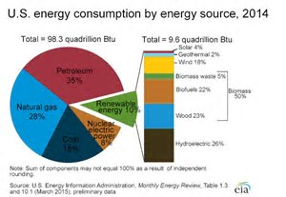

Slide 5
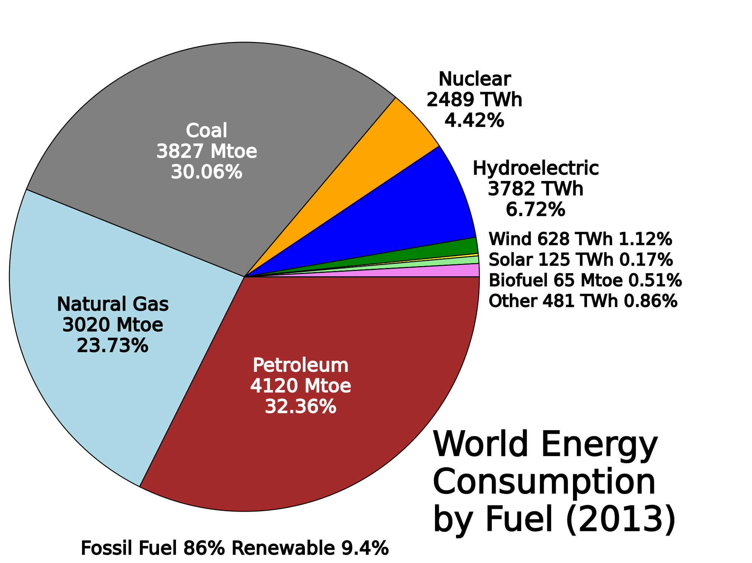

Slide 6
Main Difference
Shift away from coal much less dramatic internationally than domestically
Primarily a reflection of China’s heavy reliance on coal
U.S. shift to natural gas is ahead of rest of world
U.S. is somewhat ahead in use of renewables

Slide 7
Renewables
10% of U.S. energy use
But, includes hydroelectric power and wood (43% of total renewable energy)
“New energy” such as solar and wind about 14% of renewables
1.4% of TOTAL energy use
Figure on biofuels interesting – 22% of renewables
For those concerned about CO2 emissions, these are carbon neutral
Wood is also carbon neutral, but has other environmental effects

Slide 8
Diversification away from Coal Reduces CO2 Emissions (Pounds per Million BTU)
Coal (anthracite) 228.6
Coal (bituminous) 205.7
Coal (lignite) 215.4
Coal (subbituminous) 214.3
Diesel fuel/heating oil 161.3
Gasoline 157.2
Propane 139.0
Natural gas 117.0

Slide 9
Cheap Natural Gas a Significant Factor in Drop in Carbon Dioxide Emissions in U.S.
Expected to continue with continued rise of fracking
Other nations (e.g. UK) are now on the cusp of fracking revolutions
Result – much cheaper energy, as it will keep ALL energy prices lower
Reduced concerns about CO2

Slide 10
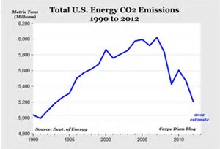

Slide 11
Petroleum Market has been Fundamentally Altered
At least for now, OPEC’s power over prices is completely gone
Any attempt to increase prices will lead to reopening of new fracking wells
$55/barrel oil is probably the limit, unless world growth rises substantially
Eventual stabilization of Venezuela (one can hope) would increase downward pressure on prices

Slide 12
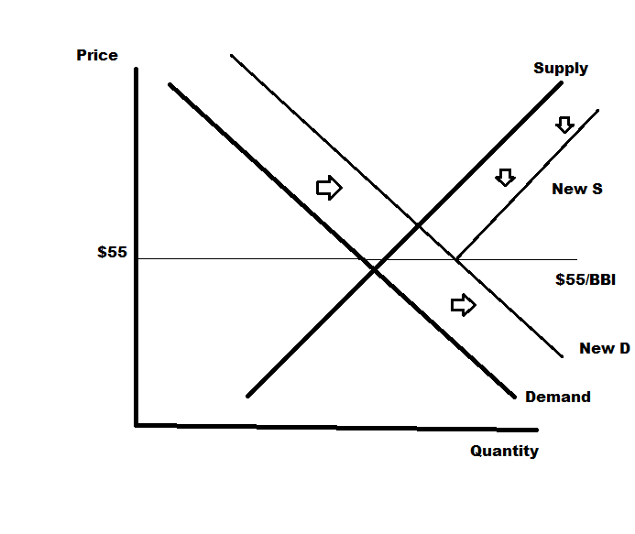

Slide 13
Corollary: Market for sugar
Cane sugar is produced by numerous, mostly small developing nations
Primary source of export earnings
But market is a perpetual problem for these countries
Sugar prices are low – any attempt to increase prices leads to increased production of a substitute – beet sugar
Maximum price is therefor capped off

Slide 14
Public Policy and the Energy Market
Continued debate about CO2 emissions and the mix of energy
Debate about “peak oil” is over – no such thing now that the technology has changed
Federal subsidies have significantly raised the amount of solar/wind/biomass fuel in use – although (as noted) still a minor source of power
Technology will undoubtedly lower costs in future

Slide 15
Carbon Capture is the New Frontier
CO2 is liquefied and pumped into the ground
Makes coal plants more expensive, but environmentally more friendly

Slide 16
Problem…………………………
Wind and solar have environmental impacts of their own
Large-scale projects, both wind and solar, are responsible for significant bird kill-offs
Wind power is suffering from significant NIMBY problems
Recent issue of The Economist – wind and solar power are destabilizing power grids “Clean Energy’s Dirty Secret”
Both due to variability in production and zero marginal cost production

Slide 17
Explanation
When power use goes up, source with lowest incremental (marginal) cost goes on line first
Solar and wind have high installation costs, but zero incremental cost (free sunlight and wind)
Traditional power plants cost money to fire up
Most expensive are the last to be put on line
Becomes unprofitable to put new capacity in place
But, solar and wind are not reliable – several cloudy days in a row, and the grid is now in trouble

Slide 18
Has Nuclear Power Returned to Viability?
Despite disasters at Chernobyl and Fukushima, nuclear power has some desirable properties
Reasonable per kwh cost
Zero carbon emissions
Unlimited availability
Newer, smaller plants would operate differently and prevent Chernobyl-type disasters
Waste disposal (and potential for plants to be terrorist targets) still major issues
New York is considering shutting down Indian Point – will encapsulate waste on site

Slide 19
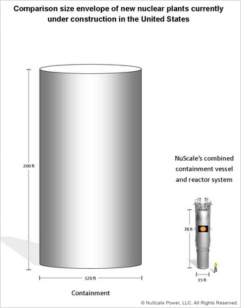

Slide 20
Has Nuclear Power Returned to Viability
Energy Source | Cost/Mghour* | CO2 Emissions
Coal w/carbon Capture | 139.5 | Approaching Zero
Conventional Natural Gas | 58.1 | Lower than traditional sources
Advance NG w/Carbon Capture | 84.8 | Approaching Zero
Nuclear | 102.8 | Zero
Wind | 64.5 | Zero
Offshore Wind | 158.1 | Zero
Solar | 84.7 | Zero
Solar Thermal | 235.9 | Zero
*Does not include tax credits

Slide 21
Although More Expensive Than Wind……
Nuclear is more reliable
Protects viability of grid
Prevents problem of zero MC power production that plague grids (wind and solar)
Waste disposal remains a serious issue, as does susceptibility to terrorism
Newer technologies makes this somewhat less of a concern

Slide 22
Economics of Different Alternatives
Power Source | Installation (fixed) cost | Fuel Operation (marginal) cost | Short-term | Long-term
Coal | Moderate | High | Expensive to bring online | Grid stable, Pollution concerns
Natural Gas | Moderate | Moderate | Less expensive | Grid stable, Pollution concerns minimized
Renewables (wind, solar) | High | Zero | Zero | Grid unstable, some environmental concerns
Nuclear | HIgh | Near Zero | Inexpensive to bring online | Grid stable, high environmental concerns (not CO2)

Slide 23
Two Possible, Divergent Paths
Continue trend towards many more points of production, most of moderate scale
Might have to regionalize power grids to prevent instability if this path is taken
May be days where grid is overwhelmed and power is cut
But, permits greater use of renewables

Slide 24
Return to Prior Practice of Centralization
Fewer, larger production points linked through a grid
Gain stability
With use of new technologies – carbon capture – doesn’t necessarily mean higher CO2 emissions
Or, the return of nuclear power as a means of reducing carbon output
Somewhat more expensive, and we still have no means of addressing waste problem

Slide 25
Government Policy has Recently Favored the First
More alternative energy – environmental rules on coal to reduce its use
But, very large drop in natural gas prices will drive market towards centralized power

Slide 26
Political side…..
U.S. likely to be come an energy exporter
Dramatic reduction in “energy trade deficit”
Less need to worry about stability in oil-producing countries
Increased use of natural gas means U.S. will meet any reasonable goal for CO2 reductions without doing anything
Subsidization of renewables needs to be re-examined in light of power grid instability
Regionalization of power may be a major politic issue in the future

Slide 27
Questions

